Slide 1
Réunion annuelle du DPNC
Conclusions
Martin Pohl, Directeur

Slide 2
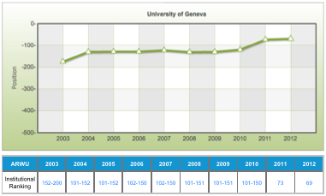
Shanghai Ranking 2012
UniGe dans les Top 100
Sciences dans les Top 40
Physique dans les Top 50

Slide 3
General observations
Journée de réflexion 2012
I share the excitement about initial LHC and ATLAS performance and results.
I do not share the premature disappointment with the lack of immediate spectacular discoveries. HIGGS !!!
We have only scratched the surface of LHC physics!
The « weight » of different pillars inside particle physics in « public opinion » is subject to large short term shifts.
Do not listen to this, our time scale is 10y!
There is no more grace period for esperiments, where statistical error hides systematics. Its all about systematics, stupid!
In general, our Road Map is still right! We can continue to use it to orient us.

Slide 4
Conclusions
Journée de réflexion 2012
DPNC is:
Innovative power in detector design, construction and data analysis;
Perseverance in getting at the physics;
Proliferation of projects for the future.
My opinion: we should not reduce our ambitions easily!
How can we live up to our ambitions?
We need a perspective for growth in personnel.
We need to maintain and develop technical groups and their skills.
NCCR Universe will give this perspective, if approved. Sorry!
In addition we need investment funds comparable to the initial ATLAS investment. Existing sources are insufficient.
We must use all imaginable sources: local, federal, European.
If we want any or all of this to be successful, we need the general public to support us. Reach out!

Slide 5
Thanks
Journée de réflexion 2012
Thanks to all speakers for their high quality presentations.
Thanks to all participants for lively discussions.
Thanks to Teresa and Xin for organising the scientific contents. Peppe
Thanks to Catherine and Liliane for organising the venue. party and for keeping DPNC alive!
Thanks to Mother Nature for providing us with unlimited mysteries to study.

