Slide 1
Activities in 2013 for the Electronics Group
« GrElec »

Slide 2
GrElec in 2013
3+1 Electronics Engineers
  Daniel La Marra
  Stéphane Débieux
  Yannick Favre
  Alessandro La Rosa
    IBL
2 Technical Assistants
  Gabriel Pelleriti
  Javier Mesa

Slide 3
Projects Highlight
ATLAS (LHC)
  IBL (upgrade phase0 2013-2014)
Astrophysique (space)
  LOFT
  DAMPE
Astrophysique (ground)
  CTA

Slide 4
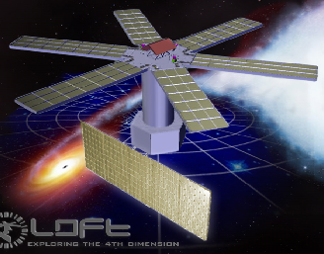
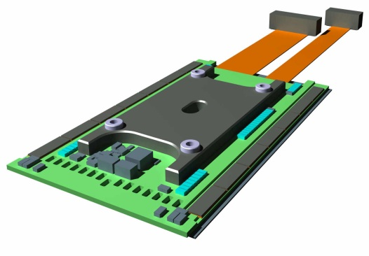
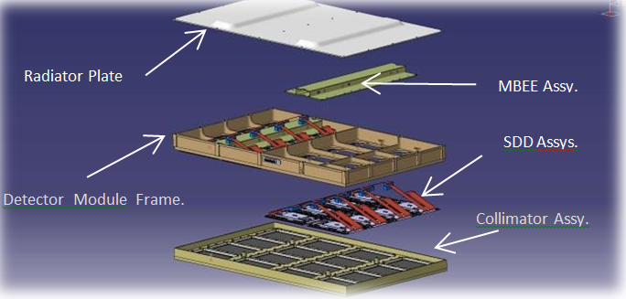
LOFT : Large Observatory For x-ray Timing
Context :
    Matter in neutrons Stars & close to black hole event horizon
    ESA program, launch 2020-22
    Wide Field Monitor : high resolution
    Large Area Detector : 10m² of detector 2-30keV :
      6 panels
      7x3 modules/panel
      4x4 Front End Electonics/modules => 2016 FEE overall : DPNC/ISDC design responsibility
Panel
Row of 7 ASICs
Hyperstac connectors on flex
FEE :
    ~130x70mm
    Very low noise
    Silicon Drift Detector technology (used in ALICE)
    14 ASICs per FEE, 16 channels/ASIC
    Chip On Board technology, very small pads (39µ)
    Bonding: ASIC to SDD (17µ), Through PCB Bonds, ASIC to PCB
    PCB: Flex-Rigid technology
Bonds through PCB holes
SDD on bottom

Slide 5
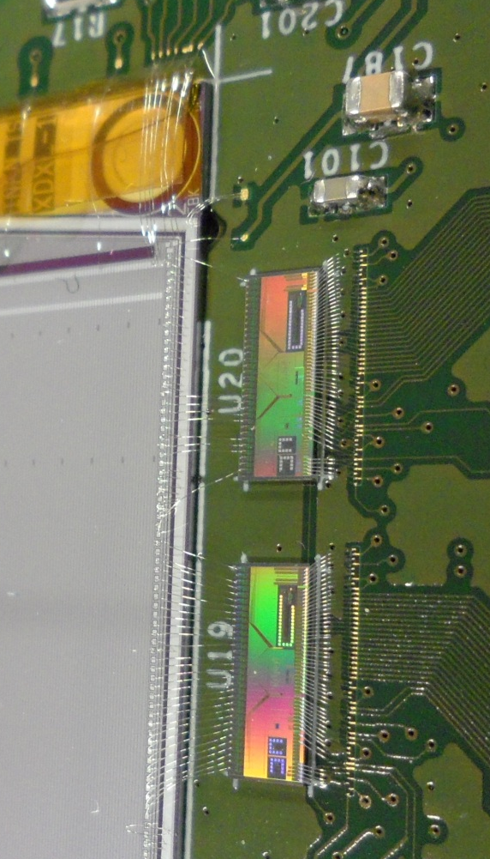
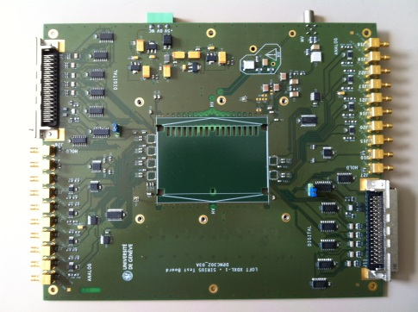
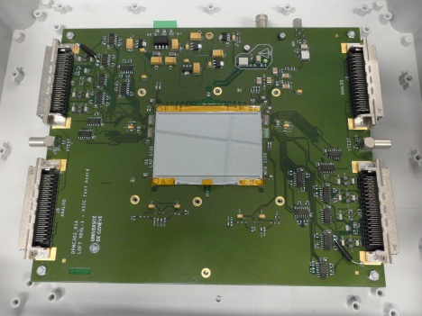
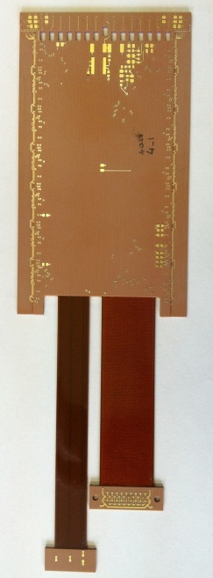
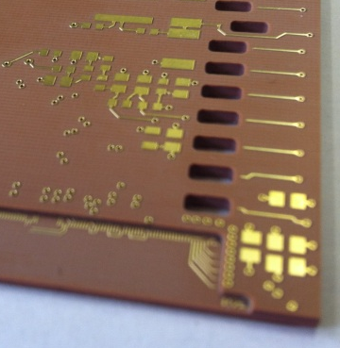
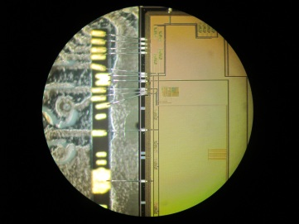
LOFT : Large Observatory For x-ray Timing
FEE Breadboards :
    Large PCBs for measurements access, SDD (4inches & 6”), EMC & HV constraints
    Components: ASICs (French/Italian), linear regulators, digital interfaces, HV/MV filters
    Labview interface
    Boards Design Schematics + Layout: Yannick
    Components & ASIC mounting/bonding: Gaby, Maarten, Coralie
    Tests : BOLOGNA (14e- rms noise)
FEE PCB (mechanical model):
    Close to final version : electronic & mechanical validation
FEE PCB
(Mechanical)
Italian ASIC
SDD 4’’
Noise = 14e-
French ASIC run1

Slide 6
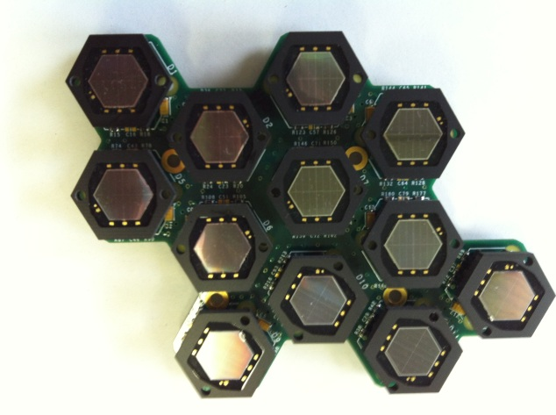
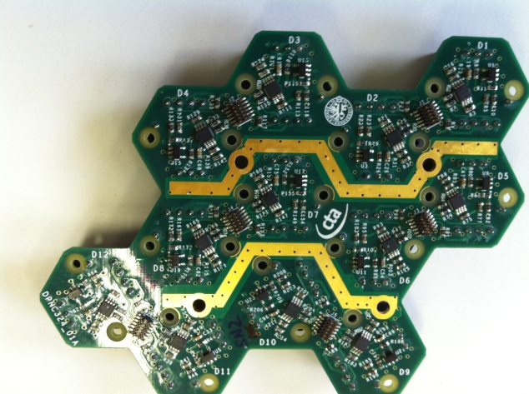
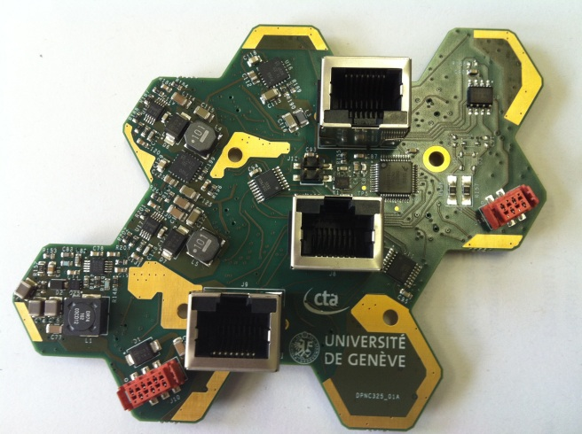
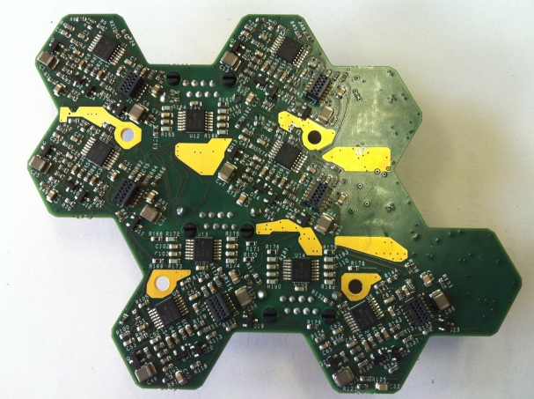
CTA : Cherenkov Telescope Array
Electronics :
    Architecture:
      Camera (~1m diameter) = 108 modules of 12 SIPM
      2 boards per module, low cost & low power !!!
    Analog board:
      12xSIPM amplifiers, tf<30ns, low noise, high dynamic range, differential output, low cost (60-90€/module)
    Slow Control board:
      Low noise +/-5V (analog) & bias (76V) power supplies for analog board + 3V3 digital, low cost (60-90€/module)
      12 independent 67-75V bias regulators (digitally set)
      Microcontroller & software with CAN bus interface for 12xSIPM temperatures readout & bias settings
Analog board
TOP : 12-hex SIPMs
BOT : 12 low noise amplifiers
FEE Breadboards & RUN1:
    Simulation, Boards Design Schematics + Layout: Yannick
    µC Software programming : Yannick
    Components mounting: Gaby, Javier
    SIPM analog tests & signal processing : Alessandro
Slow Control board
TOP : 12 bias regulators + connectors with Analog board
BOT : connectors, µC, CAN bus,
+/-5V, 3V3 & 76V power supplies

Slide 7
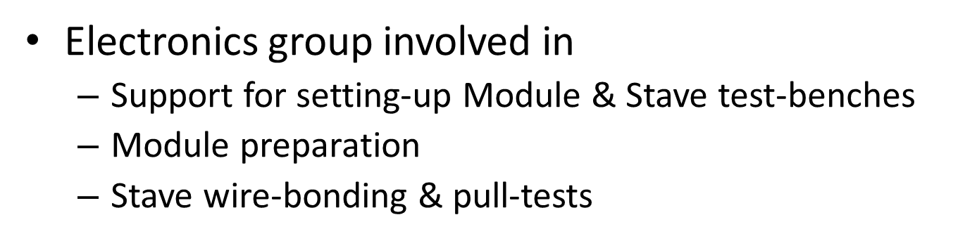
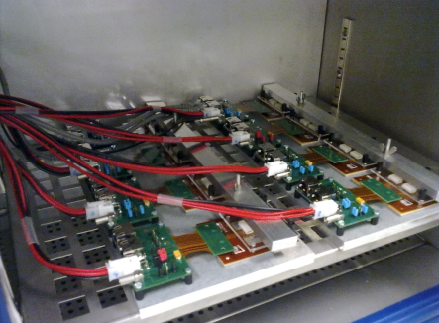
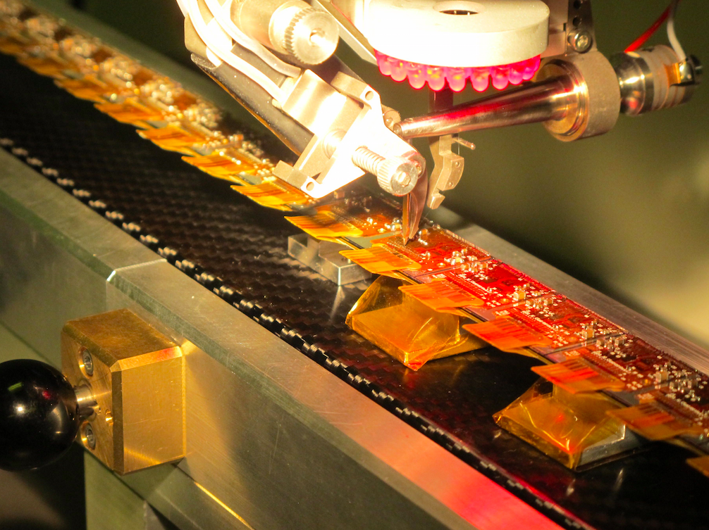
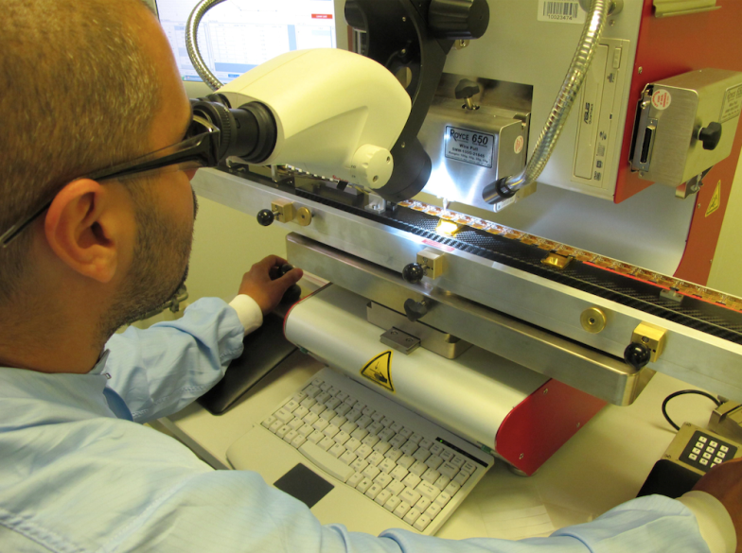
The ATLAS Insertable B-Layer (IBL)

Slide 8
TFH for DAMPE
DArk Matter Particle Explorer
Launch in China foreseen in 2015
Tracker Front-end Hybrid PCB
  Flex-rigid PCB
  5 layers on the rigid part
  Almost 1mm thickness.
  A “pigtail” (flex) used as a cable on one side
  On the other side, a flex as support for the Silicon Detectors
  Four SD 95mm x 95mm
  Front End Electronic Based ASICs VA140 (upgraded version of AMS)
  64 channel/ASICs given 384ch/TFH
This PCB is in production today we hope a delivery for 8th of January 2014

Slide 9
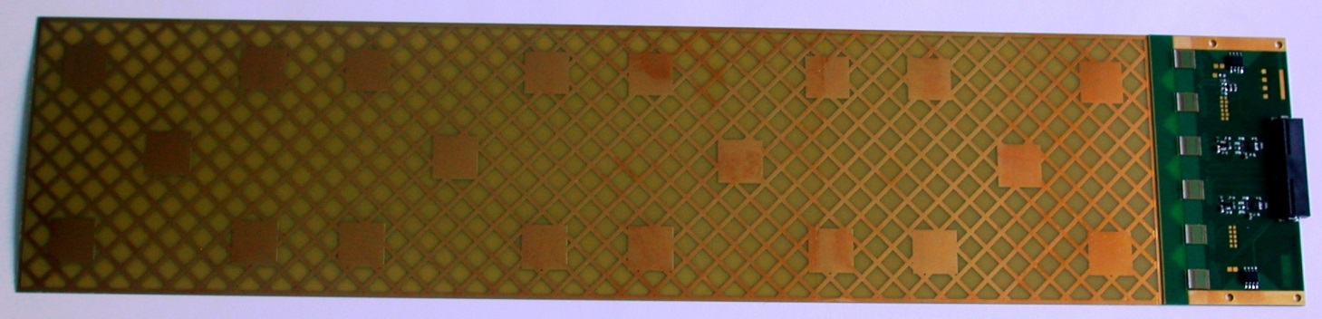
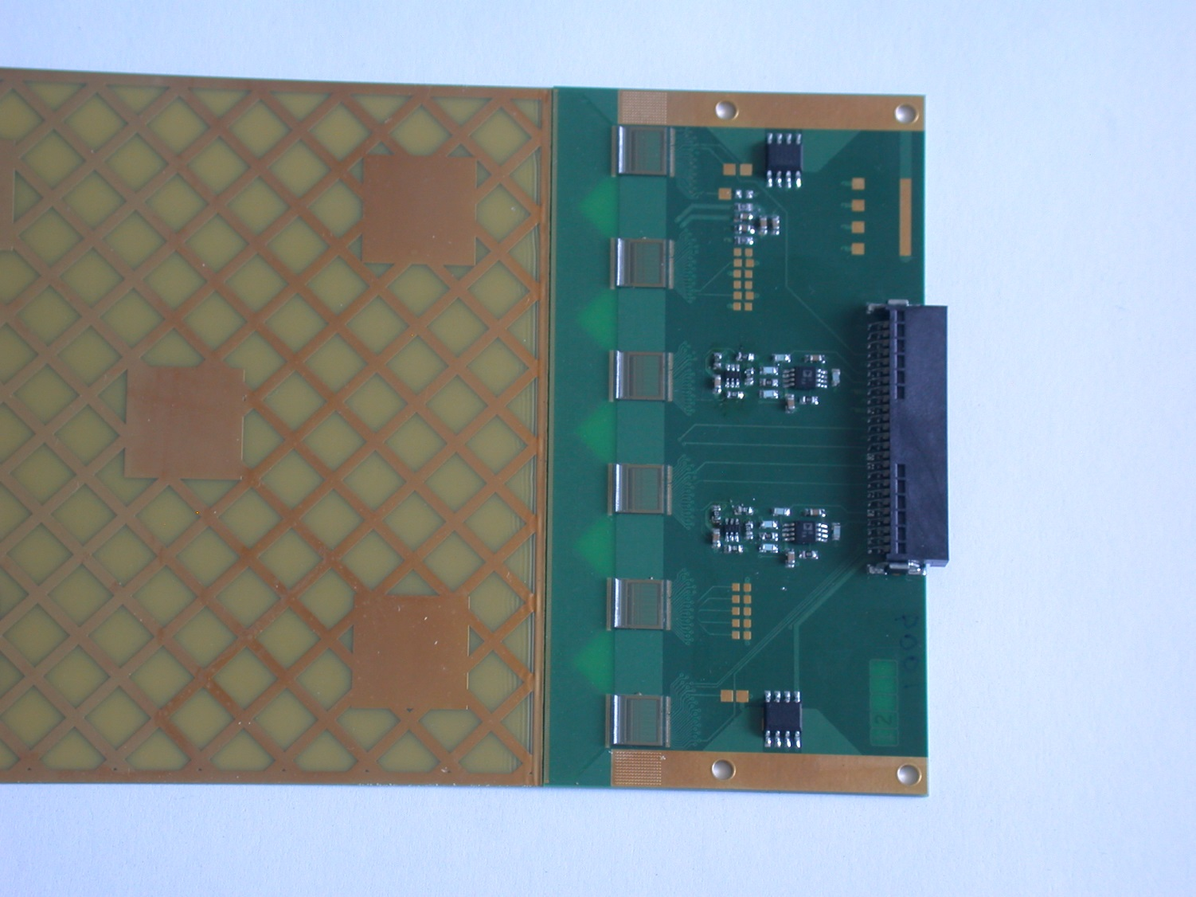
TFH 1st prototype

Slide 10
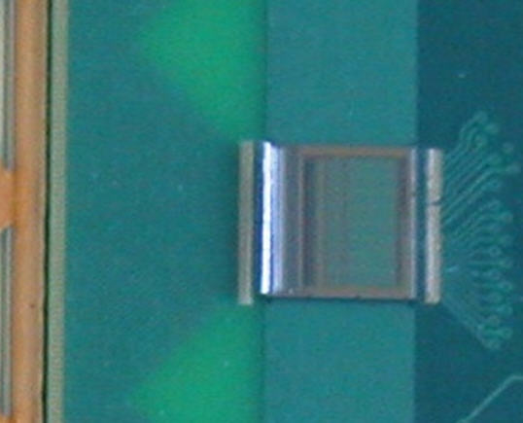
ASICs VA140 (DAMPE)
Dimension pads:
  Detector side is:
    400µm x 60µm pitch: 100µm
  Electronic side is:
    400µm x 120µm pitch: 200µm

Slide 11
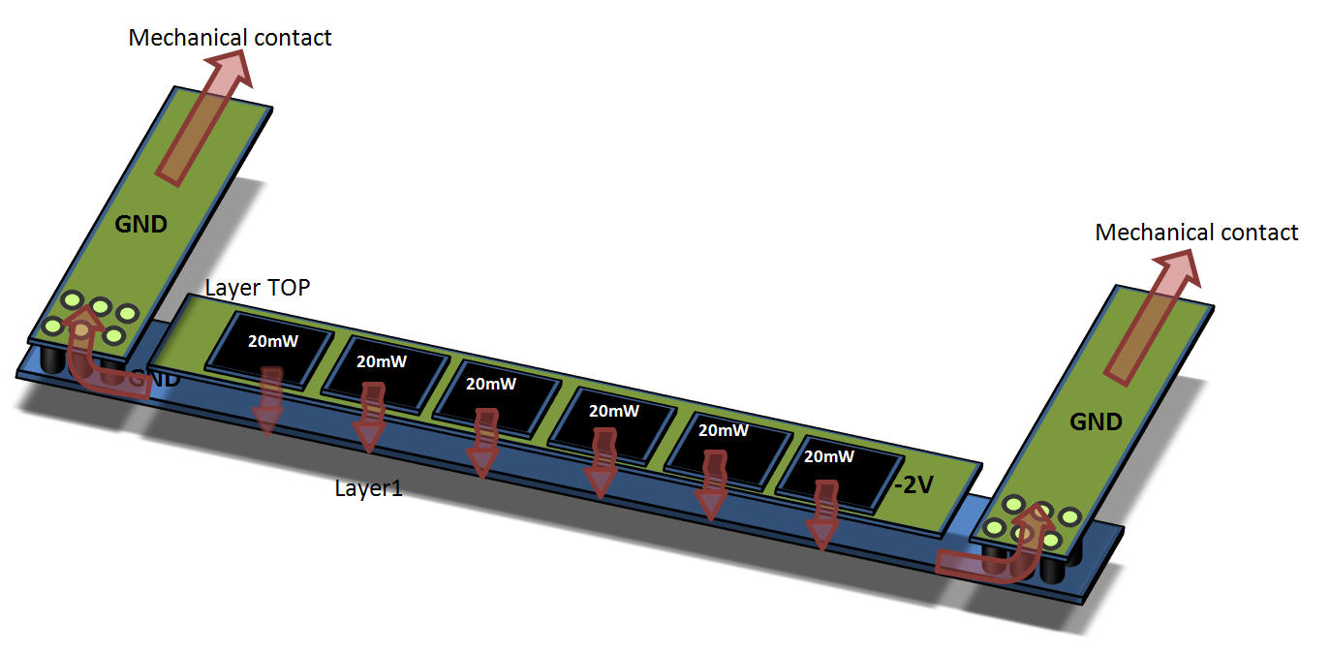
Heat flow

Slide 12
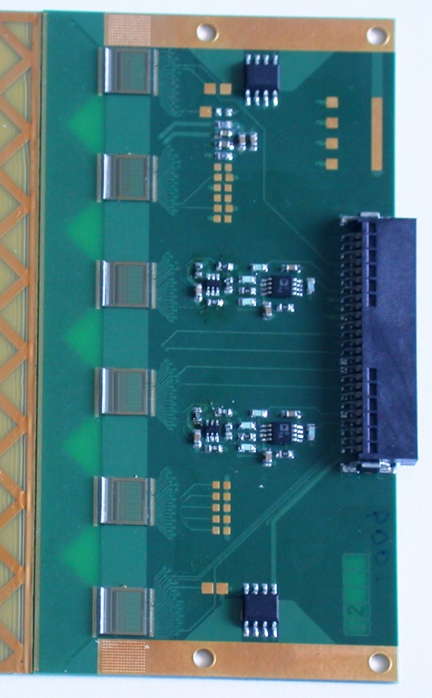
Heat flow (2)

Slide 13
Interaction between Electronics & Mechanics
Tools in Cadence Allegro allows:
  Export IDF (3D)
  Import in Catia
Advantages:
  Reduce a lot risks of errors.
  Easily transfer dimensions.
  Allows to easily know the position of a test pad
  Integrate the PCB in a 3D mechanical view

Slide 14
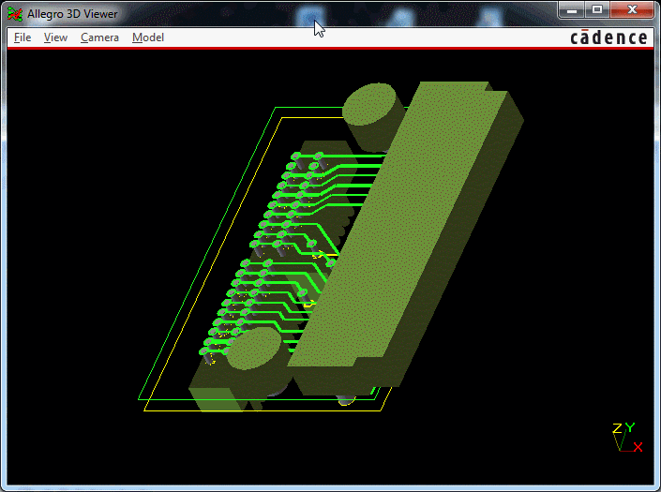
3D view of an
Adapter AirBorn/Erni

Slide 15
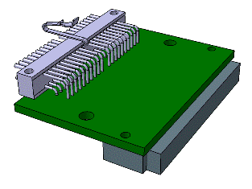
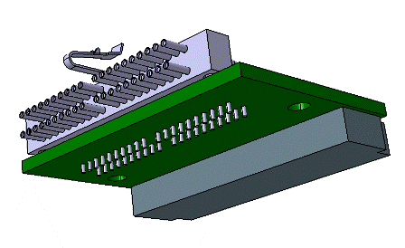
Import in Catia
Connector AirBorn replaced by the STEP 3D model given by the manufacturer
Here we placed a right angle instead of the straight configuration.

Slide 16

Conclusion
This year was going on with some news projects:
  LOFT
  CTA
  DAMPE
  NA61 (neutrinos)
But we still follow the old projects:
  IBL
  ABCn130
  POLAR
We whish success to all these project for the following years.

