Slide 1
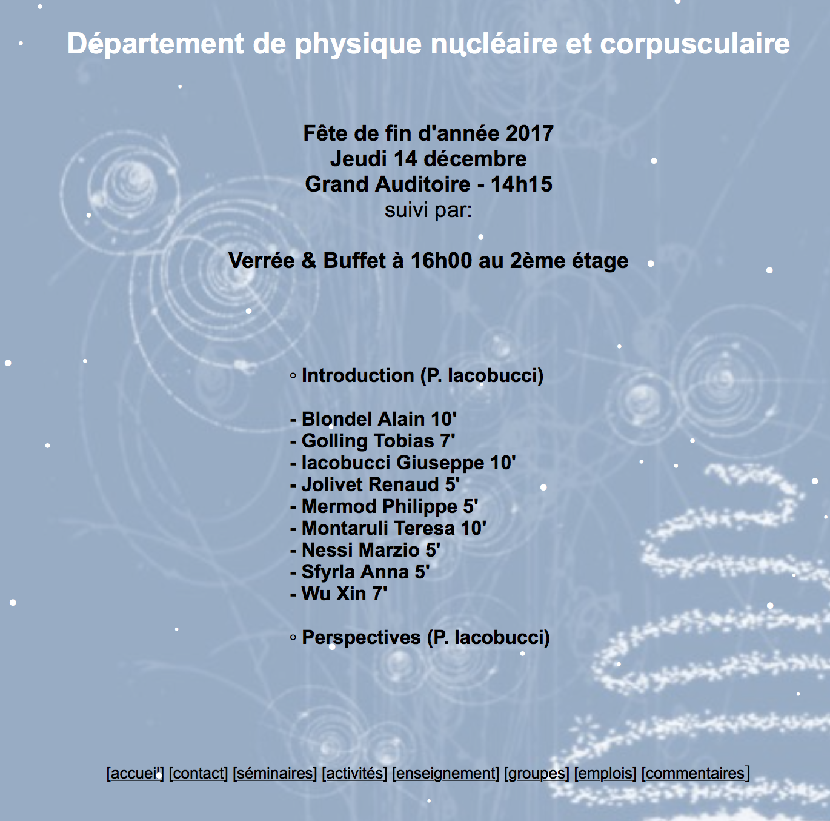

Slide 2
Neutrino Platform @ CERN
http://cenf.web.cern.ch
130 institutions involved (MOU)
Acad. of Sciences, Czech Republic; AGH University of Science and Technology, Krakow, Poland; Alikhanian National Science Laboratory (YerPhi), Armenia; Argonne National Laboratory, United States; Boston University Study Abroad Program Geneva, Switzerland; Brookhaven National Laboratory, United States; Campinas University, Brazil; CEA/IRFU,Centre d'études de Saclay Gif-sur-Yvette – IRFU, France; Centre d'études nucléaires de Bordeaux-Gradignan, France; Centre National de la Recherche Scientifique - LAPP-Laboratoire d'Annecy-le-Vieux; France; Centro de Investigaciones Energéti cas Medioambientales y Tecnológicas (CIEMAT), Madrid, Spain; Colorado State University, United States; Czech Technical University, Czech Republic; Dipartimento de Fisica e Astronomia, Universita di Roma, Italy; Dipartimento di Fisica E. Pancini, Università di Napoli Federico II, Italy; Dipartimento di Fisica, Universita di Bari, Italy; Dipartimento di Fisica, Universita di Bologna, Italy; Dipartimento di Matematica e Fisica, Universita del Salento, Lecce, Italy; Dipartimento di Matematica e Fisica, Universita Roma Tre, Italy; Duke University, United States; ETH Zurich Institute for Particle Physics, Switzerland; European Organization for Nuclear Res. (CERN), Federal University of ABC, Brazil, Fermi National Accelerator Lab., United States; High Energy Accelerator Research Organization, Tsukuba, Japan, Indiana University, Bloomington, United States; INFN e Laboratori Nazionali di Frascati, Italy; INFN, LNGS, Assergi, Italy; INFN, Rome, Italy; INFN, Sezione de Bari, Italy; INFN, Sezione di Lecce, Italy; INFN, Sezione di Pavia, Italy; Institut de Fisica d'Altes Energies (IFAE), Bellaterra, Barcelona, Spain; Institute of Theoritical Physics and Modeling, Armenia; Joint Institute for Nuclear Research (JINR), Dubna, Russia; Justus-Liebig-Universität Gießen, Germany; Kansas University, United States; Laboratoire de physique nucléaire et de hautes énergies Paris (LPNHE), France; Laboratori Nazionali del Gran Sasso, Italy; Lancaster University, United Kingdom; Lawrence Berkeley National Lab., Berkeley, United States; Lebedev Physical Institute of Russian Academy of Science, Moscow, Russia, Lomonosov Moscow State University, Russia; Los Alamos National Laboratory, United States; Louisiana State University, United States; Michigan State University, United States; Middle East Technical University (METU), Ankara, Turkey, National Centre for Nuclear Research, Otwock, Poland, National Taras Schevchenko University of Kyiv, Ukraine, National Technical University of Athens, NTUA, Greece; OMEGA Ecole Polytechnique IN2P3 / CNRS, France; Princeton University, United States; Roma 2, Italy; Ruder Boskovic Institute, Zagreb, Croatia, Russian Academy of Sciences - Institute for Nuclear Research, Russia; SLAC National Accelerator Laboratory, United States; South Dakota School of Mines and Technology, Rapid City, United States; Southern Methodist University, Dallas, United States; State University of New York (Stonybrook), United States; STFC - Rutherford Appleton Lab. - Rutherford Appleton Laboratory, United Kingdom; Theoretical Nuclear Physics Research Group, Department of Physics and Astronomy, Ghent University, Belgium; Univ. of Valencia and CSIC - Instituto de Fisica Corpuscular (IFIC), Spain; Universita & INFN, Milano-Bicocca, Italy; Università degli Studi e INFN Milano - Sezione di Milano, Italy; Universita e INFN, Bologna - Sezione di Bologna (INFN) , Italy; Universita e INFN, Catania - Sezione di Catania, Italy; Universita e INFN, Napoli - Sezione di Napoli (INFN) , Italy; Universita e INFN, Padova, Italy; Universitaet Bern - Laboratorium fuer Hochenergiephysik, Switzerland; Universite Claude Bernard-Lyon I - Institut de Physique Nucleaire de Lyon, France; Universite de Geneve - Dept. de Phys. Nucl. et Corpuscul., Switzerland; Universite de Paris VII - Laboratoire APC - Astroparticules et Cosmologie, France; Université Paris Diderot, France; Université Pierre et Marie Curie (UPMC) et Paris Diderot, France; Université Savoie Mont Blanc, France; University of Bristol, United States; University of California Davis, United States; University of California Los Angeles, United States; University of California, Berkeley, United States; University of California, Irvine, United States; University of Cambridge, United Kingdom; University of Glasgow, United Kingdom; University of Hawaii, Honolulu, United States; University of Houston, United States; University of Jyvaskyla - Department of Physics, Finland, University of Liverpool, United Kingdom; University of London - University College London, United Kingdom; University of Manchester, United Kingdom; University of Minnesota, United States; University of Minnesota, Duluth, United States; University of Oulu, Finland, University of Oxford - Particle Physics, United Kingdom; University of Pennsylvania, Philadelphia, United States; University of Pittsburgh, United States; University of Seville, Spain; University of Sheffield, United Kingdom; University of Sofia, Department of Physics, Bulgaria, University of Sussex, United Kingdom; University of Texas, Arlington, United States; University of Warwick, United Kingdom; University of Wisconsin, Madison, United States; Virginia Tech, United States; Warsaw University of Technology, Poland, William & Mary College, United States; Yale University, United States;

Slide 3
ν Detectors generic R&D
Short Baseline Neutrino Experiments (US based)
Long Baseline Intensity Facilities (US and Japan) …. Neutrino Physics and Proton Decay
Near Detectors for Neutrino Oscillation experiments (Baby Mind, T2K upgrade, DUNE, ND forum at CERN)
LAr Dark Matter future experiments

Slide 4
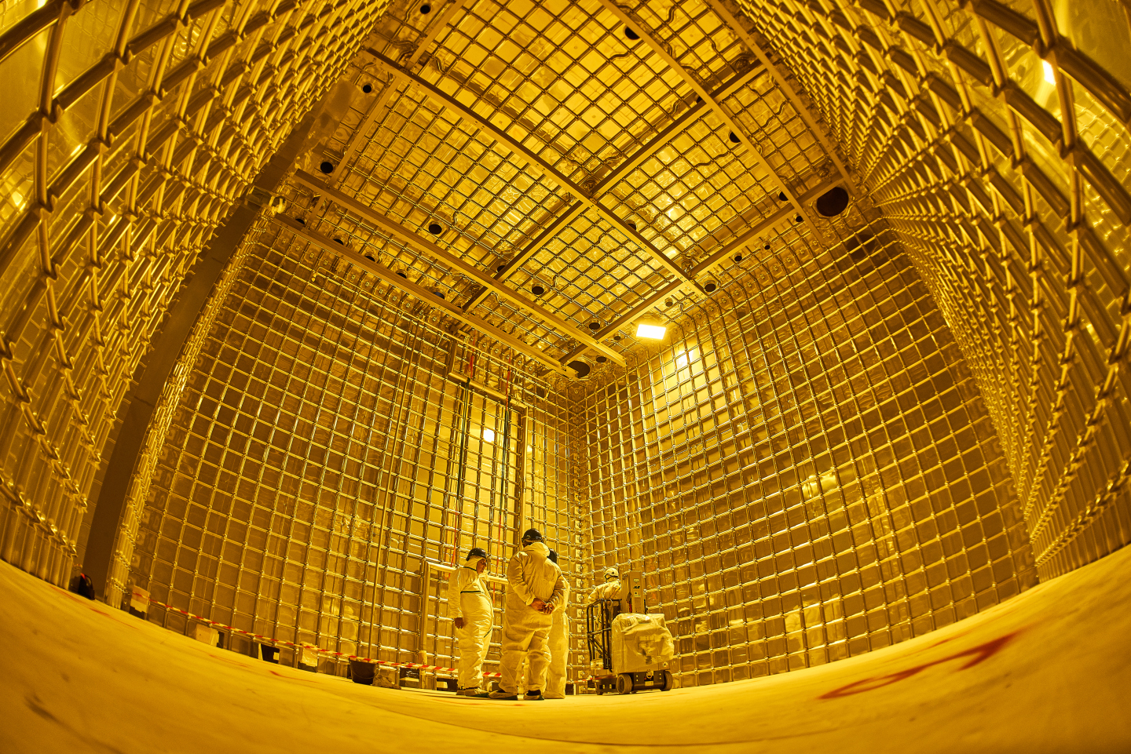
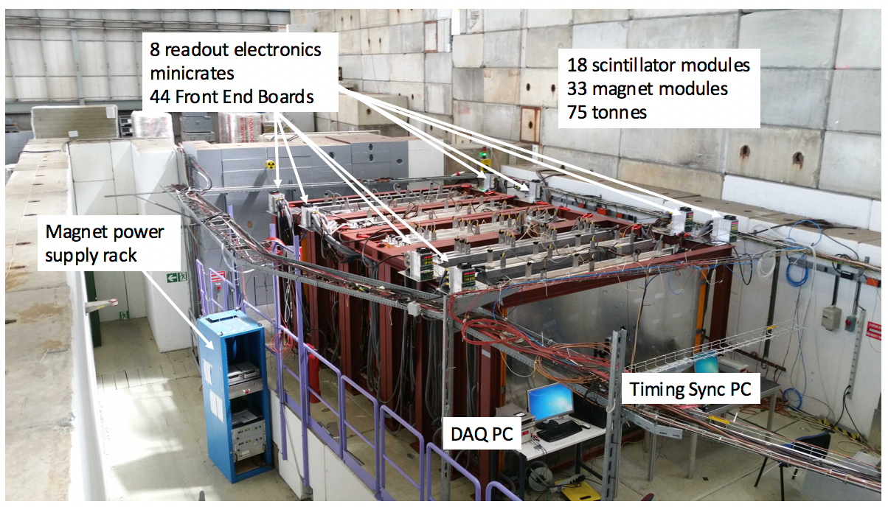
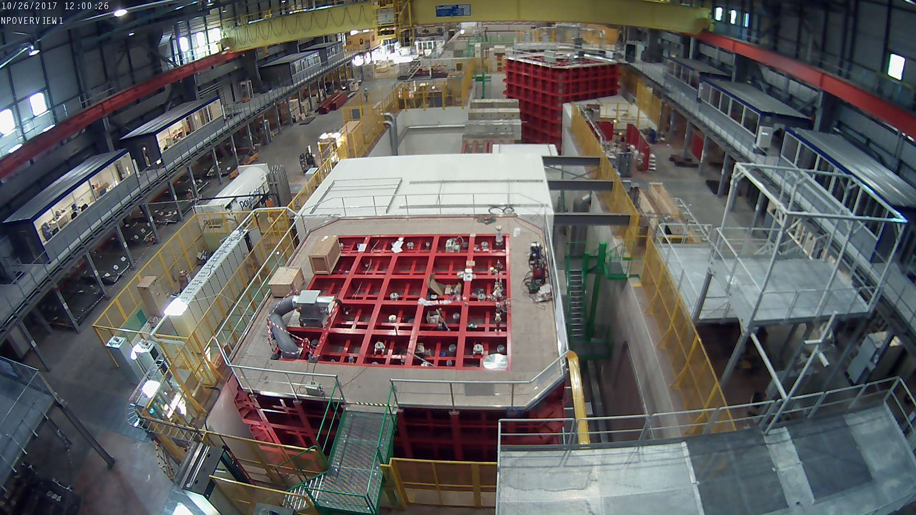

Slide 5
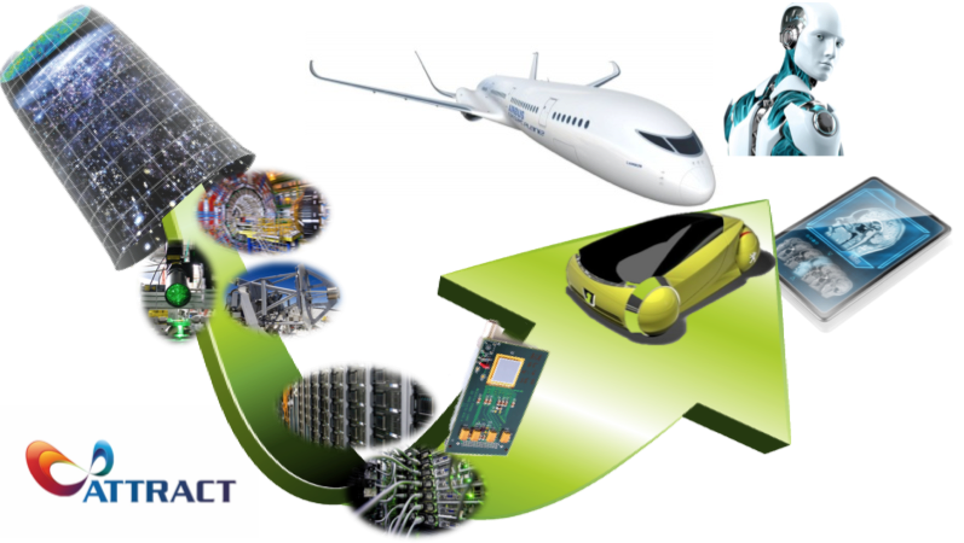
EU-ATTRACT project
http://www.attract-eu.org

Slide 6
From
Open
Science…
…to Open Innovation

Slide 7
Business & Innovation Experts
Research
Infrastructures
Public & Private Investment
Industry

Slide 8
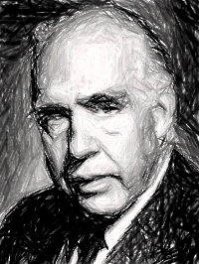
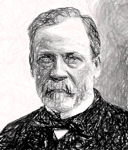
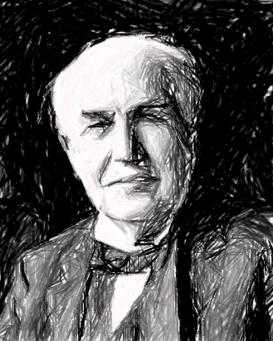
Pure
Basic Research
Use-inspired
Basic Research
Fundamental
Advancement
Applied Research
Applicability

Slide 9
Breakthrough
Detection and Imaging
Technologies

Slide 10
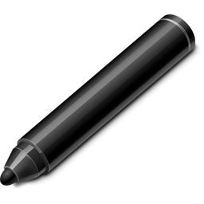
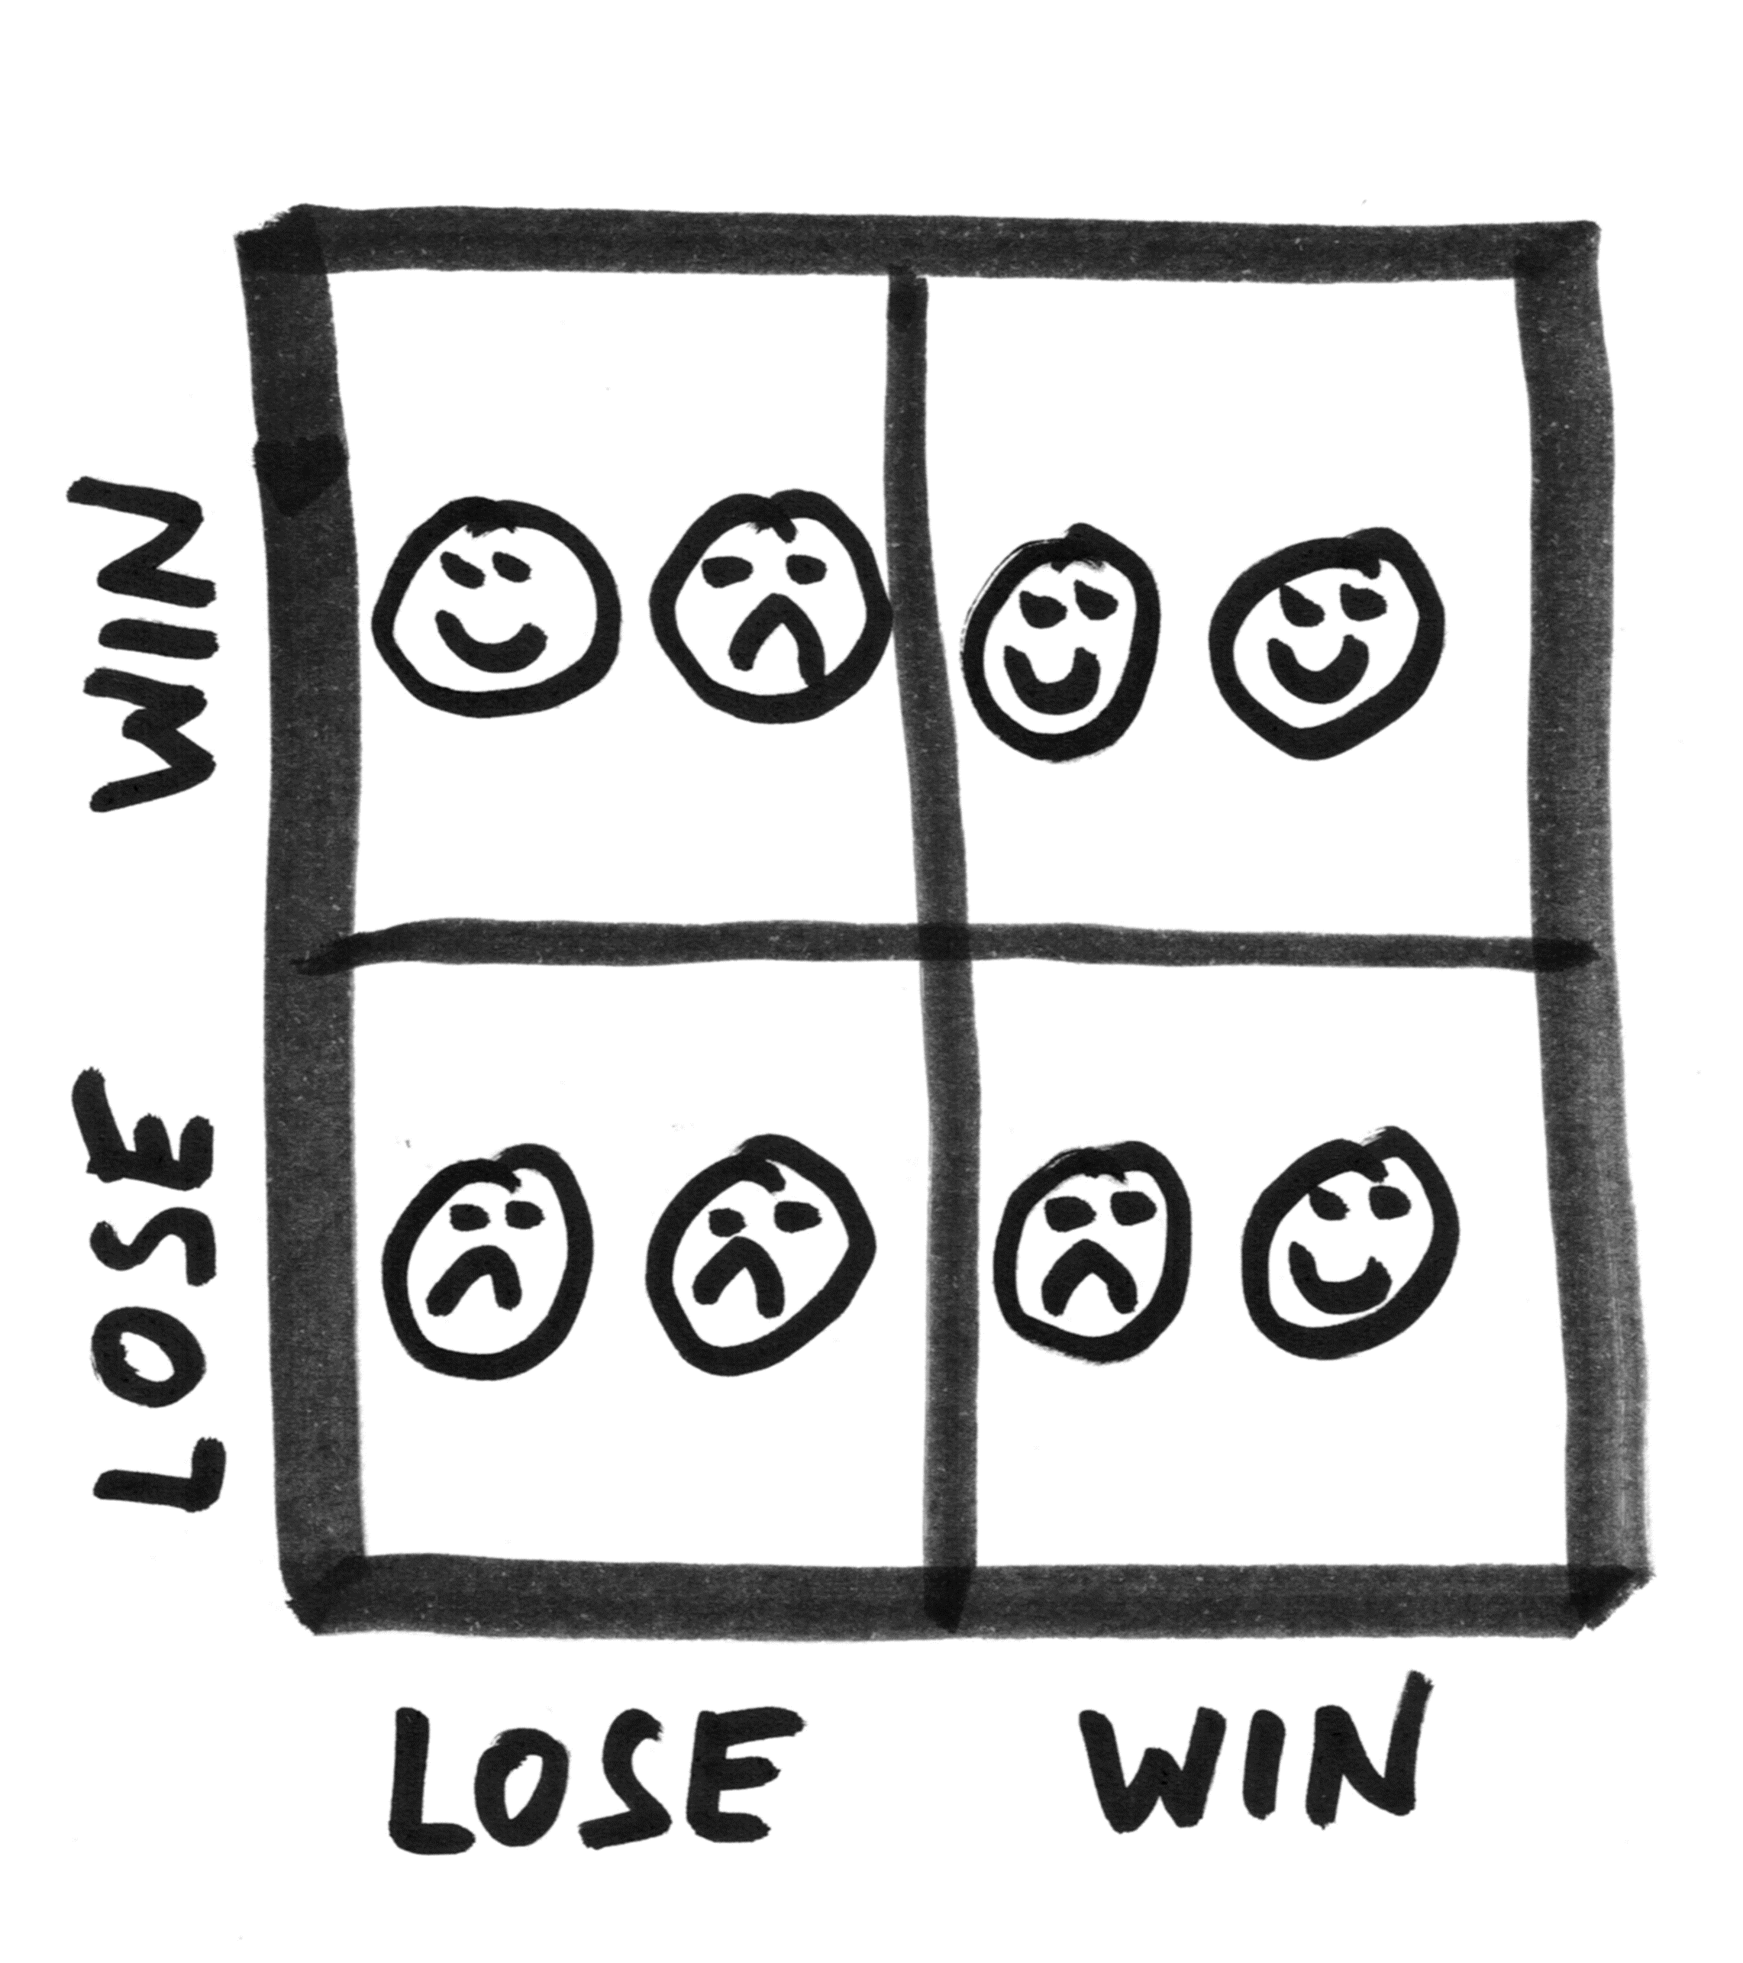
Win-Win
Cooperation
+
Competition
Co-Innovation

Slide 11
2018
20 M Euros EC fund.
Seed funding of 180 breakthrough projects.
2025
Scale-up Public-Private
Capital Model
150M/y
1
2019
4
50M Scale-up EC fund.
Private capital in place.
2
2020
Sustainable Public-Private
Capital Model
3

