Slide 1
GeV to Multi-TeV Cosmic Rays:
AMS-02 Status and Future Prospects
Martin Pohl
DPNC
Center for Astroparticle Physics (CAP Genève)
Université de Genève
Switzerland
ICHEP Paris July 24, 2010

Slide 2
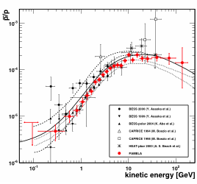
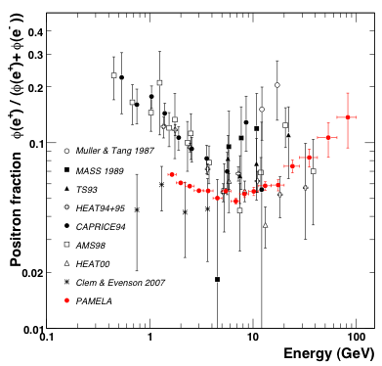
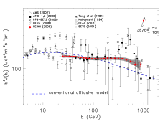
Renewed Interest in Galactic CR
Antiproton spectrum compatible with secondary production
Positron and (e⁺+e⁻) spectra show unusual shape
HEAT (2001), AMS-01 (2002), ATIC (2008), Pamela (2009), Fermi-LAT (2009), H.E.S.S. (2010)
Astrophysical or DM source?
O. Adriani et al., arXiv:1007.0821 (2010)
A.A. Abdo et al., Phys.Rev.Lett.102:181101,2009.
O Adriani et al. Nature 458, 607-609 (2009)

Slide 3
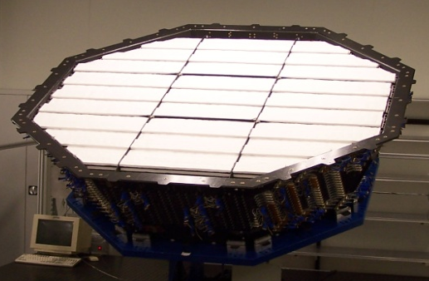
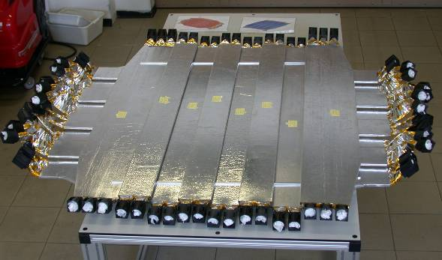
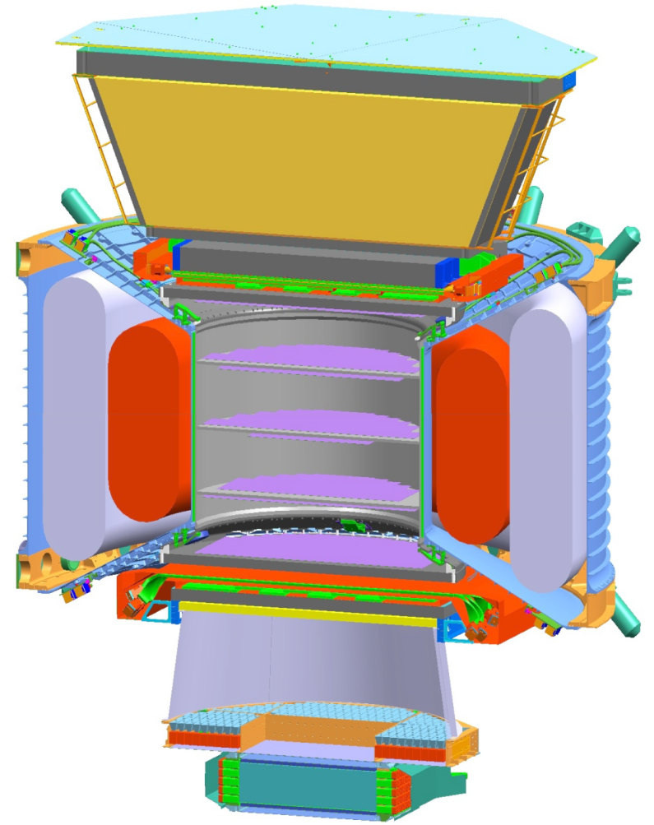
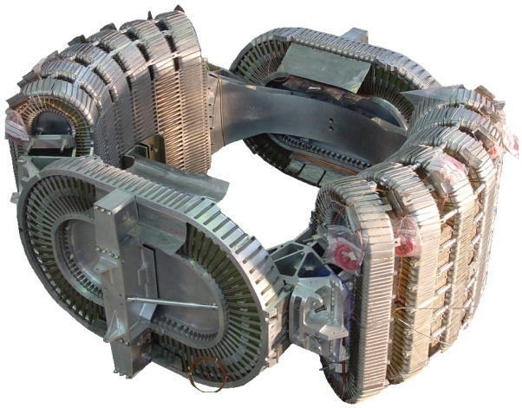
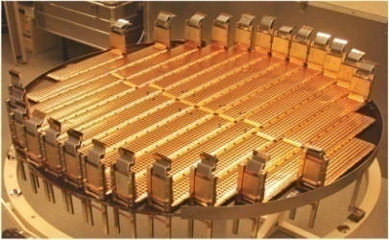
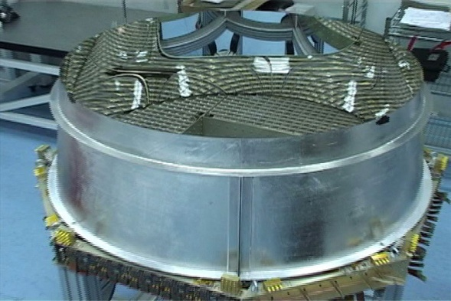
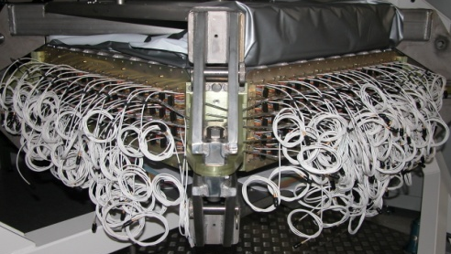
AMS-02 with Superconducting Magnet
TRD
Identify e+, e-
TOF
m, Z, E
TRD
Magnet
±Z
Silicon Tracker
m, Z, P
TOF
1
2-3
4-5
Superconducting
Magnet
Tracker
2500 L SF Helium
6-7
8
RICH
m, Z, E
ECAL
E of e+, e-, γ
TOF
RICH
ECAL
m, Z, E are measured independently from Tracker, RICH, TOF and ECAL
3
Notes:
3
3
3

Slide 4
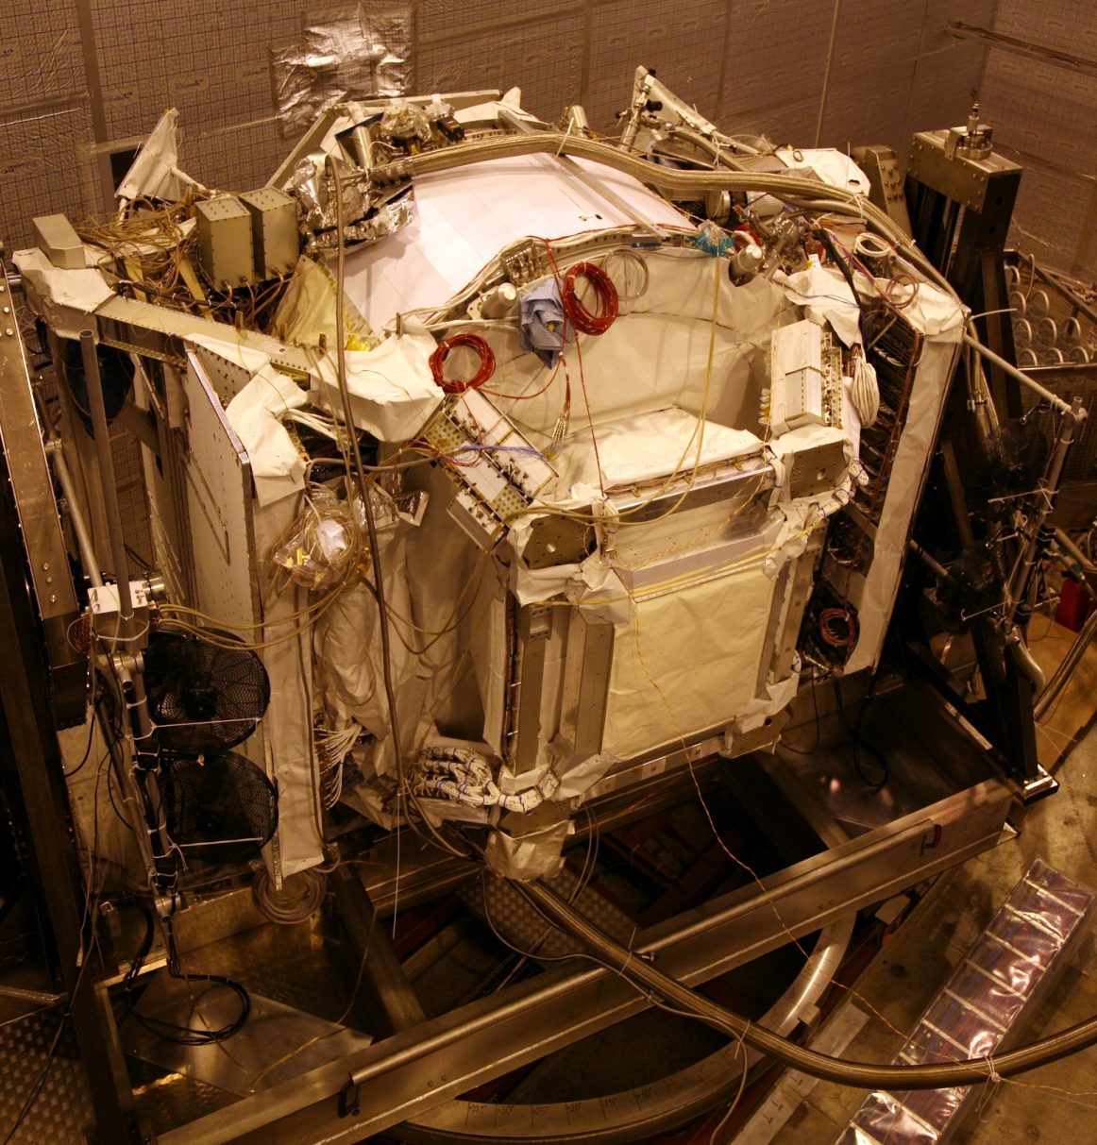
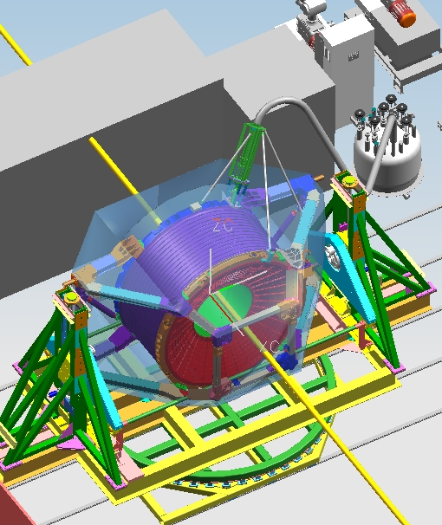
AMS in CERN SPS Test Beam, Feb 4-8, 2010
Beam
θ
Φ
Z
X
Notes:
4

Slide 5
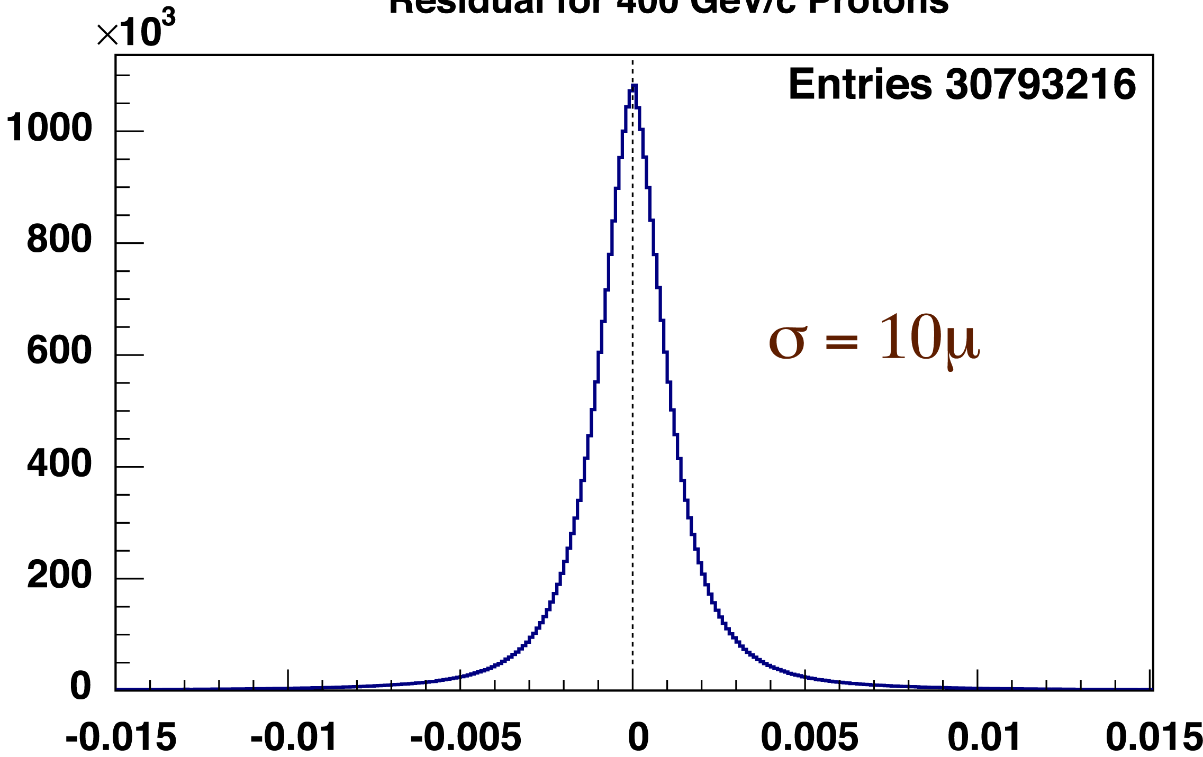
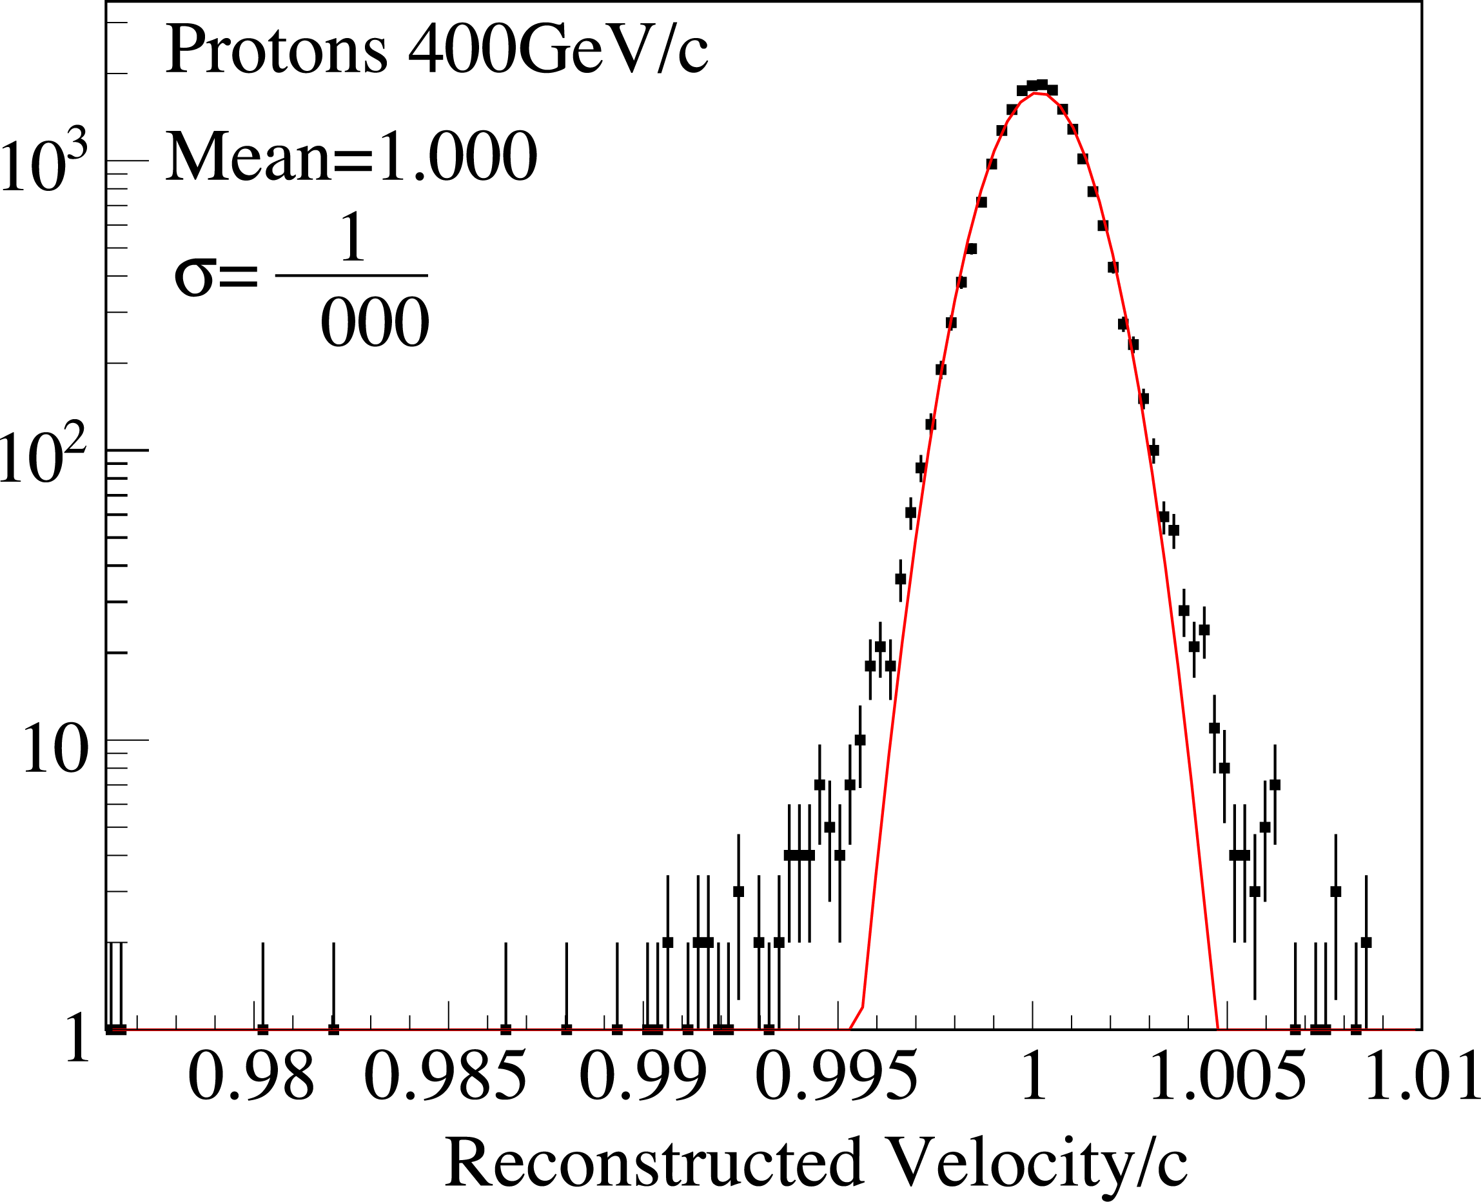
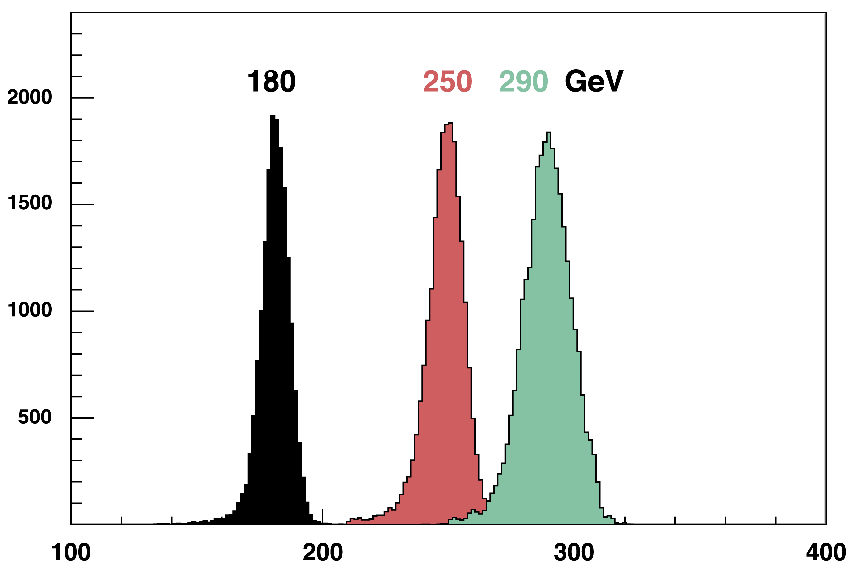
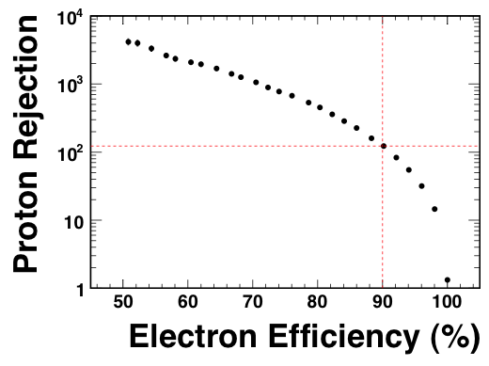
N
N
Velocity measured to
an accuracy of 1/1000
for 400 GeV protons
Bending Plane Residual (cm)
N
Electron Energy Resolution: 2.5-3%
TRD: 400 GeV Protons
Energy
Combined rejection power at 400 GeV: e⁺/p = 10⁻⁶

Slide 6
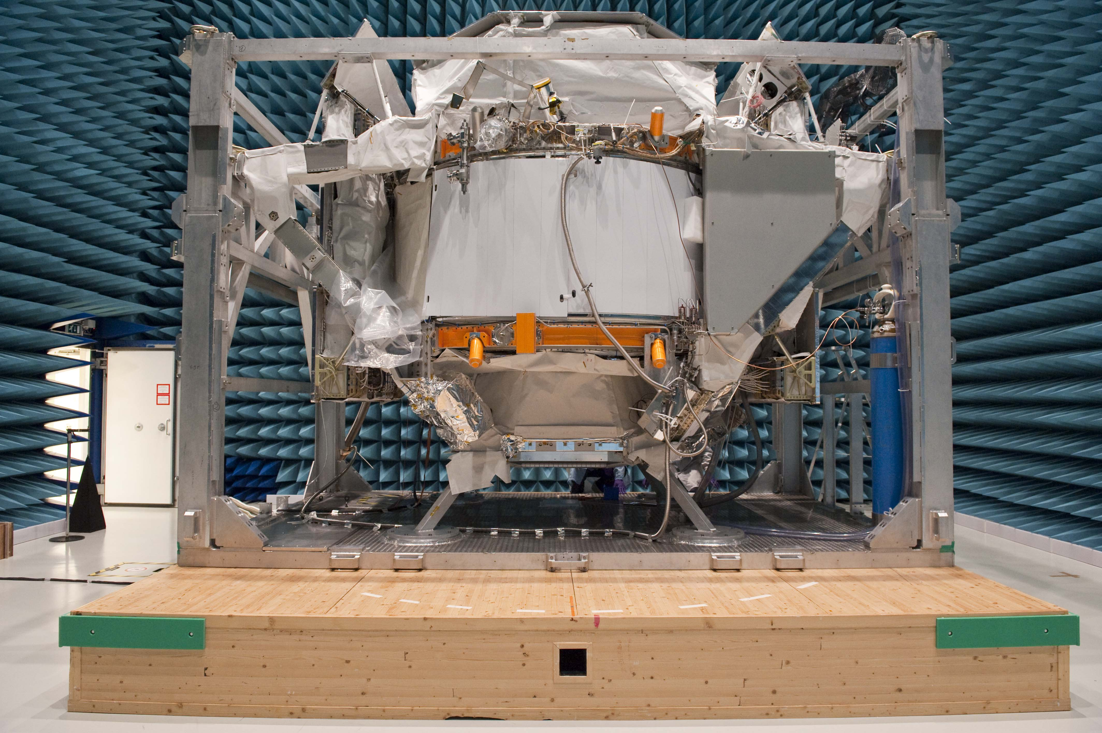
AMS in the Maxwell EMI chamber at ESTEC
NASA LIMIT (16.8A)
Notes:
6

Slide 7
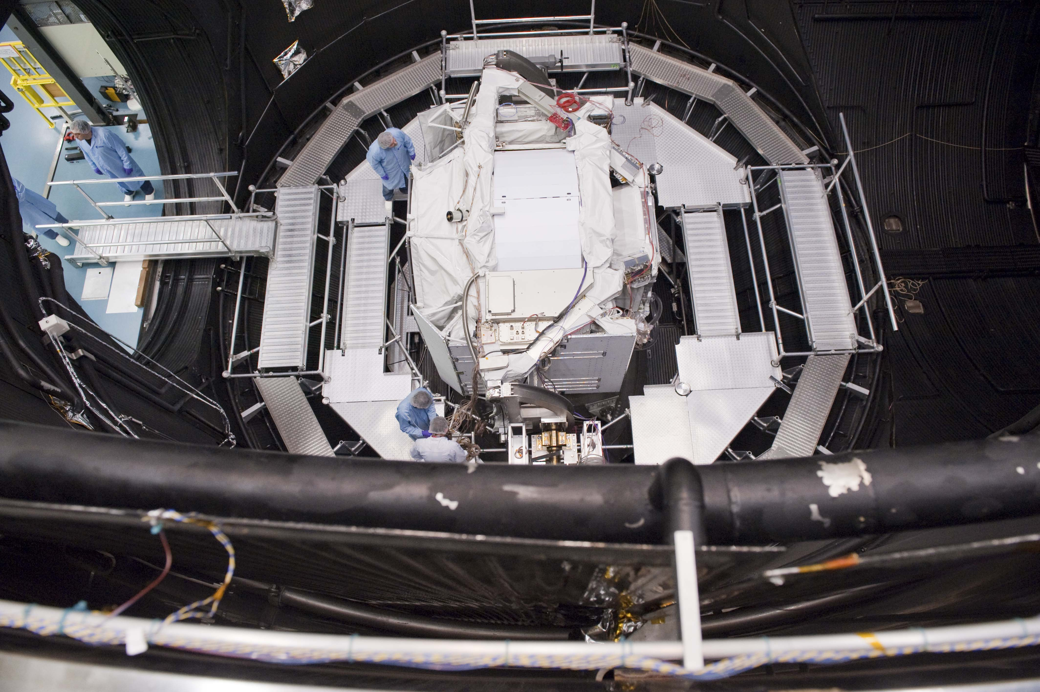
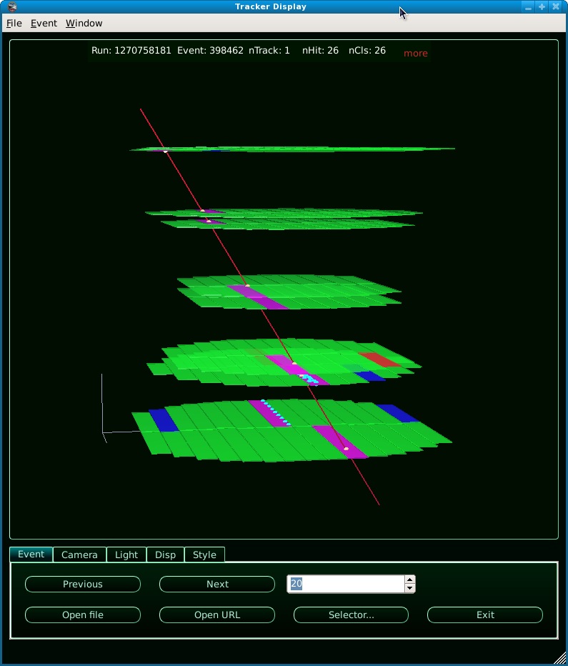
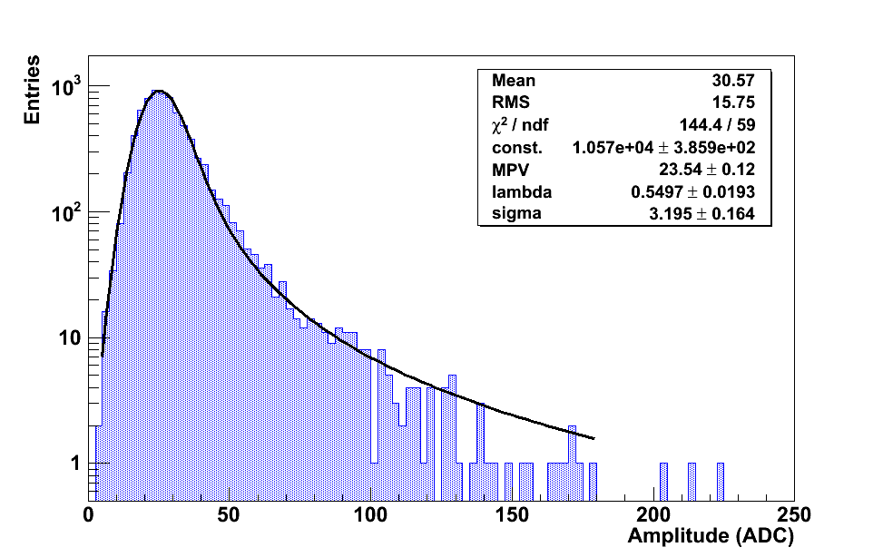
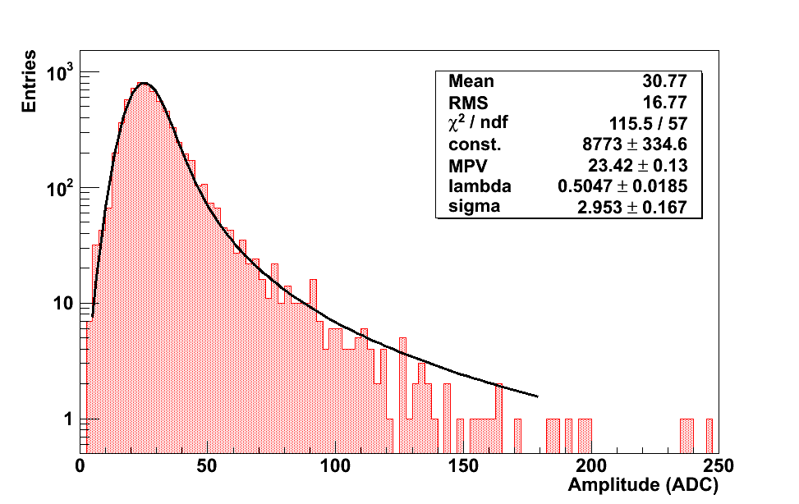
AMS in the ESA TVT Chamber
Tracker performance at −90ºC:
muon track & mip signal

Slide 8
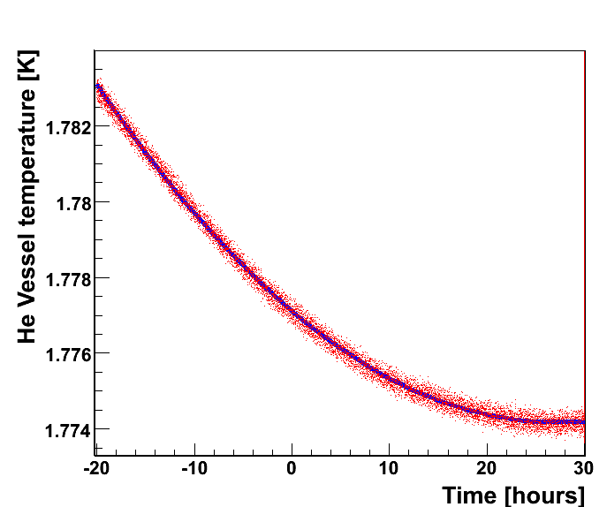
Stabilization of the He Vessel
Chamber walls set to -90ºC
• Data
– Model
Stability criteria:
dT/dt < 0.0001K/h
Expected life time of the AMS Cryostat on ISS:
      20±4 months with M87 cryocoolers (1999)
      28±6 months with GT cryocoolers (2010)

Slide 9
ISS Lifetime Extension
The ISS lifetime has been extended from 2015 to 2020 (or even 2028).
The Shuttle program will be definitely terminated, thus eliminating any possibility of returning and refilling AMS.
A superconducting magnet was ideal for a three year stay on ISS as originally planned for AMS.
With the extended ISS life, the super-conducting magnet is no longer the optimum choice.
AMS-02 with the permanent magnet from AMS-01 will have 10-18 years time to collect data, providing much more sensitivity to search for new phenomena.

Slide 10
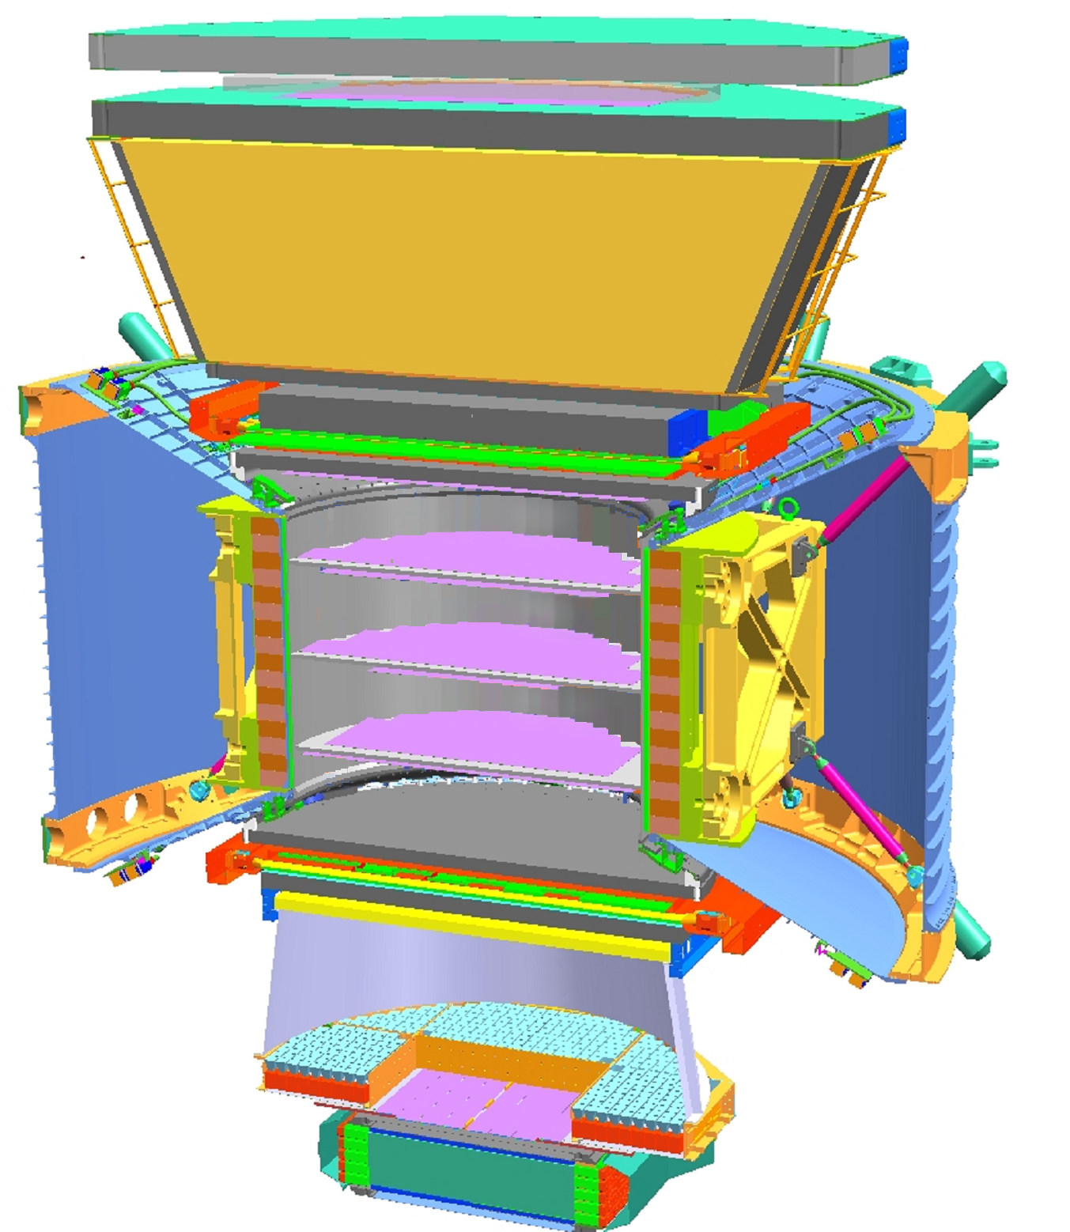
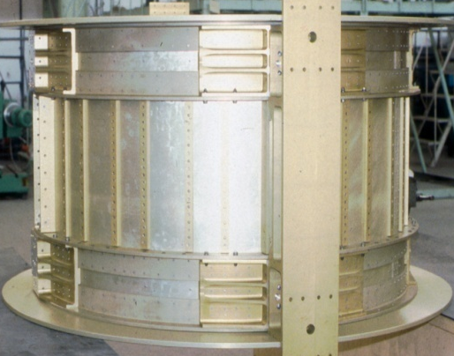

AMS-02 with Permanent Magnet
TRD
TOF
1
TRD
Permanent Magnet
Silicon Tracker
TOF
2
3-4
5-6
Tracker
7-8
TOF
RICH
RICH
ECAL
9
ECAL
One Tracker plane displaced to top
One additional plane on bottom
Notes:
10
10
10

Slide 11
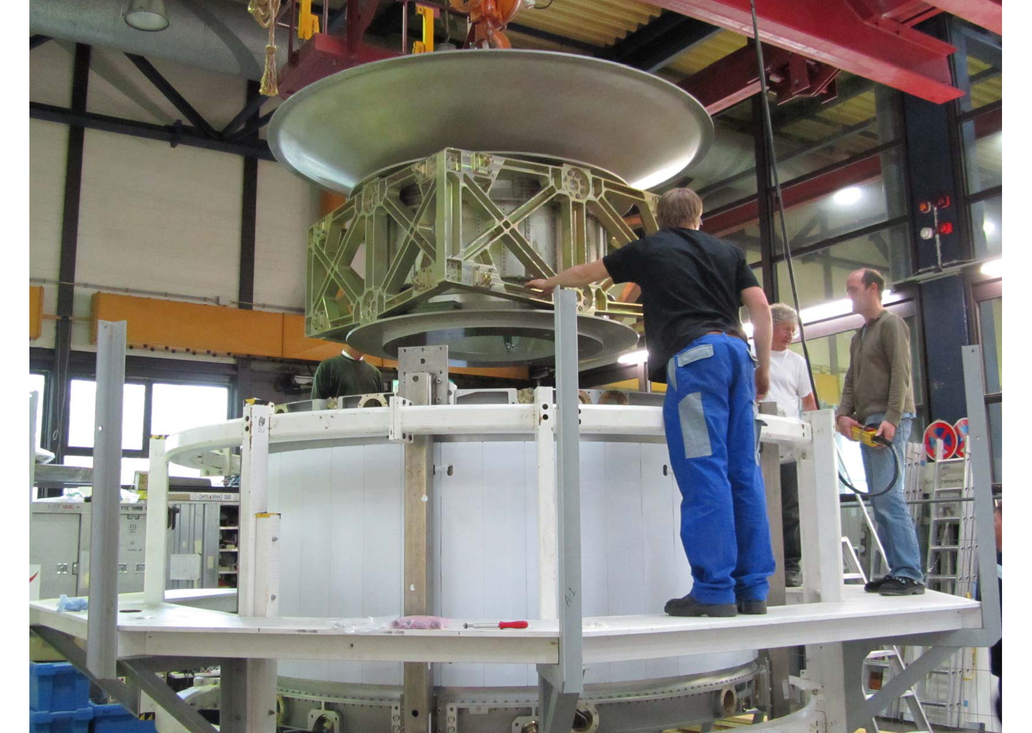
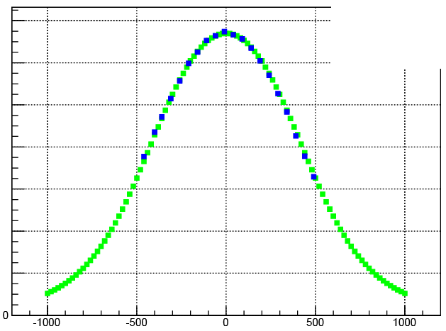

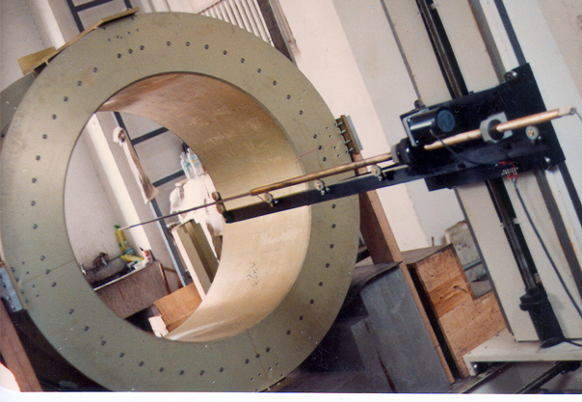
AMS-01 Permanent Magnet
in Aachen Germany,
April/May 2010
Aachen, 03/2010
1200
Zurich,1997
800
B in Gauss
400
SC: B_{max} = 0.87T
PM: B_{max} = 0.14T

Slide 12
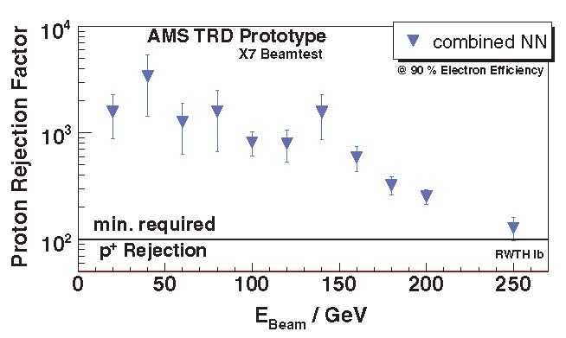
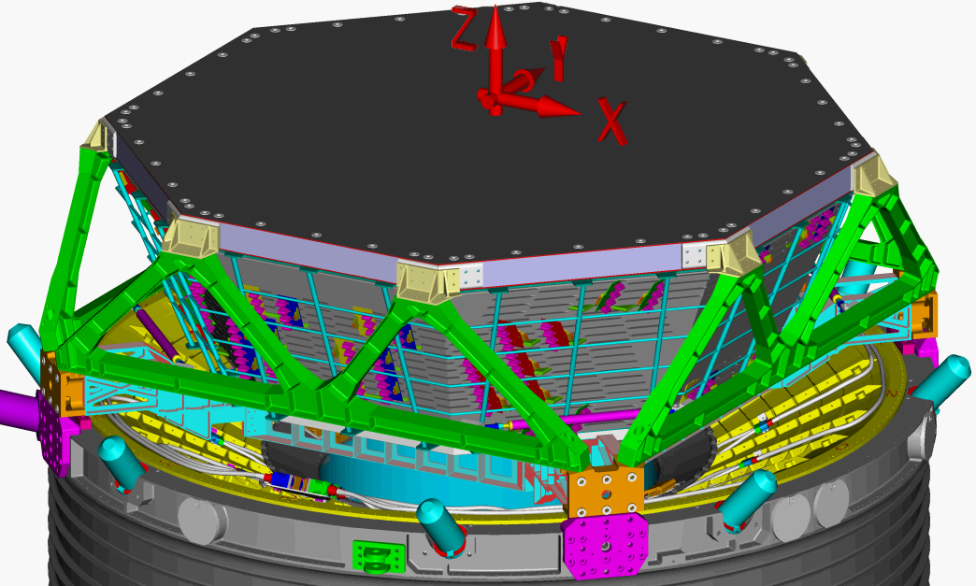
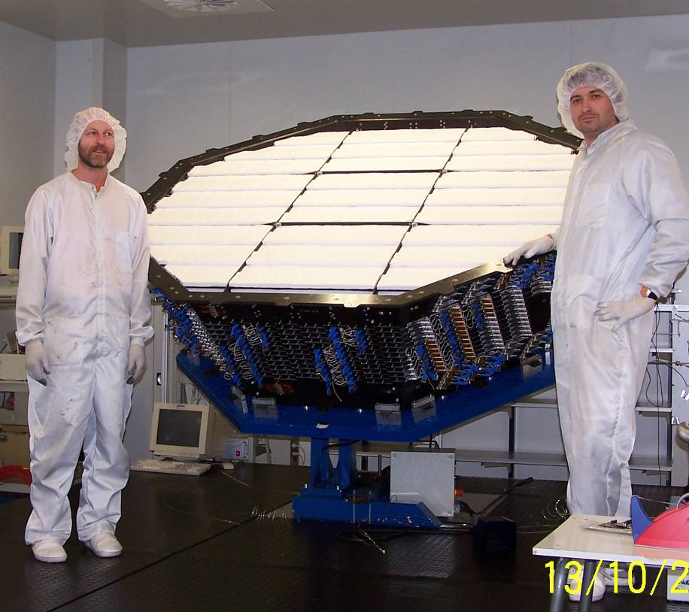
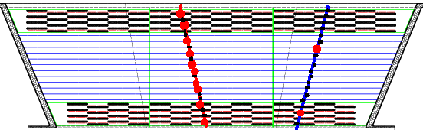
Transition Radiation Detector (TRD)
e⁺
p
20 layers
Notes:
12

Slide 13
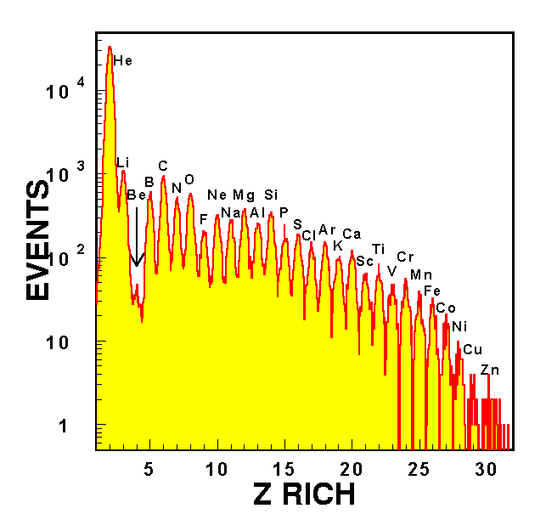
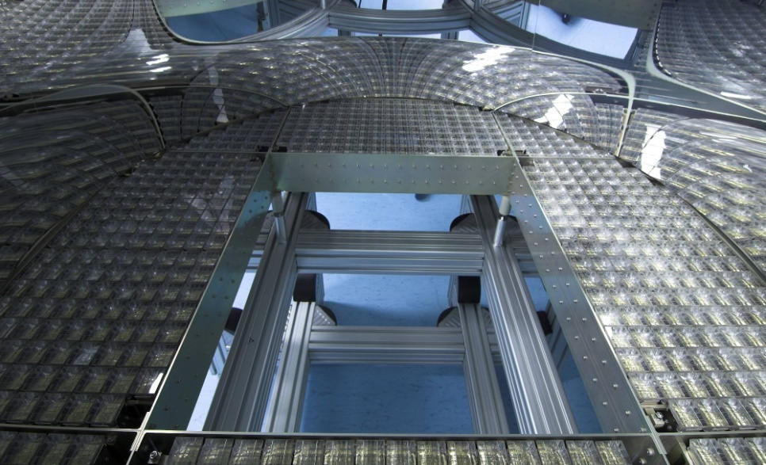
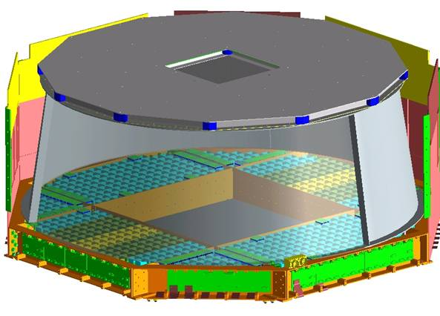
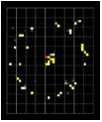
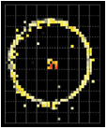
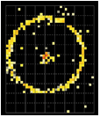
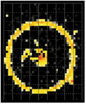
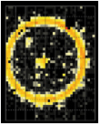
Ring Imaging Cherenkov (RICH)
RICH test beam E=158 GeV/n
10⁴
10³
10²
10
1
10,880 photosensors
Particle
Radiator
NaF
Aerogel
Reflector
Θ
detectors
He
Li
C
O
Ca
Single Event Displays
Intensity ∝ Z²
Θ ∝ v
RICH test beam E=158 GeV/n

Slide 14
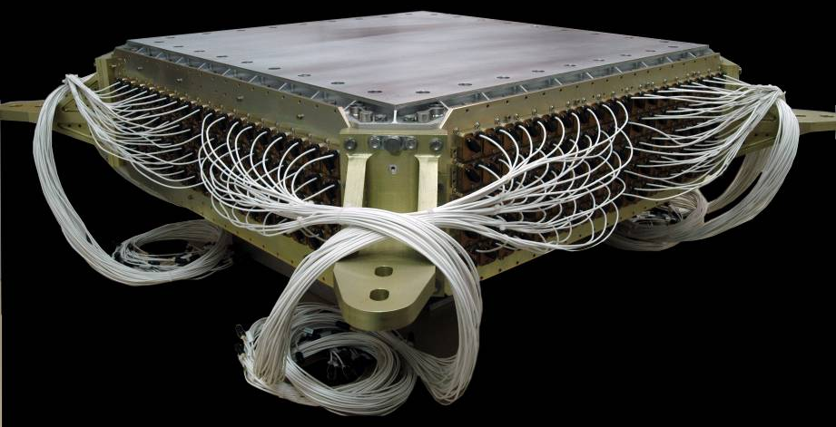
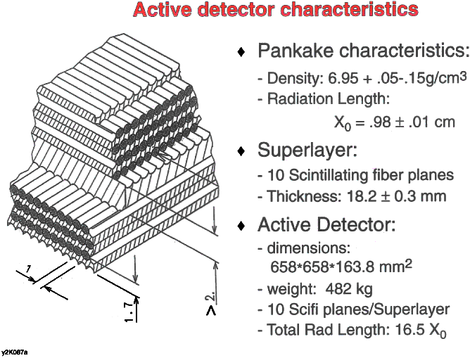
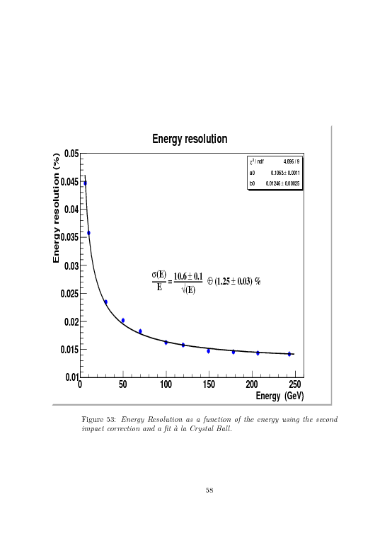
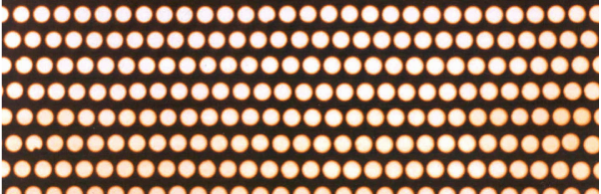
Calorimeter (ECAL)
e±
Lead foil
(1mm)
Fibers
(φ1mm)
10 000 fibers, φ = 1 mm
distributed uniformly
inside 1,200 lb of lead

Slide 15
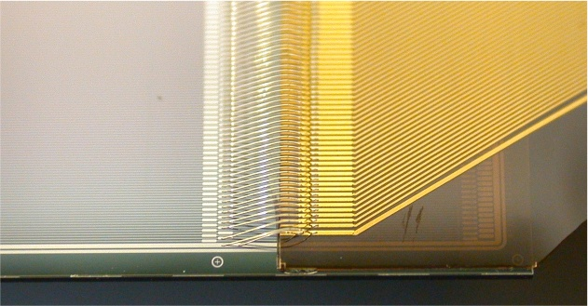
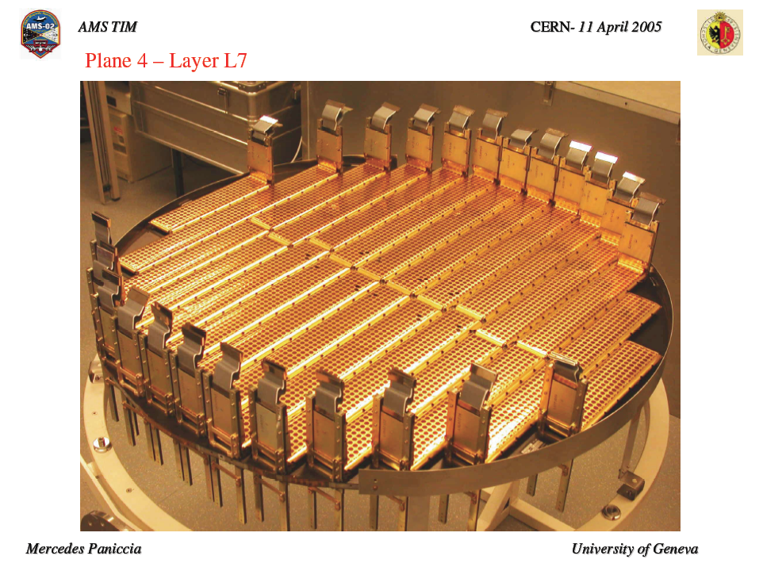
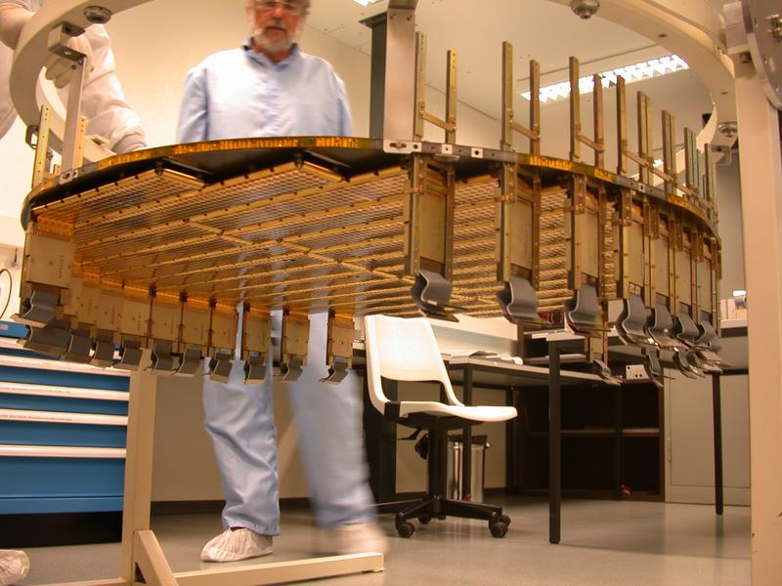
Silicon Tracker: Rigidity and Charge
S Charge
S Charge
K Charge
K Charge

Slide 16
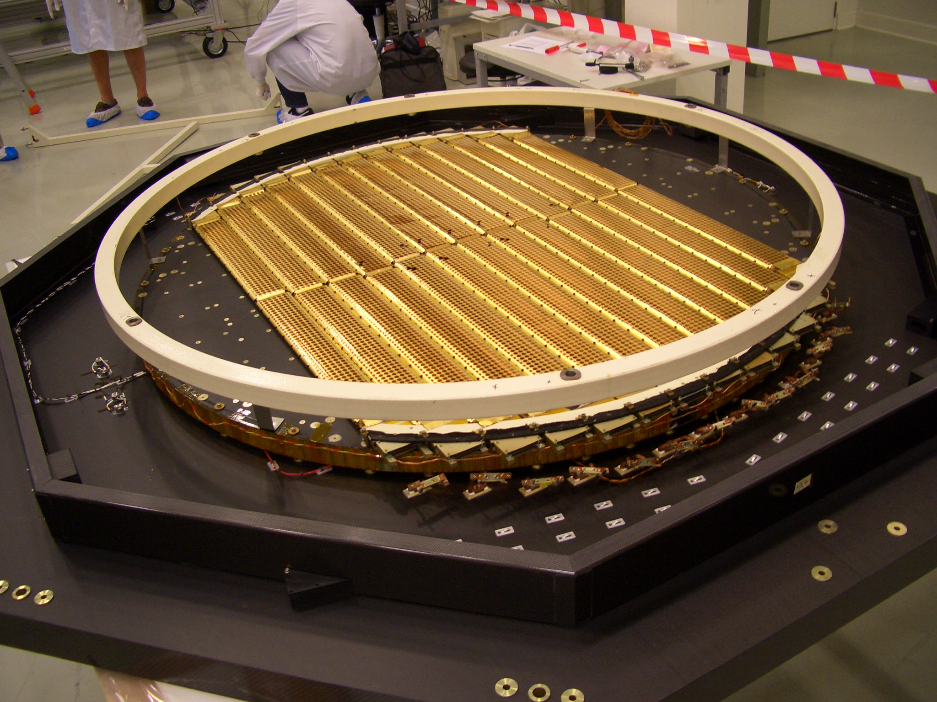
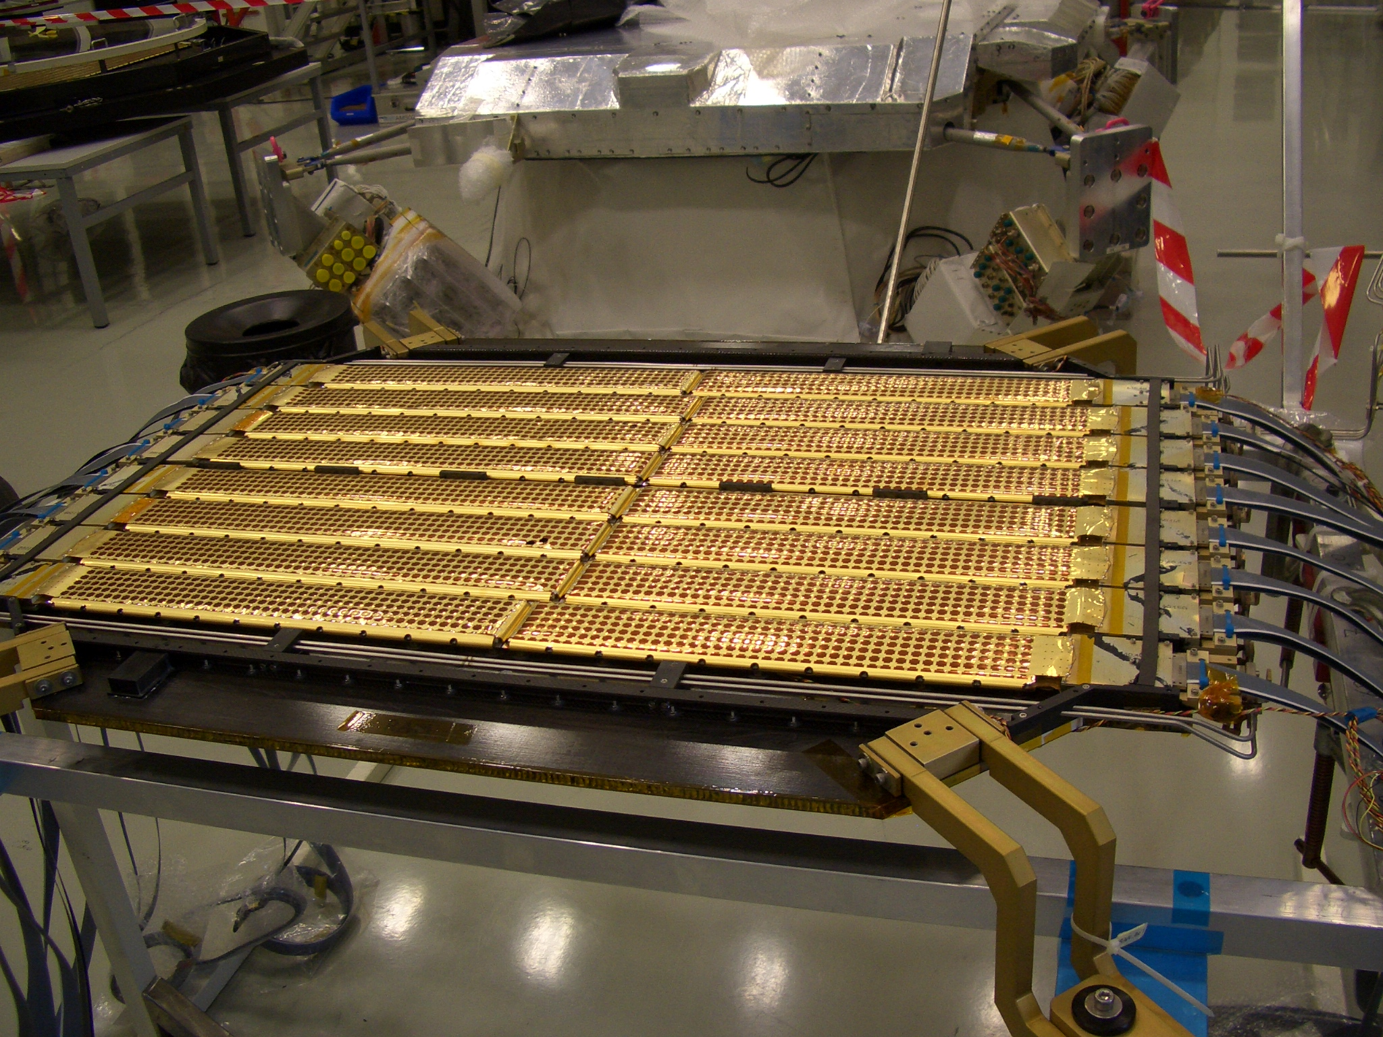
AMS-02 Permanent Magnet
Silicon Tracker Layers
1N
TRD
1
1
2-3
4-5
6-7
RICH
9
ECAL
Layer 9 comes from moving the ladders at the edge of the acceptance
from layer 1. Layer 8 is moved on top of the TRD to become 1N.

Slide 17
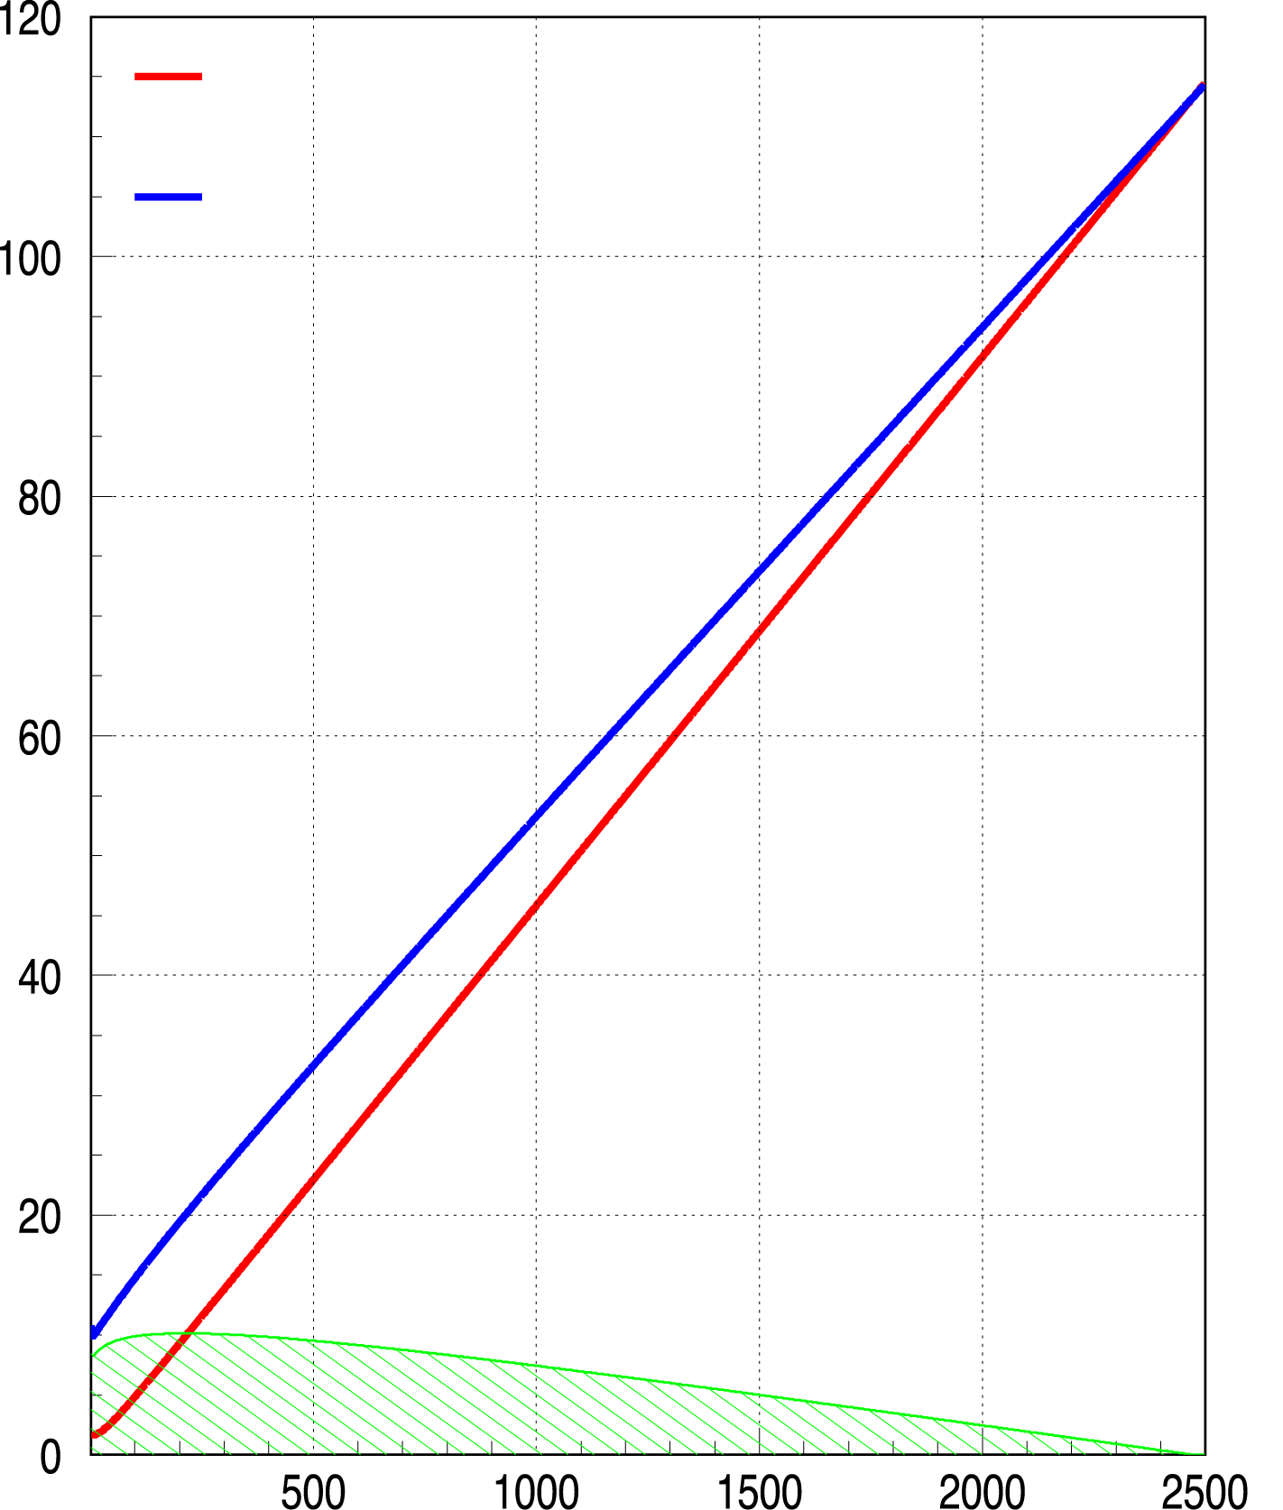
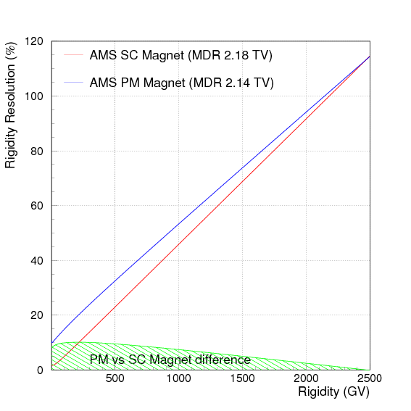
AMS SC Magnet (MDR_{P} 2.18 TV)
With 9 tracker planes in the new configuration, the rigidity resolution of AMS with the permanent magnet
is equal (within 10%) to that of the superconducting magnet.
For helium nuclei, the MDR for the permanent magnet is 3.75 TV.
Alignment will be done with 10’000 CR tracks per minute in orbit.
AMS PM Magnet (MDR_{P} 2.14 TV)
Rigidity resolution %
PM vs SC Magnet difference
Proton Rigidity (GV)

Slide 18

Cosmic μ–, July 14, 2010

Slide 19

Physics of AMS: Nuclear Abundances Measurements
Φ (s^{r-1} m⁻² sr⁻¹ GeV⁻¹)
E_{kin}/n (GeV)
AMS will measure of cosmic ray spectra for nuclei, for energies from 500 MeV to 2 TeV to 1% over the 11-year solar cycle.
These spectra will provide experimental measurements of all the assumptions that go into calculating the background in searching for Dark Matter,
i.e., p + C →e⁺, p, …

Slide 20








Dark Matter Candidate χ⁰ χ⁰→ e⁺e⁻
for mχ⁰ = 200 GeV
e⁺/( e⁺ + e⁻)
Energy [GeV]
e⁺/( e⁺ + e⁻)
Energy [GeV]
Energy [GeV]
Notes:
20
20

Slide 21




Superconducting magnet
3 years
Bergström, Edsjö, Zaharias 2009
Fit to Pamela, Fermi-LAT, HESS
Nomura-Thaler model N3
M_{DM} = 3.65 TeV
E_{F} ≈ 2500
Permanent magnet
10 years
Energy [GeV]
Notes:
21

Slide 22

Search for Residual Antimatter

Slide 23


Φ_{s} = 5x10⁻¹⁰(cm²s sr)⁻¹
Search for Strangelets
AMS02 Permanent Magnet 10 Years
E. Witten, Phys. Rev. D,272-285 (1984)
Events
Strangelet Flux (cm² s sr)⁻¹
AMS PM 10Yrs Limit

Slide 24
Conclusions
AMS-02 has successfully been integrated with the long lifetime permanent magnet, to match the extended ISS lifecycle.
The experiment performance at high energies is preserved.
Schedule:
  CERN test beam in final configuration from August 7 to 14, 2010.
  US Air Force C5 will take us on August 26 to Kennedy Space Center, Florida.
  On flight STS-134, scheduled for Feb. 26, 2011, space shuttle Endeavour will take us to the ISS.

Slide 25
The momentum resolution (Δp/p) is the sum of two contributions:
L₁
1. Measurement inside the magnet with an effective length L
(Q/p)·(Δp/p) α 1/BL²
2. Measurement of the incident (θ₁) and exit (θ₂) angles which depend on the length L₁
(Q/p)·(Δp/p) α 1/BLL₁
θ₁
L
B
θ₂
L₁
For both magnets, L ∼ 80 cm,
but in the permanent magnet B is 5 times smaller
to maintain the same Δp/p we increase L1 from ∼15 cm
(Superconducting Magnet) to ∼125 cm (permanent magnet)

Slide 26

Long term support from NASA already planned.
NASA AMS Project Office Budgets for AMS-01 and AMS-02
Budget Per Year ($k)
Total NASA Budget from 1995-2020 is $104,157,000*
* Budget does not include launch costs

Slide 27

AMS Vacuum Cases

Slide 28
Independent Alignment Systems of the AMS Tracker Planes
Alignment with CERN Test beam on 7-14 Aug 2010 using the highest energy protons (400 GeV).
2. Alignment with 10,000 cosmic rays every minute in every orbit

Slide 29

External Plane Alignment with Cosmic Rays
Minute by Minute
1200
1200
1 Minute Thermal Movement measurements
1 Minute Thermal Movement measurements
Simulated Top Plane Thermal Movement
Simulated Bottom Plane Thermal Movement
1000
1 mm
1000
1 mm
800
800
Plane Thermal Movement (μm)
Plane Thermal Movement (μm)
600
600
400
400
200
200
0
20
40
60
80
0
20
40
60
80
Time (min)
Time (min)

Slide 30

External Planes Alignment Studies
4
Residual Top Plane Misalignment < 4μm
4
Bottom Plane Misalignment < 4μm
2
2
Residual Top Plane Misalignment (μm)
Residual Bottom Plane Misalignment (μm)
0
0
-2
-2
-4
-4
0
20
40
60
80
0
20
40
60
80
Time (min)
Time (min)

Slide 31

Kaluza-Klein Bosons (B) are also Dark Matter candidates with a typical mass of 100 GeV to 1 TeV.
A. L. Fitzpatrick, J. Kaplan, L. Randall, L-T Lian-Tao,, JHEP 0709 (2007) 013.
BB collisions produce structures in the e⁺ and p spectra
H.C.Cheng, J.L.Feng and K.T.Matchev, Phys.Rev.Lett V89, N21 (2002) 211301-1

