Slide 1
Orbital Welding
Reports at Stave WG meeting August 24th
Machine from Nikhef – Operators Erno Roeland & Martijn van Overbeek
Test made at CERN (AMS cleam room) on July 15th and on July 21st 2010
Investigations made by UniGe: S. Débieux, D. Ferrère
3 series of tests made so far: July 15th, July 21st and August 10th
Very many thanks to Nikhef for their strong support and help
Test equipment:
Swagelok MS100 and accessories for the orbital welding
Test with the standard fixtures on July 15th
Test with the small fixtures on July 21st
Test again with standard fixture on August 10th
Pipe made of SS: 4mm OD and 0.7 mm wall and round Ti 4 mm OD.
Argon flushed on the welding head and inside the pipe
Measurements made with a current probe, a Hall probe and a 1scope (1 GHz – 10 GS/s) and a scope probe

Slide 2
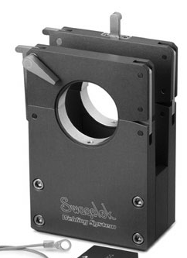
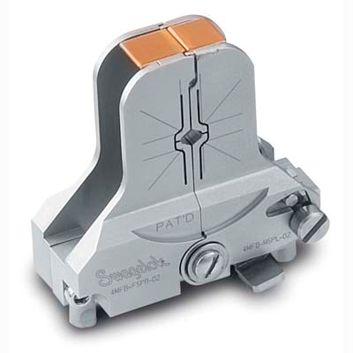
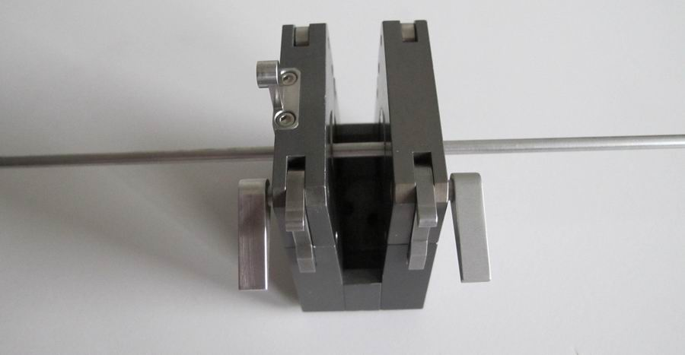
Fixtures used for the tests
“Standard” fixture with normal weld head
“Small” fixture with micro-weld head
“Standard” fixture with SS-pipe of 4mm OD

Slide 3
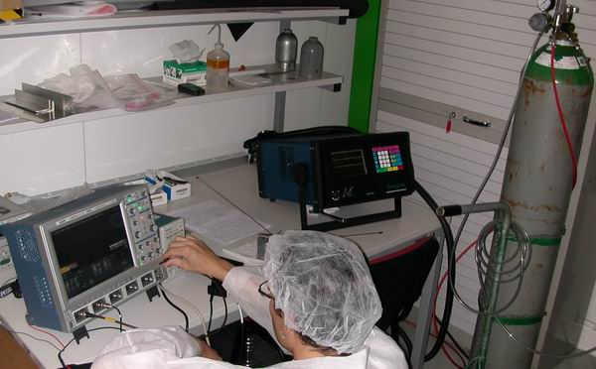
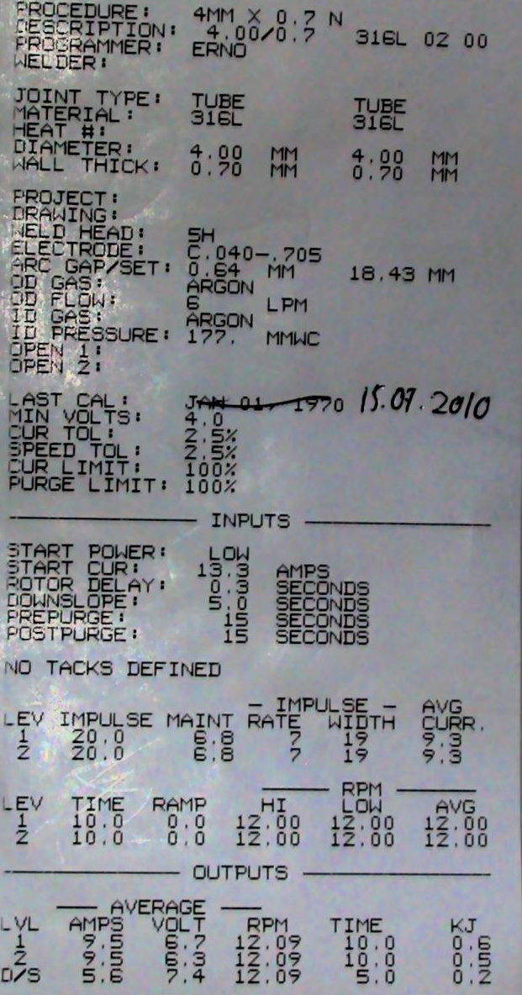
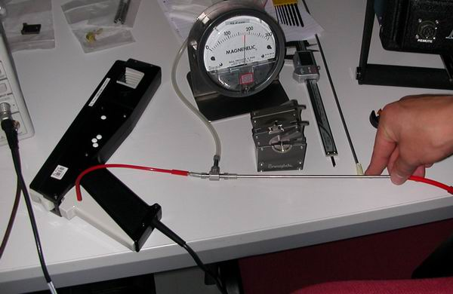
Few pictures of the set-up
Welding parameters

Slide 4
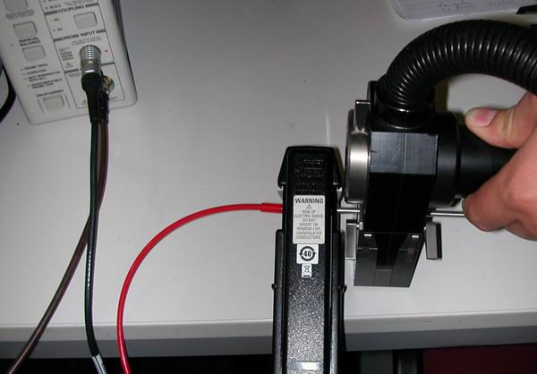
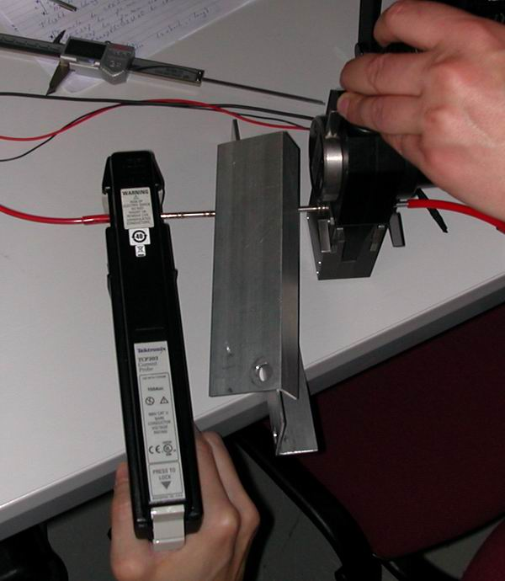
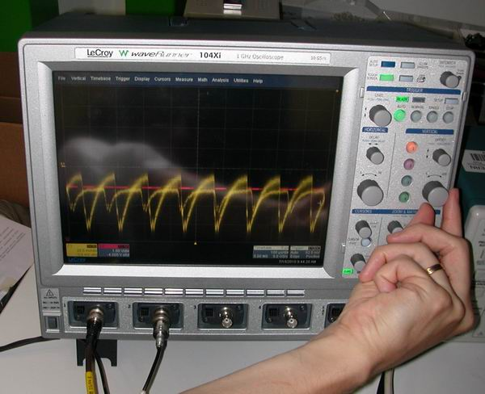
Few pictures during the measurements
Hall probe position

Slide 5
Test sequences - Standard Fixture
Test # | Purpose & Test condition | Comments
1 | 1st investigation to find a signal and frequency | Identified cyclic current peaks Amplitude: +/- 150 mA - Period: 150 µs
2 | Change acquisition time to have a larger view of the welding | Found about 0.3s before the welding cycles a huge current peak
3 | Current probe very close to collar setting 500mV/div | Huge peak out of scale
4 | Current probe very close to collar setting 1.5V/div (zoom) | The current peak is found at 25A and undershoot at 15A
5 | Current probe at ~10 cm from the welding head. | The current peak is found at 20A and undershoot at 10A
6 | Current probe at ~10cm from the welding head plus a Al shield in between | The current peak is found at 20A and undershoot at > 20A
7 | Current probe at ~ 15 cm and around the Ar exhaust plastic pipe | The current peak is found at 5A and undershoot at 15A
8 | Current probe far from the welding head at ~70cm | The current peak is found at 20A and undershoot at 20A
9 | Current probe far from welding head ~60cm and head far from the machine welder | The current peak is found at 14A and undershoot at 10A
10 | Same as before plus a copper mesh set around the pipe and connected to a GND | The current peak is found at 14A and undershoot at 10A

Slide 6
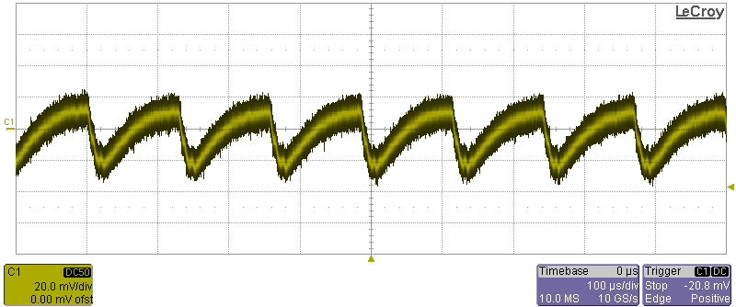
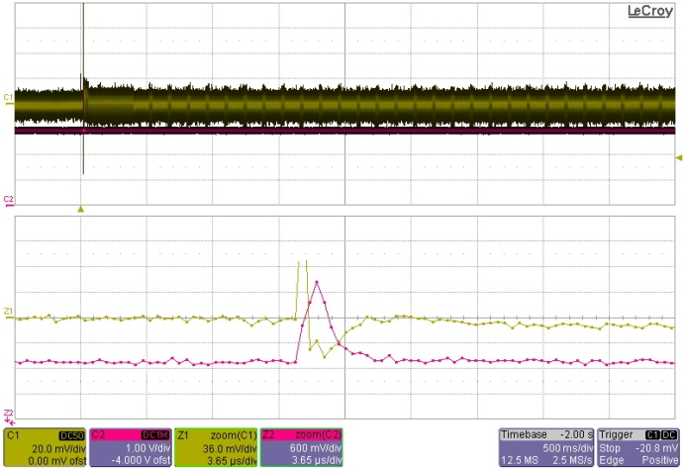
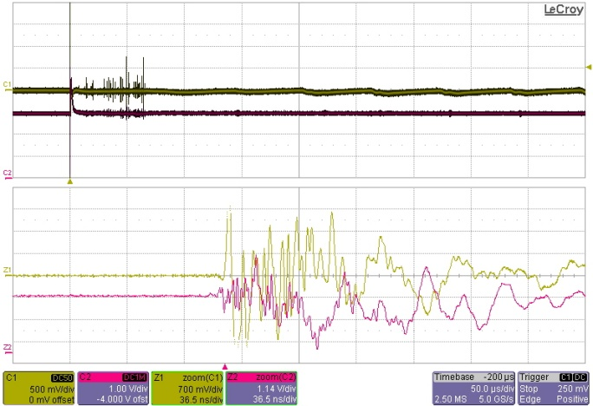
Test sequences –Scope Traces (Standard Fixture)
Test # | Scope Traces
1
2
3
+/- 150 mA
T cycle: 150 µs
Current probe trace (5A/V)
Hall probe trace

Slide 7
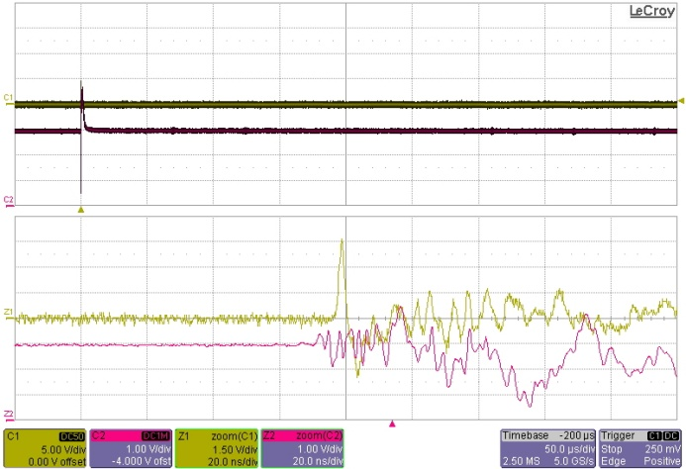
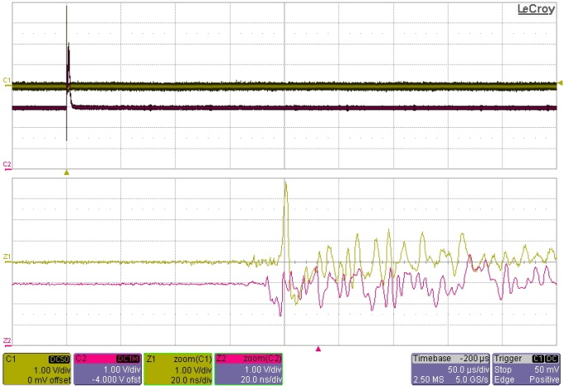
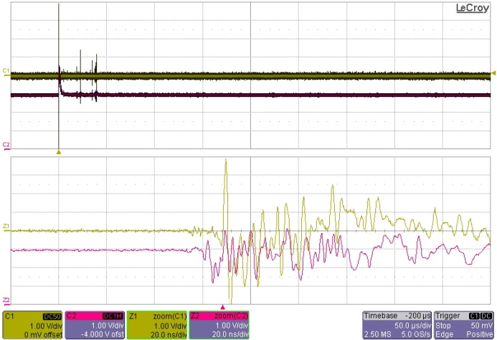
Test sequences –Scope Traces (Standard Fixture)
Test # | Scope Traces
4
5
6

Slide 8
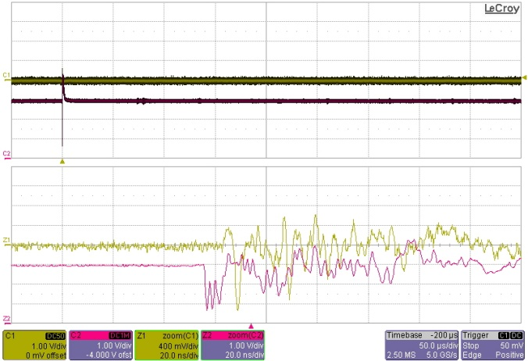
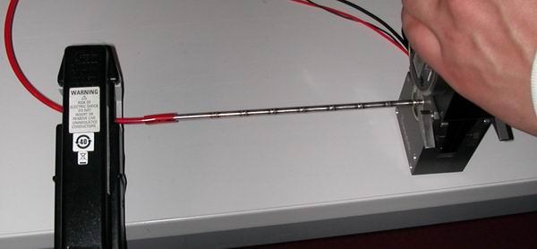
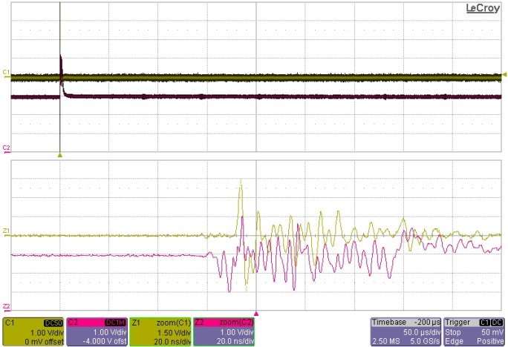
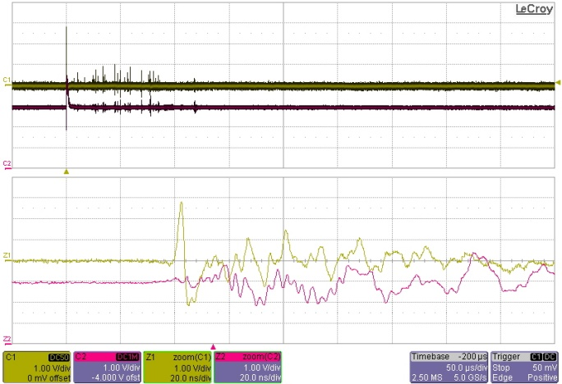
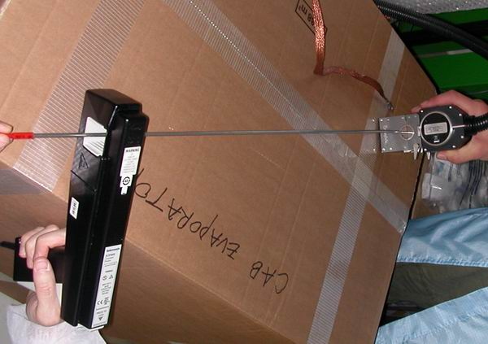
Test sequences –Scope Traces (Standard Fixture)
Test # | Scope Traces
7
8
9

Slide 9
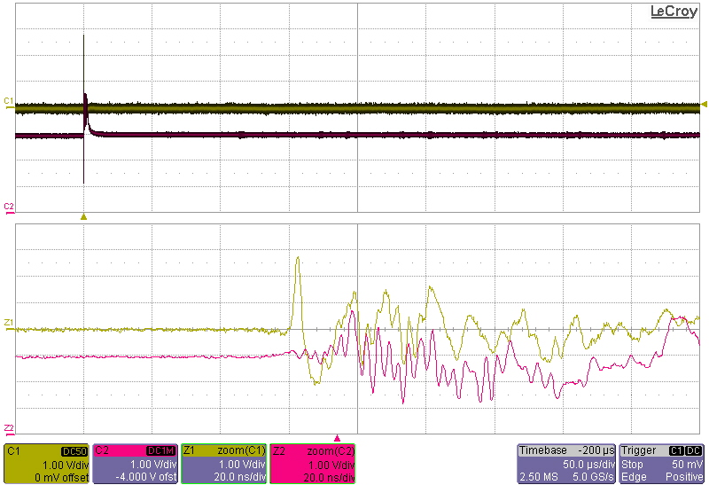
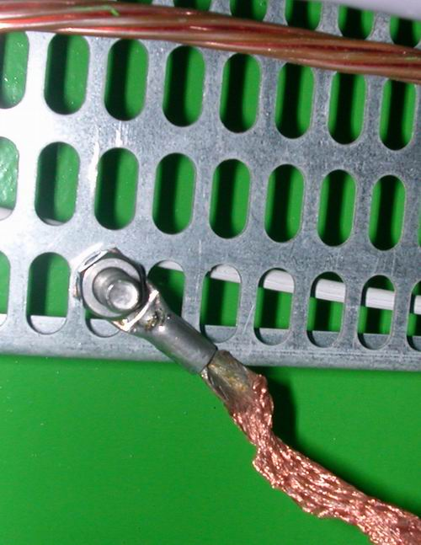
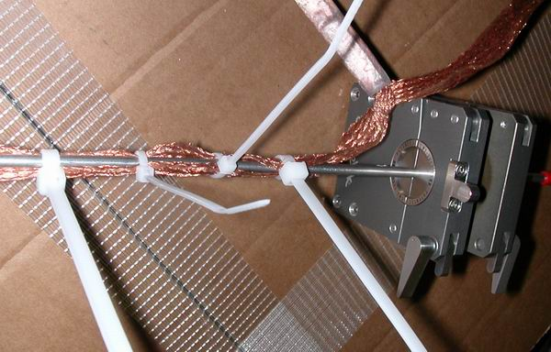
Test sequences –Scope Traces (Standard Fixture)
Test # | Scope Traces
10

Slide 10
Test sequences - Small Fixture and Micro-Weld Head
Test # | Purpose & Test condition | Comments
1 | 1st investigation to find a signal | Identified a current peak in the middle of the welding process possibly
2 | Trigger the scope on the start current. Probe at 10cm from the weld head | The current peak is found : 10A and undershoot : 13A
3 | Trigger the scope on the start current. Probe at ~50cm from the weld head | The current peak is found : 3A and undershoot : 3.5A
4 | Trigger the scope on the start current. Probe not around the pipe but just outside and at 10 cm from the weld head | The current peak is found : 4A and undershoot : 3A
5 | Trigger the scope on the start current. Probe far from the weld head and pipe. | Not trigger – No signal Trigger threshold: 100mA
6 | Scope probe now use to measure a voltage between 2 points on the pipe. 70mm between the probe and the return | 1st peak is negative: -85V Overshoot: +70V Suspect inductance in the probe cable!
7 | Scope probe. 4mm between the probe and the return | 1st peak is negative: -50V Overshoot: +40V
8 | Scope probe with coiled pipe of 3 loops: Probe and the return between the 2 ends of the coil | 1st peak is negative: -170V Overshoot: +140V Suspect inductance in the probe cable and in the loop that is now longer!

Slide 11
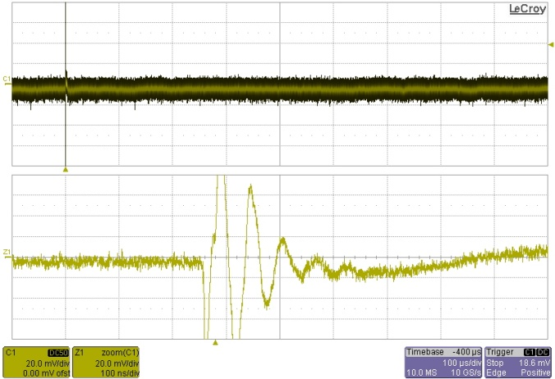
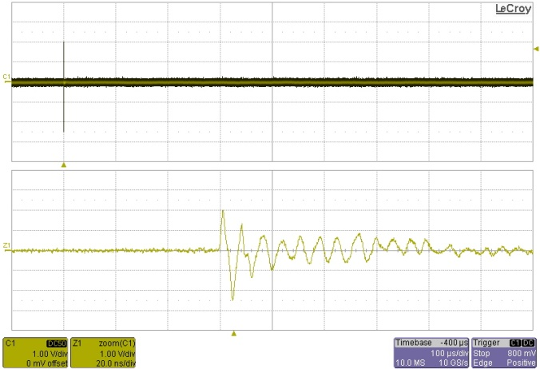
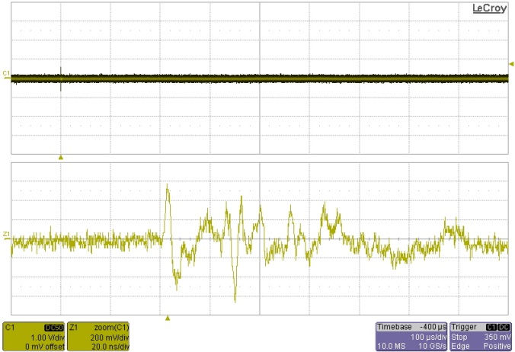
Test sequences –Scope Traces (Small Fixture)
Test # | Scope Traces
1
2
3

Slide 12
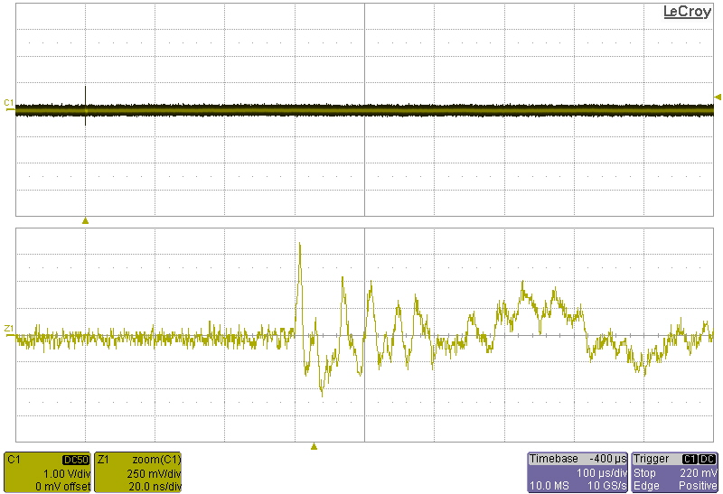
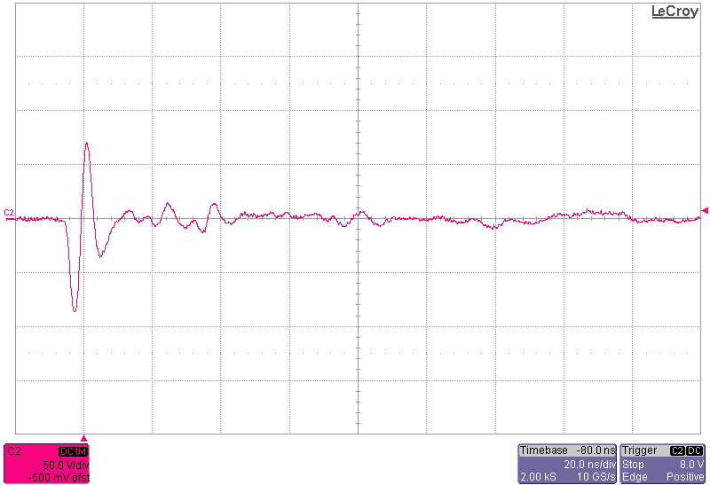
Test sequences –Scope Traces (Small Fixture)
Test # | Scope Traces
4
5 | No result since no signal found!
6
Scope probe

Slide 13
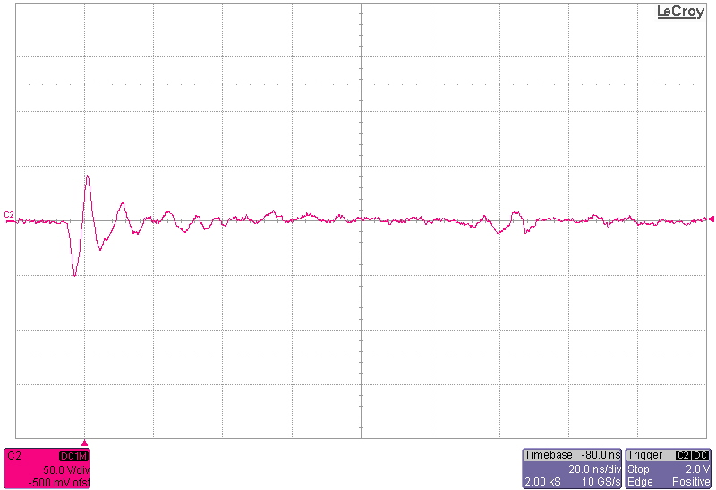
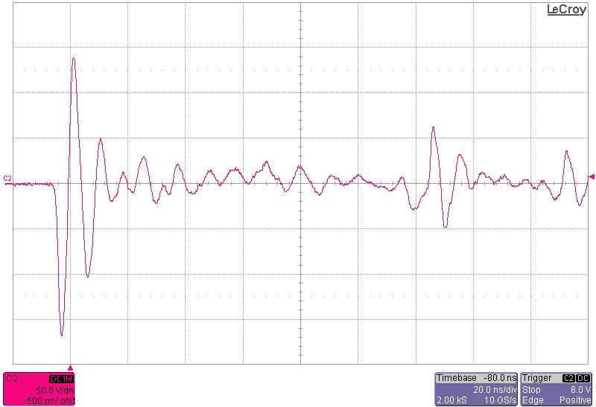
Test sequences –Scope Traces (Small Fixture)
Test # | Scope Traces
7
8

Slide 14
Test sequences - 3rd series of tests on August 10th
Test # | Purpose & Test condition | Comments
1.1 | Small Fixture – 4 mm Ti round 5mm from fixture | 2A current which is much smaller than the previous test
1.2 | Small Fixture – 4 mm Ti round 300mm from fixture | Did not trigger at 250mA
2.1 | Small Fixture – 4 mm Ti round 300 mm from fixture | Did not trigger at 250mA
2.2 | Small Fixture – 4 mm Ti round 50 mm from fixture | Peak seen at 0.5A inside 100ns
2.3 | Small Fixture – 4 mm Ti round 300 mm from fixture | Trigger threshold set at 50mA Peak seen at 0.35A
2.4 | Small Fixture – 4 mm SS, 0.7 mm wall 300 mm from fixture | Trigger threshold set at 50mA Did not trigger!
2.5 | Small Fixture – 4 mm SS, 0.7 mm wall 50 mm from fixture | Trigger threshold set at 50mA Peak seen at 0.4A
2.7 | Small Fixture – 4 mm SS, 0.7 mm wall 50 mm from fixture + New tungsten head | Trigger threshold set at 50mA Peak seen at 0.4A
Small fixture measurements could not reproduce what was measured the 1st time!

Slide 15
Test sequences - 3rd series of tests on August 10th
Test # | Purpose & Test condition | Comments
3.1 | Normal Fixture – 4 mm SS, 0.7 mm wall 50 mm from fixture – head at 0.64mm | Trigger threshold set at 250mA Did not trigger!
3.3 | Normal Fixture – 4 mm Ti round 50mm from fixture – Power socket changed | Trigger threshold set at 250mA Did not trigger!
3.4 | Normal Fixture – 4 mm Ti round 8 mm from fixture – head at 0.8mm | Trigger threshold set at 250mA Did not trigger!
3.5 | Normal Fixture – 4 mm Ti round 8 mm from fixture – head return lock loosely | Trigger threshold set at 250mA 1A current peak seen
3.7 | Change of welding param: Start power set to “normal” instead of “low” | Peak +: 1A Peak -: 1.75A
3.8 | Change of welding param: Start power set to “lowl” and start current set at 20A instead of 13.3A | Peak +: 0.5A Peak -: 1A
Normal fixture measurements could not reproduce what was measured the 1st time!

Slide 16
Summary
What have we learnt?
When something is measured the current pulse and undershoot can be as high as 25A and is happening inside 10ns during a power glitch.
Otherwise during the welding revolution and for ~20s there is a periodic current measure with up to 150mA peak and at a period of 150 µs.
When measuring the voltage across the pipe one measured a high induced voltage in the scope probe and as high as 320V peak to peak!
The 3rd series of tests were supposed to learn us more but were confusing
Unfortunately /fortunately all the measurements made with both fixtures did not show high current as the 1st times
Identification after discussion:
The glitches we measured are significant even if the current probe we used has a bandwidth of 15MHz (ok for rise time of ~20ns)
G. Blanchot from PH-ESE suspect a capacitive inductance link to the power cord of the welder
When the probe was left far from the pipe nothing was measured
One may now suspect that the long power supply cord of the head coming from the welder may have been laid differently at the 3rd series of test
Given what is said in 4) the pipe may work as an antenna
Can the glitch be more destructive than the small current pulses seen over the 20s?

Slide 17
Future
List of tests potentially interesting to investigate:
Use a current probe with higher bandwidth (100 MHz) like the TCP312. BUT possible only for pipe lower than 3.5mm OD
Orientation and positioning of probe has to be part of the future tests relative to the welder power cord
Use high bandwidth near field probes from ETS LINGREN (G. Blanchot agreed to lend us the equipment). Can measure H and E field within 3GHz bandwidth.
Use an amplifier with one of the input set to a long wire laid along the pipe or set in different positions.
Try to use FEI4 mounted on PCB and laid on top of the pipe during OW. Make full FE characterization after each series of tests.
Ideally it would be nice to have the OW machine at CERN or to make the investigation at Nikhef by local staff. It is estimated that many iterations are needed.
Input for discussion:
Test program can be long until one can certify that there is no risk to do OW with FEI4 modules in vicinity. 1 to 2 years investigation without any guaranty on the results!
As soon as something is wrong or destroyed it could certainly be a show stopper!
If everything goes fine what next to qualify?
Can an ageing be accelerated when doing a welding and how to evaluate it?
One think that the surrounding of the module/stave can change the conclusion and induce field that may be generated by the flex, the tape or the wings. Final qualification has to be done on a real stave. Is this conceivable?

Slide 18
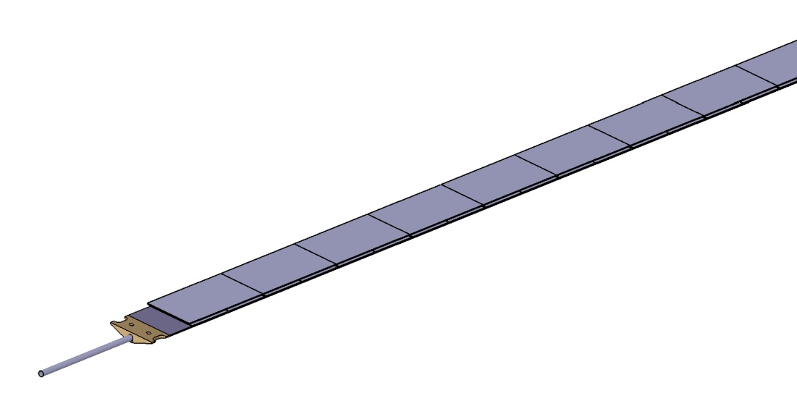
Implications
Stave design include todays 2 options:
Have the stave built with 7m long pipes (capillary on 1 side) and hold inside a long jig that will permanently be attached until the integration to the beam pipe. It require that there is no show stop all along the stave loading steps: loading, wire bonding, metrology, electrical testing, thermal cycling …
Have a reduce length to ~1.2 m stave and make the orbital welding just before or after the integration
UniGe has though that modular pipe could be an alternative:
Pro: Pipe may then be glued at the latest after the integration to the beam pipe
Cons: This is purely conceptual and it really needs some time for investigation to qualify the thermal performance, the material budget, …
CFRP
CFRP
Airex
Airex
PocoFoam
TPG

