Slide 1
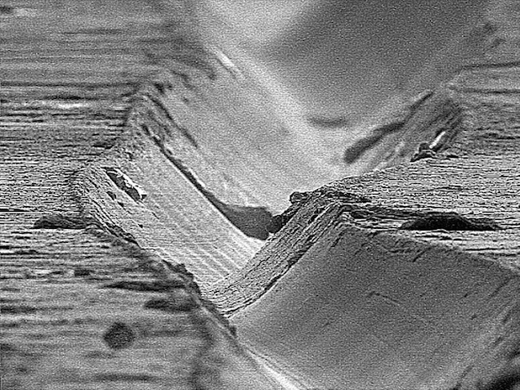
Synthèse Musicale
Anna Sfyrla (DPNC)
Module en cours
« Physique du quotidien »
Avril 2019

Slide 2
Contenu
Analyse musicale
Un peu de maths…
Synthèse musicale

Slide 3
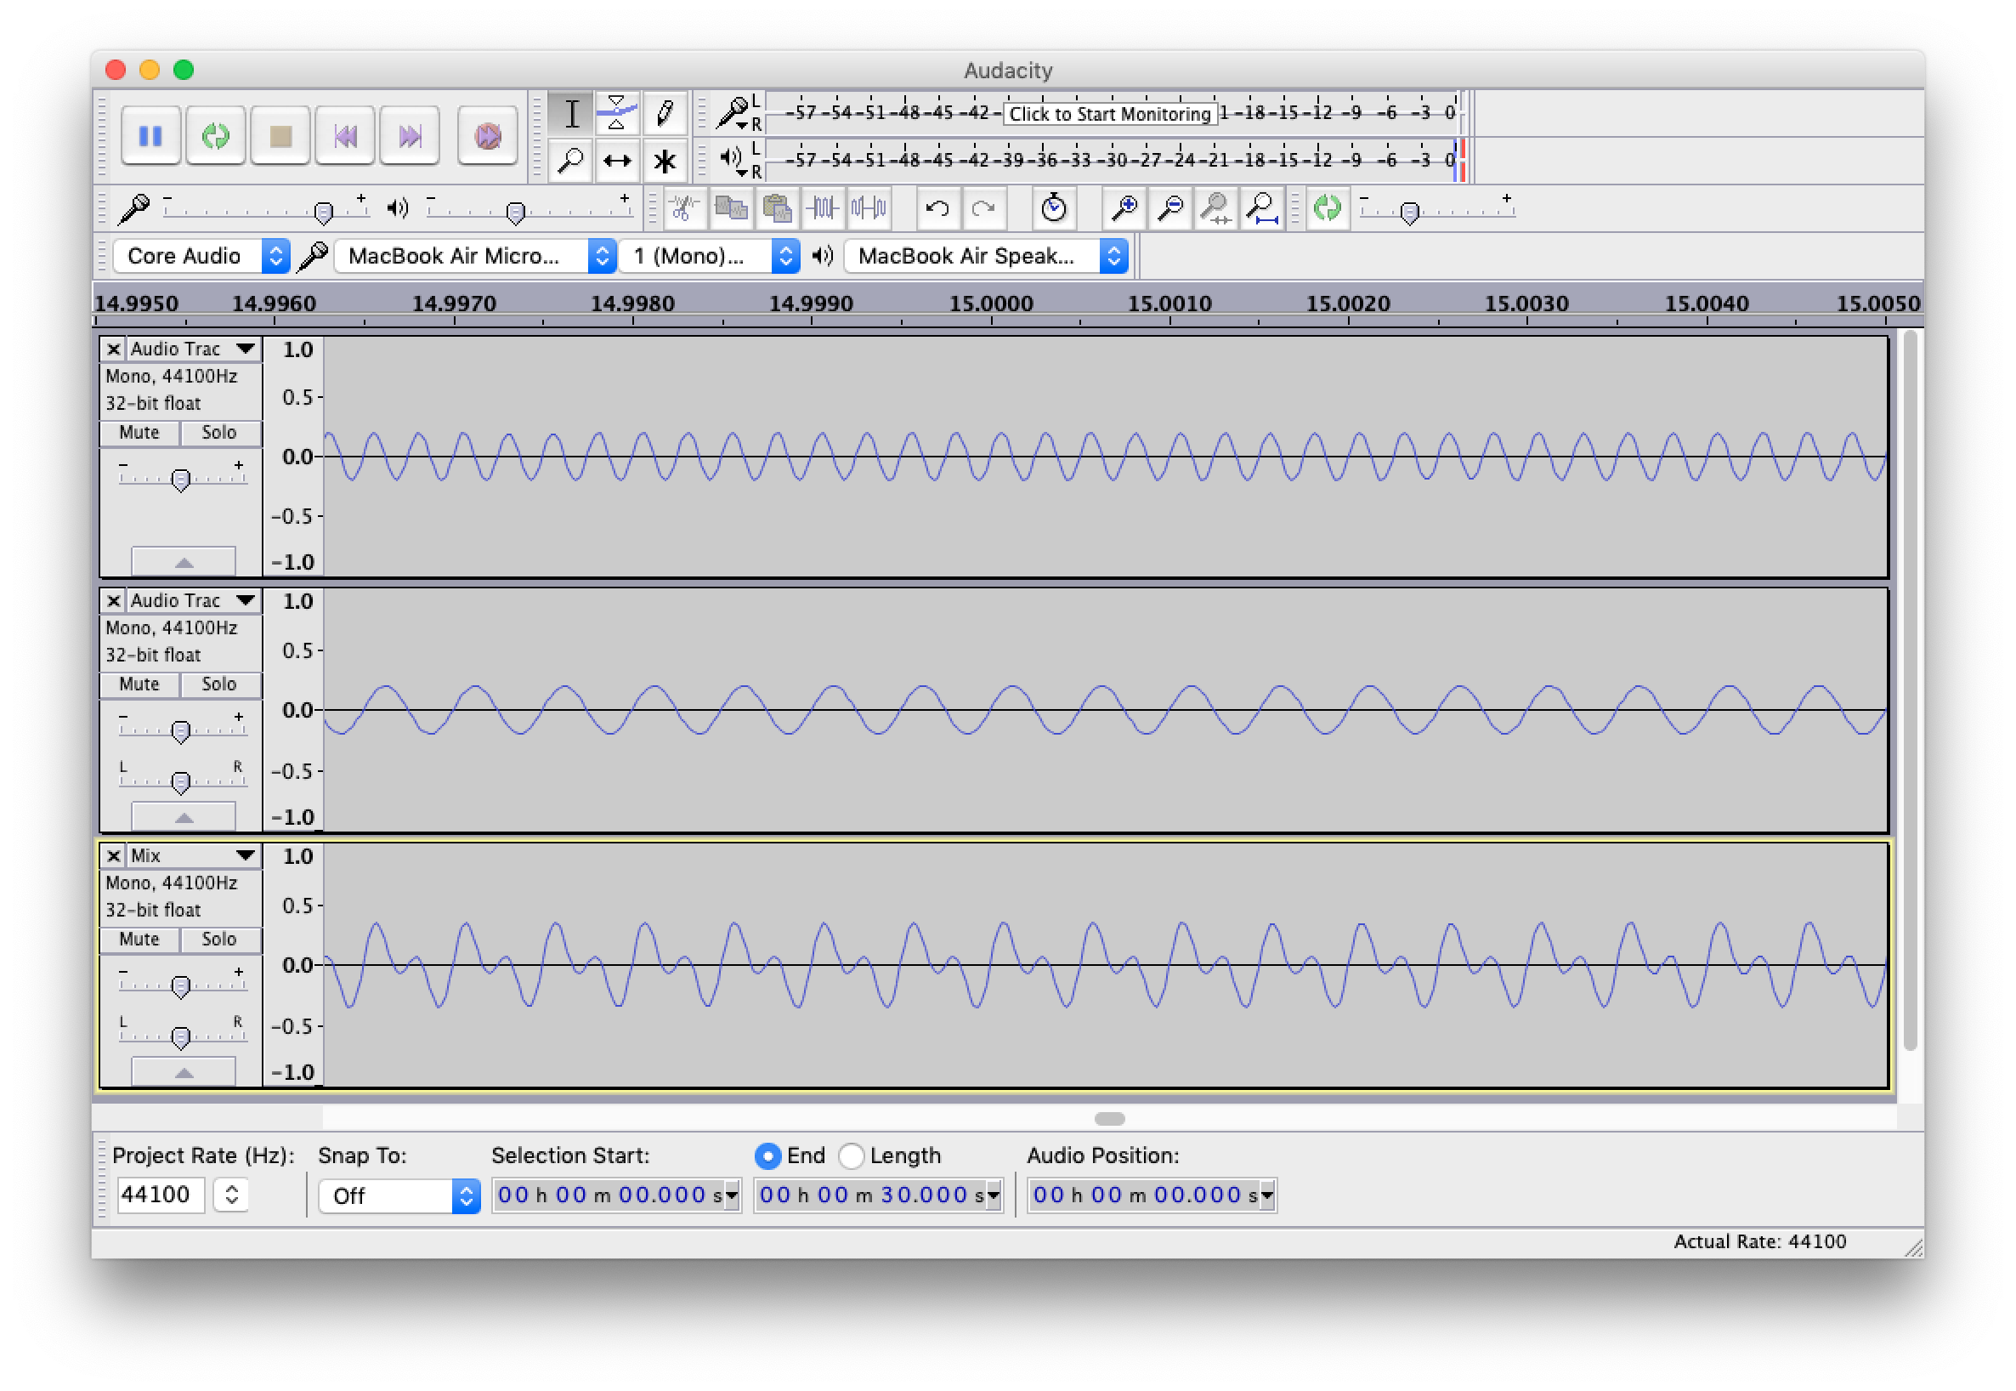
Ton de fréquence fixe

Slide 4
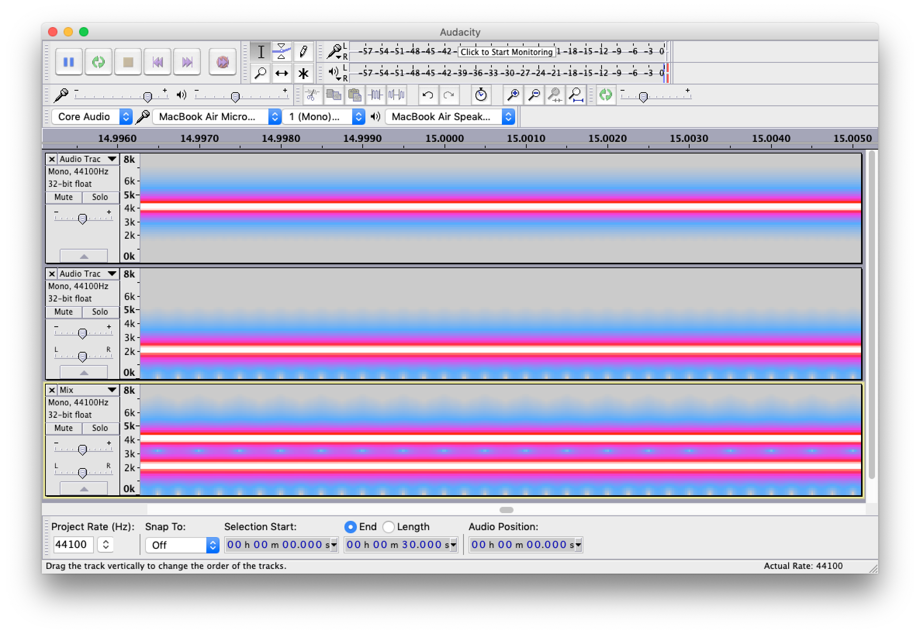
Ton de fréquence fixe

Slide 5
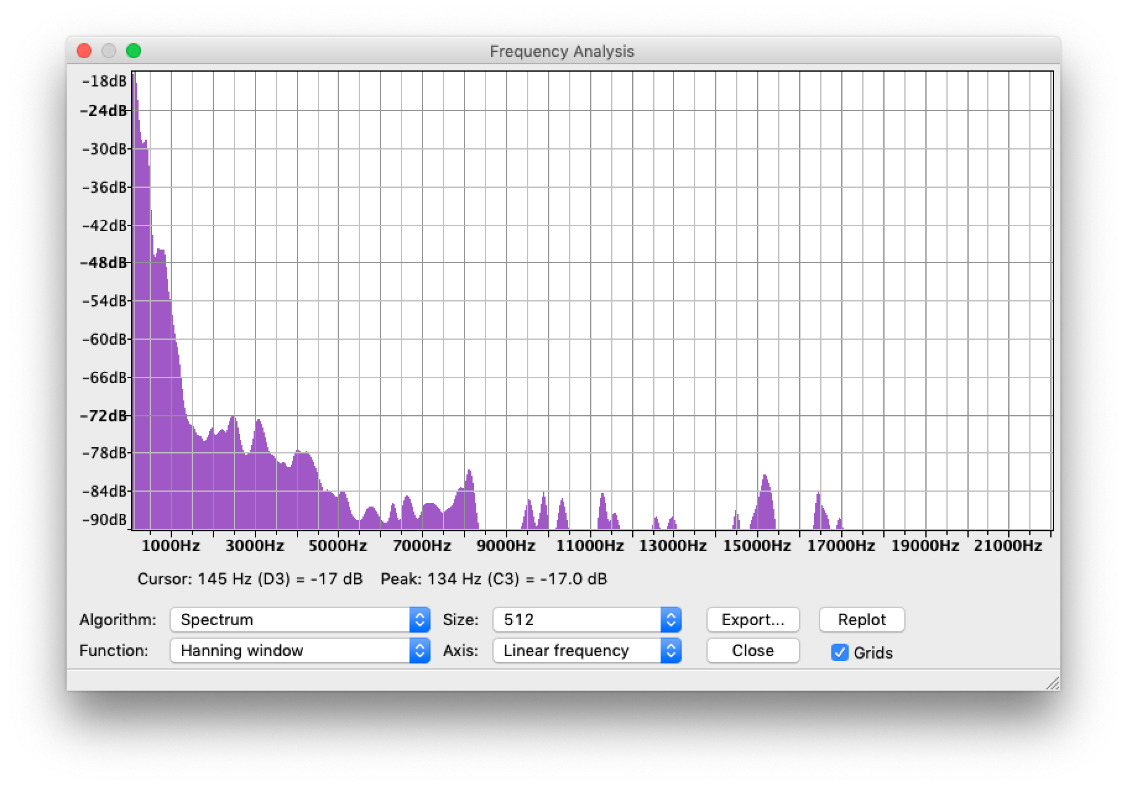
Voix humaine

Slide 6
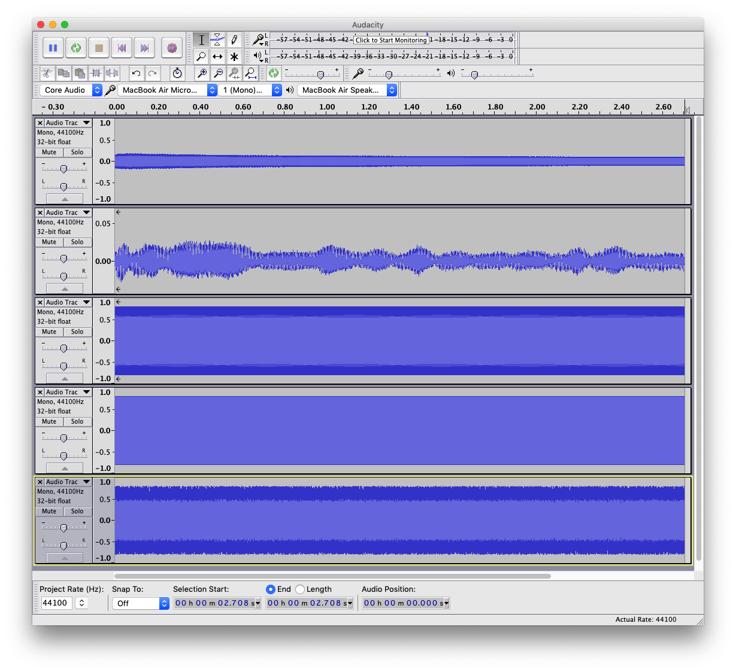
Diapason
Human voice
Sin wave
Square wave
Noise

Slide 7
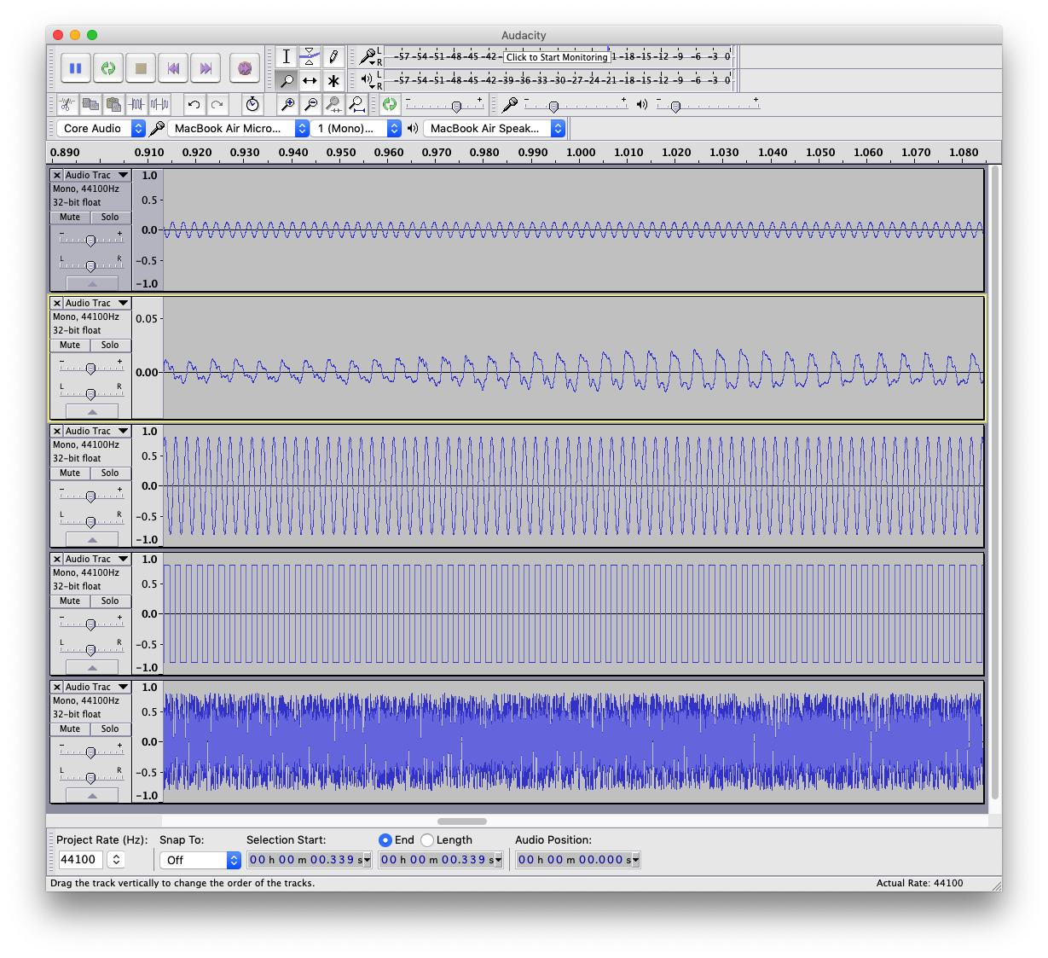
Zoom in
Diapason
Human voice
Sin wave
Square wave
Noise

Slide 8
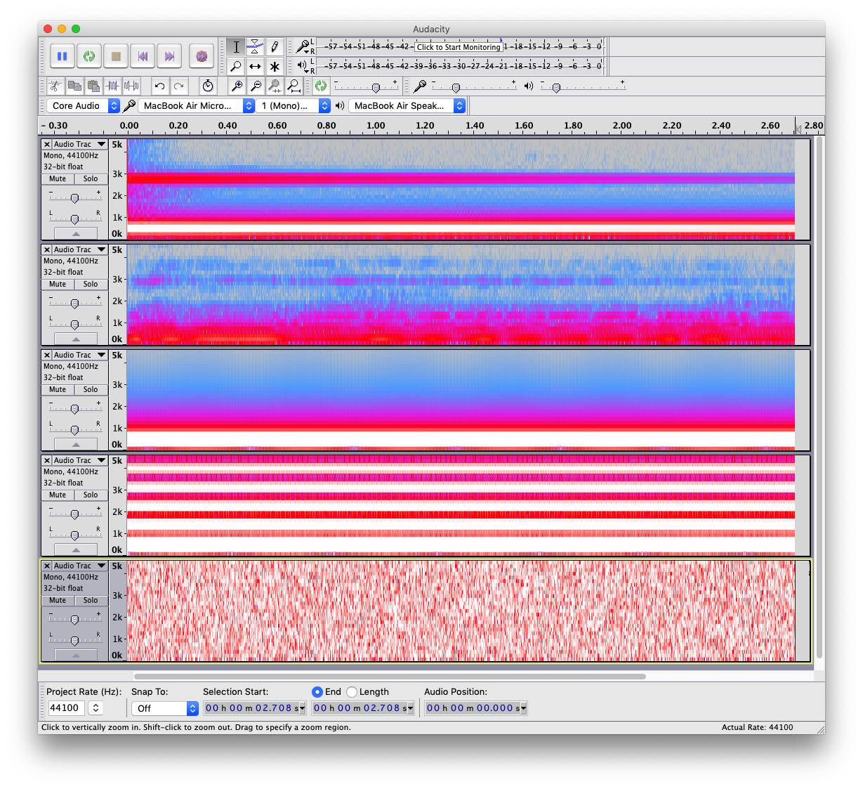
Diapason
Human voice
Sin wave
Square wave
Noise

Slide 9
Un peu de maths

Slide 10
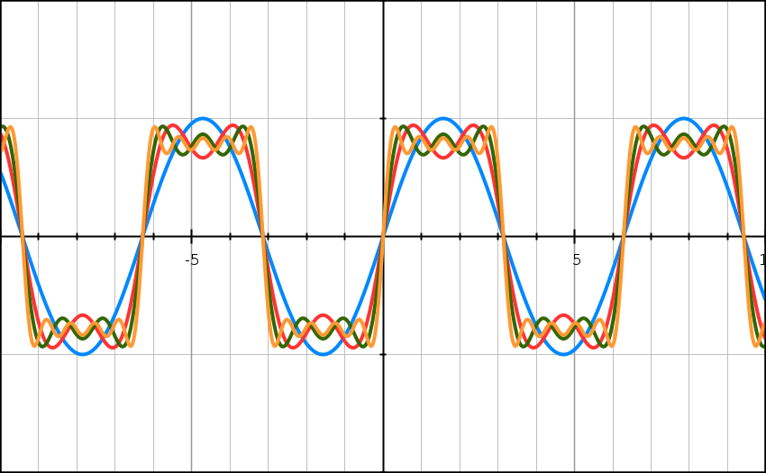
e.g. square wave
1 term
2 terms
3 terms
5 terms
https://graphsketch.com/

Slide 11
Applications FFT
En musique:
MP3 encoding
Filtering
Noise-gates in pre-amplifiers
Synthesizers
Electronic music
Ailleurs:
Antennes
GPS
Radars
Compression (e.g. JPEG)
Mais aussi en seismologie, beam dynamics, data processing, …

Slide 12
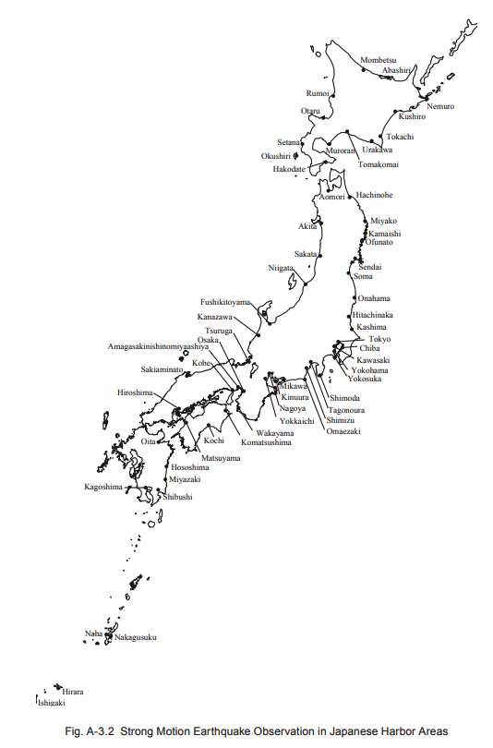
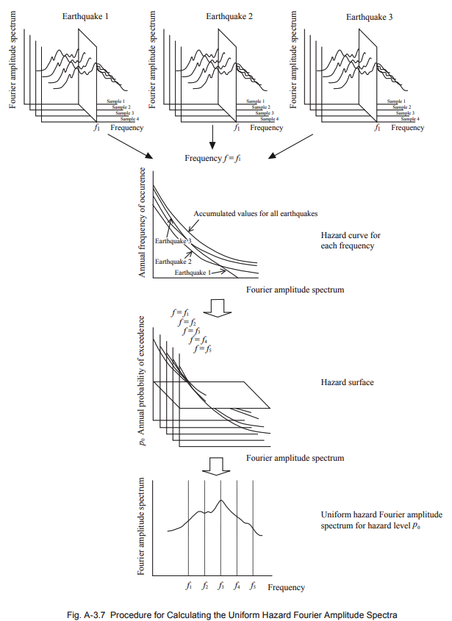
Seismologie
http://ocdi.or.jp/tec_st/tec_pdf/tech_235_270.pdf

Slide 13
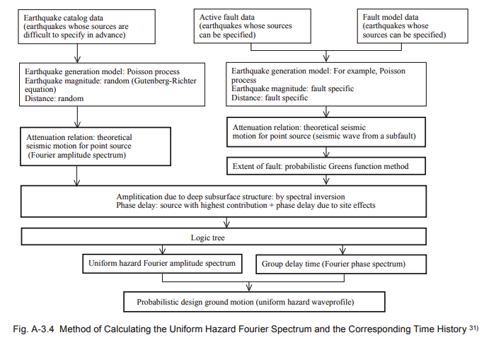
Seismologie
http://ocdi.or.jp/tec_st/tec_pdf/tech_235_270.pdf

Slide 14
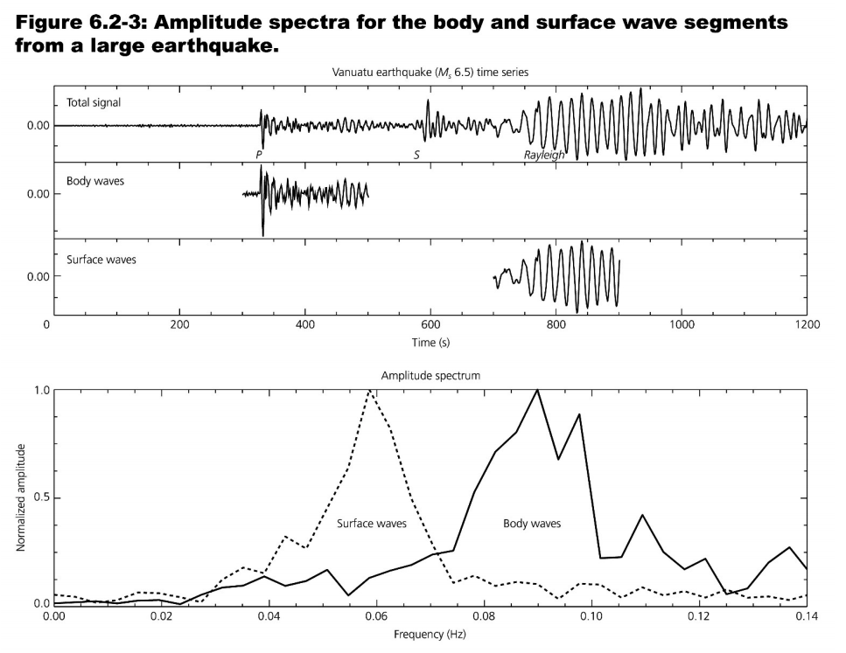
Seismologie
https://www.geophysik.uni-muenchen.de/~fbernauer/teaching/Spektralanalyse/Spektralanalyse02.pdf

Slide 15
Beam Dynamics
http://dpnc.unige.ch/seminaire/talks/steerenberg.pptx

Slide 16
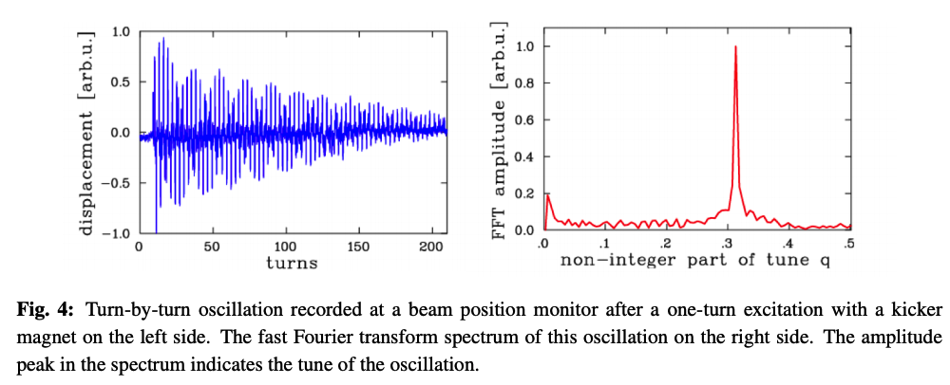
Beam Dynamics
https://cds.cern.ch/record/2206741/files/arXiv:1608.02449.pdf

Slide 17
Le timbre

Slide 18
Synthese musicale

Slide 19
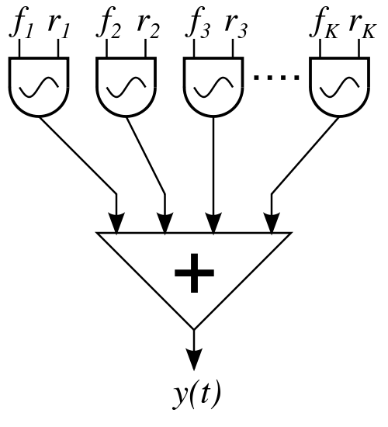
Basic components
Sound waves: oscillators of various forms
Sine
Square
Sawtooth
Triangle
Frequency
Pitch
f: frequency; r: amplitude

Slide 20
e.g. square wave
1 term
2 terms
3 terms
5 terms

Slide 21
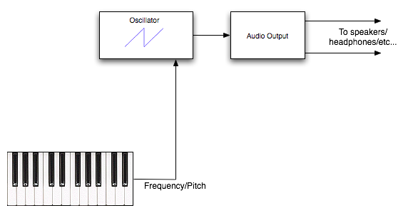
Synthesizer
http://beausievers.com/synth/synthbasics/

Slide 22
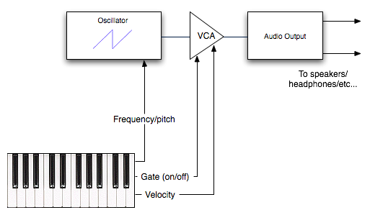
Volume control
VCA: Voltage Controlled Amplifier
http://beausievers.com/synth/synthbasics/

Slide 23
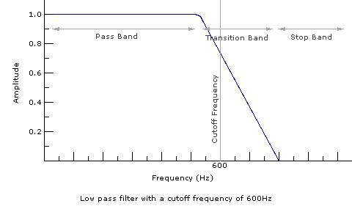
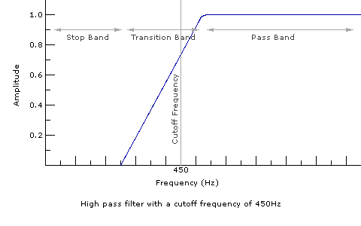
Filters
http://beausievers.com/synth/synthbasics/

Slide 24
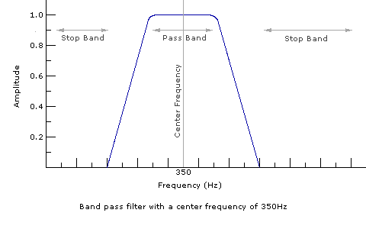
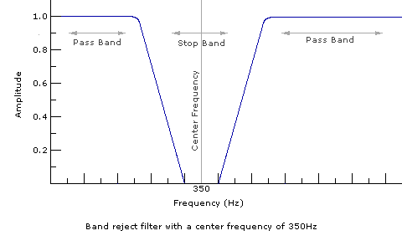
Band filters
http://beausievers.com/synth/synthbasics/

Slide 25
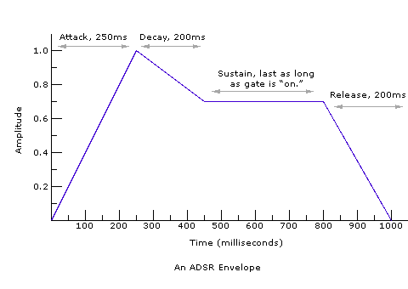
Envelope generators
Signal controls
(Attack, Decay, Sustain, and Release)

Slide 26
Low frequency oscillators
To create “advanced” effects, such as “tremolo”

Slide 27
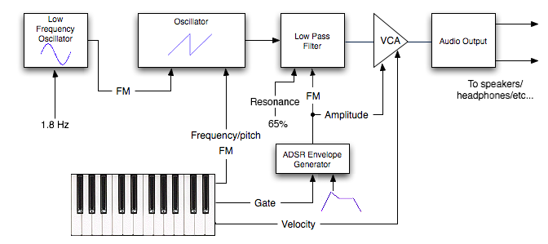

Slide 28
Fourier synthesizer: build by yourself a square wave!
1 term
2 terms
3 terms
5 terms

