Slide 1
NA61 Readout Upgrade based on the DRS

Slide 2
Overview
DRS initially proposed as replacement for ToF readout
DRS ~= sampling ADC ~= 5 GHz waveform digitizer
very flexible readout system, originally designed for very fast signals like PMTs,
but can be used for a variety of detectors and applications
DRS can be used to upgrade the readout of different NA61 subsystems:
ToF (add multihit capabilities … )
PSD (analysis of waveforms … )
“beam” (not all beam counters readout with TDCs, add multihit …)
BPD (add timing information to beam tracks ~ Δt ~ 10 nsec …)
i.e. replace all old electronics
combine discriminator (CFD), ADC (multihit !), and TDC (multihit !) in a single module
i.e. remove CFDs, splitters, TDCs, ADCS, …
add multihit capabilities

Slide 3
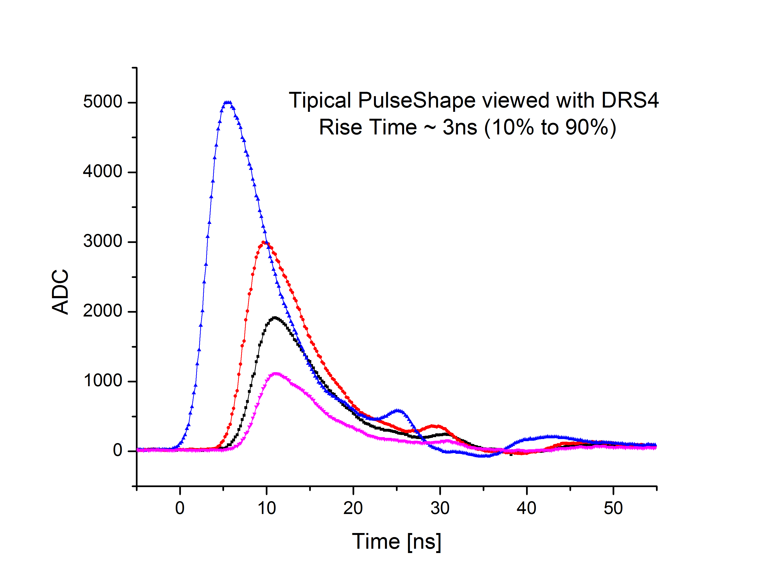
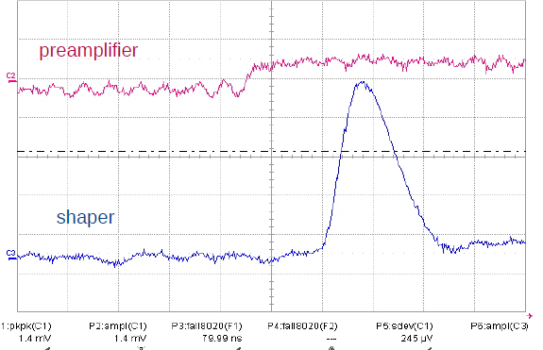
Waveforms
ToF-L signals
BPD signlas
FWHM ~ 120 ns
-> slow digitization
risetime ~ 3 ns
-> fast digitization

Slide 4
How to Measure Best Timing (1)
basically two options:
1. (CF) discriminator + multihit TDC
2. waveforme digitizer (flash ADC + FPGA)
the waveforme approach combines different functionalities with no D.T.:
discriminator, multi-hit TDC, Q-ADC, peak-sensing ADC, etc.
PROBLEM : 10(0) ps resolution requires very high sampling rate > 1 GHz
Si-PM
amplifier ~10x
discriminator
(const fract)
multihit TDC
25 ps res.
optical link
10 kHz readout
deep buffer
~ 25 bit encoding
flash ADC
< 1 GHz
10 -12 bit
amplifier ~10x
FPGA
same frequency
Si-PM
optical link
continuous readout
CFD algorithm
(real time)

Slide 5
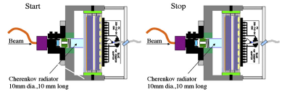
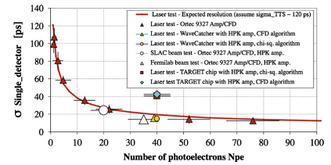
How To Measure Best Timing (2)
simulation of MCP PMT
with realistic noise and best discriminators
Beam measurements
@ SLAC and FNAL
J.-F. Genat et al., NIM A607 (2009) 386
D. Breton et al., NIM A629 (2011) 123
17 ps (σ) can be achieved with waveform digitizing and 40 photoelectrons

Slide 6
Digital Constant Fraction Discriminator
Delayed
signal
simpler CFD version
Inverted
signal
¼ max ampli
Sum
t
Clock
200 ps sampling
without doing nothing
-> 200 ps / sqrt(12) ~ 60 ps
with interpolation
expect 5 x better
performance
12 bit
Latch
Latch
Latch
Latch
+
Latch
Latch
Σ
+
<0
&
MULT
≥0

Slide 7
DRS “Philosophy”
based on a circular capacitor array (1024 caps per channel), 12 bit resolution
sampling frequency 5 GHz (200 ps) → ~ 500 MHz (2 ns)
buffer depth 200 ns → ~ 2 μs
several channels (up to 16) can be daisy chained → 30 μs buffer depth
waveform stretcher
~ GHz sampling → 30 MHz conversion → 30 kHz readout (30 μs dead time)
needs frequent “re”calibration in time and energy + synchronization
switch
diff. driver
DRS4
trigger
FPGA
DRS
AD9222
12 bit
65 MHz
analog front end
global trigger bus
E. cal
ch. 9
LVDS
8 + 1 ch.
parallel
or serial ?
sinus wave
continuous T calibration and synchro

Slide 8
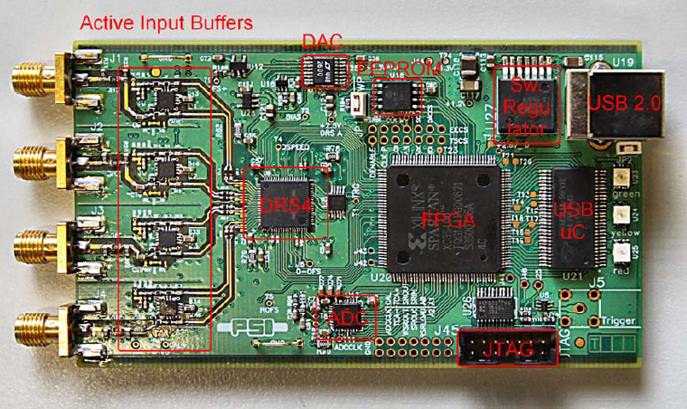
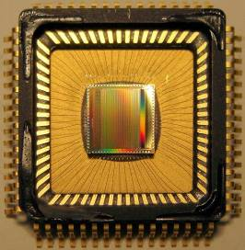
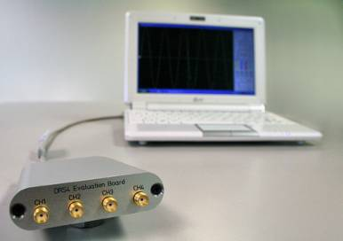
DRS4 @ PSI http://drs.web.psi.ch
S. Ritt
DRS4 Evaluation Board
4 channels
1-5 GSPS
12 bit
USB power

Slide 9
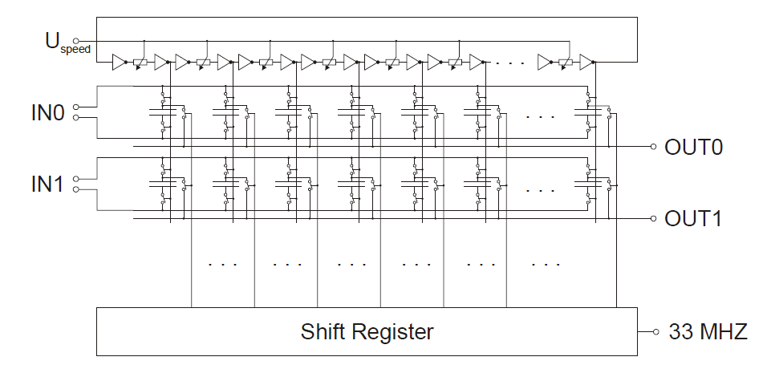
“Time stretcher” GHz → MHz

Slide 10
Switched Capacitor Array
0.2 - 2 ns
Inverter “Domino” ring chain
IN
Waveform
stored
Out
FADC
33 MHz
Clock
Shift Register
“Time stretcher” GHz → MHz

Slide 11
DRS Functional Block Diagram
REFERENCE CLOCK
CONTROLS
IN
8 + 1 ch
OUT

Slide 12
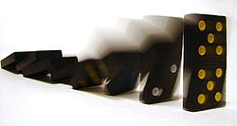
Domino Wave Circuit (Digital Delay Line)
once the domino wave starts,
It continues indefinitely

Slide 13
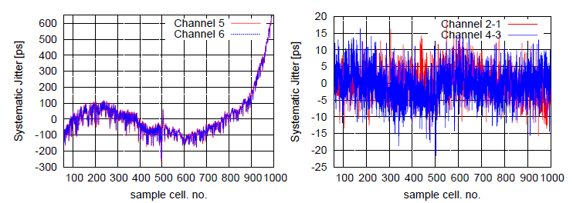
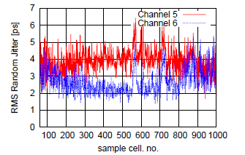
DRS Linearity
based on DRS 3
need accurate calibration
better if continous (ch. 9)
after “calibration”

Slide 14
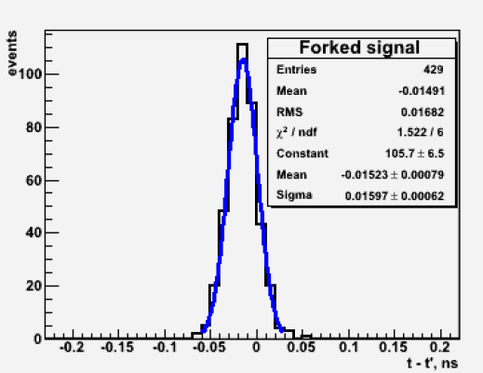
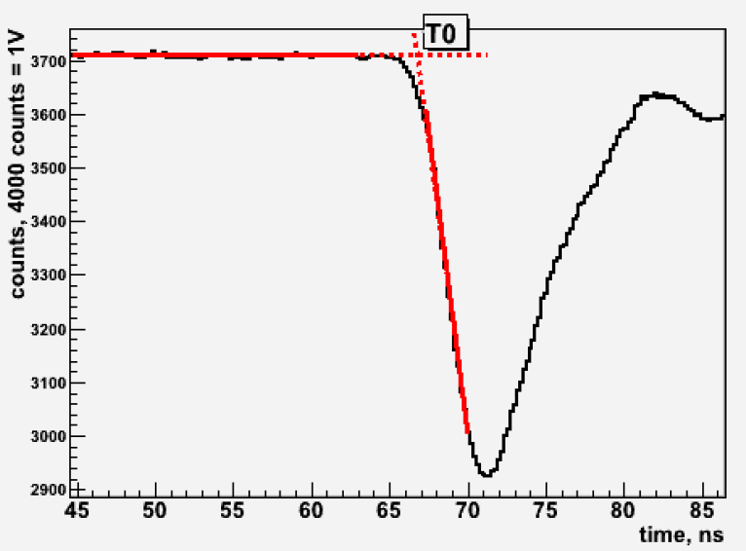
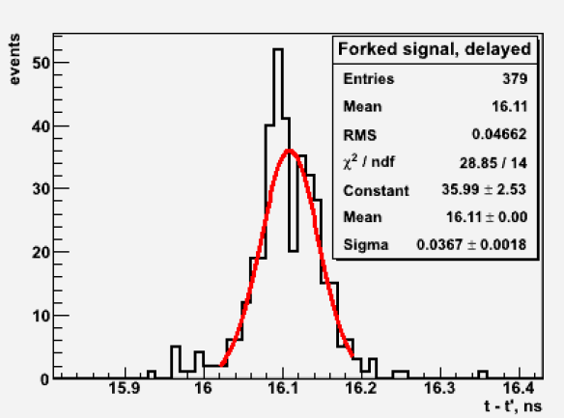
Performance – A detector
2011 studies in 2011 : Sasha, Oleg, Slava
same split signal
no delay
~ 15 ps
with delay
~ 35 ps
difference understood :
additional DRS time calibration required

Slide 15
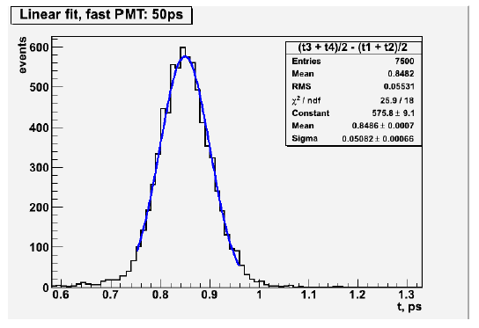
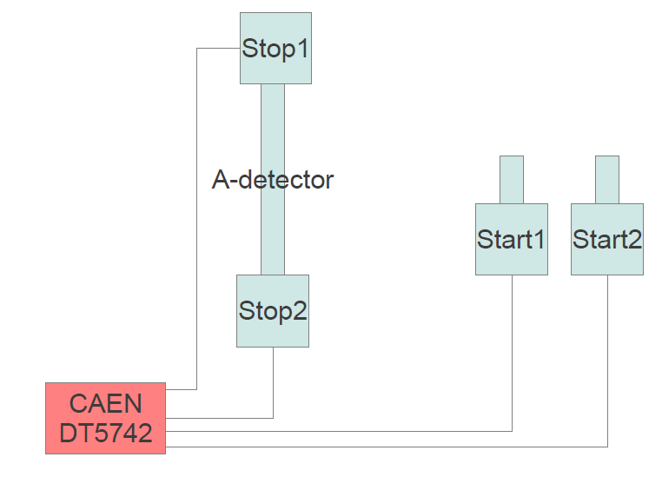
Performance – A Detector
~ 50 ps
~ 35 ps with improved algorithm

Slide 16
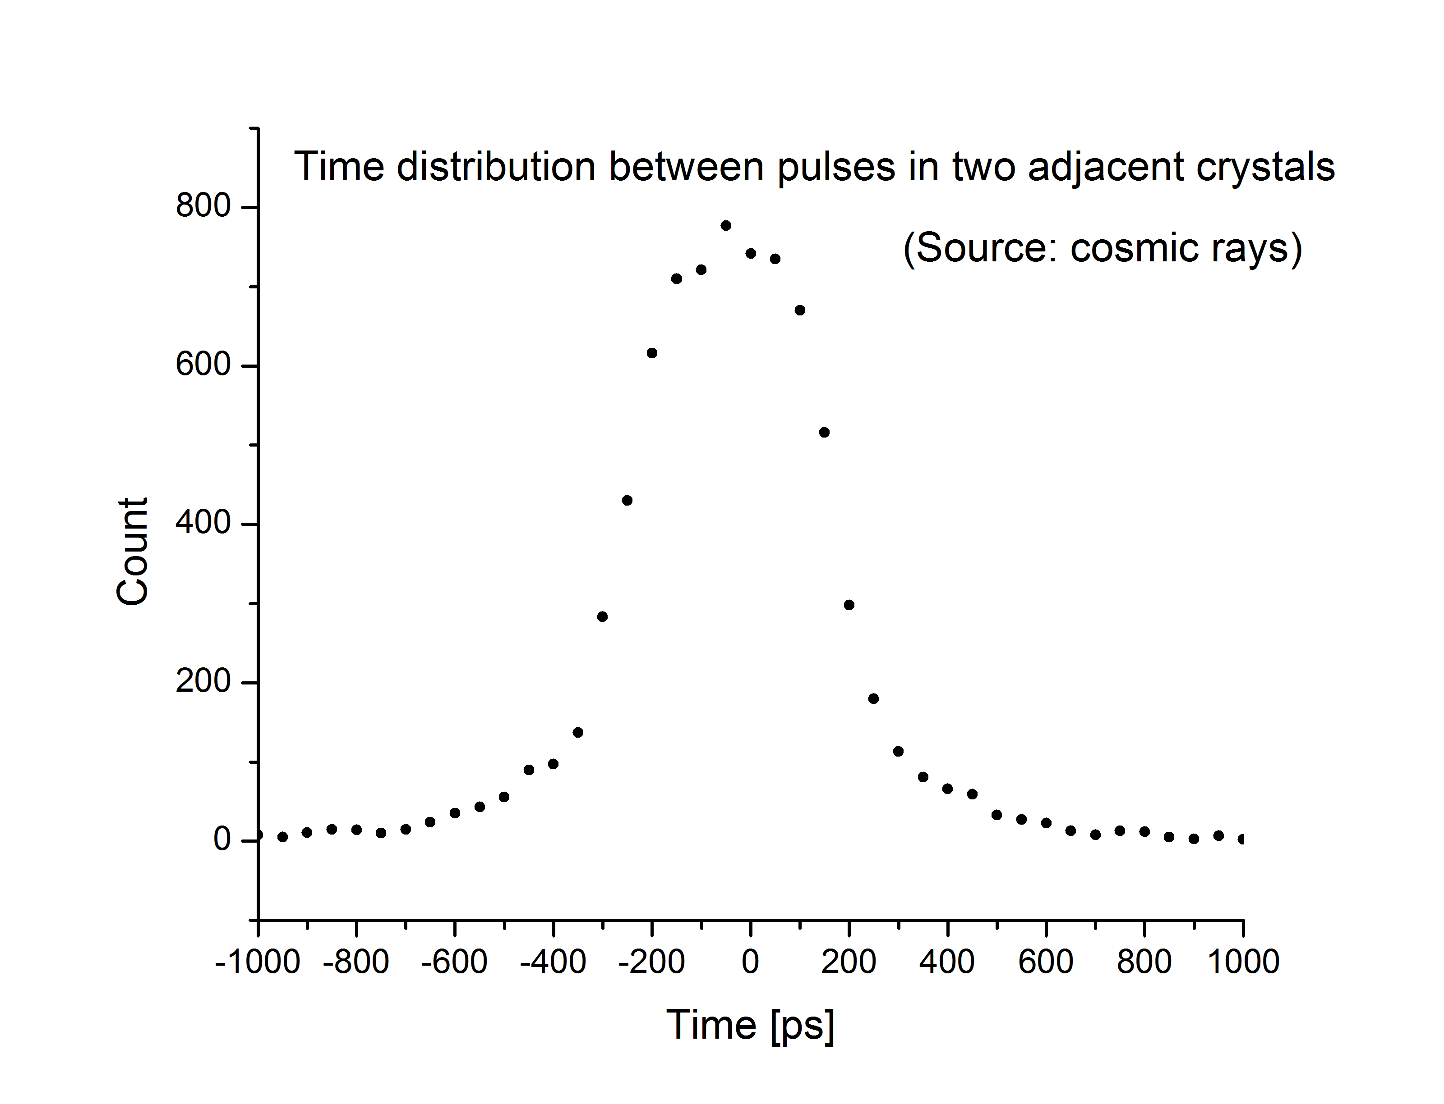
Performance – ToF/L-R
rest with cosmic muons
result not so good
however:
intrinsic DRS resolution
discriminator (algorithm)
detector

Slide 17
Performance tests
Plan extensive tests of the DRS system over the next two months
in particular
NA61 beam line with S1 (4 PMT’s,) + S2 + S4 (parasitically)
using available PSI test boards and CAEN modules
use several chips / boards -> synchronization of chips
Everybody welcome to join !

Slide 18
Conceptual Layout (1)
DRS mother board (9U format)
DRS board
16 x in
serial
data collector
16 x in
DDL
FPGA
16 x IN
16 x in
OUT
serial
16 x in
clock
trigger
read
clear
busy
4 DDL links
define readout protocol
(DRS board → data collector)
flexible enough for other applications

Slide 19
Conceptual Layout (2)
calibration
1 Mbit
DAC
FPGA
kintex 7
calib
control
control
DRS4
AD9222
8 ch ADC
33 MHz
12 bit
trigger
read
……..
8 x in
sinus wave
clock ch 9
ch 9
clock
trigger
1 ch ADC
serial out
1 Gbit / s
x 2 (16 + 2 ch)
EPROM

Slide 20
Overall structure
tentative design : 16 channels / DRS board board = 16 ch
64 channels / DRS mother board
ToF-L + ToF-F(L) (56 + 5 boards @ 5 GHz) DDL
ToF-R + ToF-F(R) (56 + 5 boards @ 5 GHz) DDL
PSD (28 boards @ 1 GHz) DDL
BPD (9 boards @ 0.5 GHz)
DDL
Beam (2 boards @ 5 GHz)
Beam (scalers, registers) VME
~ 2600 channels + spares
combine discriminator (CFD), ADC (multihit !), and TDC (multihit !) in a single module
i.e. remove CFDs, splitters, TDCs, ADCS, …
add multihit capabilities

Slide 21
Location of DRS electronics
close to detectors or counting house ?
everything depends on trigger latency !
NOW : common start DRS : common stop
inside : remove cable delays, ??? ns
add trigger distribution, ??? ns
very likely not enough time to locate DRS electronics close to ToF
outside : delay trigger by ~ 200 ns
use more selective trigger than S1 (i.e. the FS already available)
to reduce data rate, read out only first 100 ns
S1
S1
ToF gate ~ 100 ns
ToF gate ~ 200 ns

Slide 22
Proposal (work in progress)
Prepare DAQ readout upgrade proposal based on the DRS by next coll. meeting,
i.e. < 08.10.12 ! (if we agree to continue in this direction …)
[everybody is welcome and encouraged to contribute]
0. motivation / justification
1. conceptual design
(don’t need to work out details at this stage, i.e. how the clocks will be distributed, …)
2. implementation plan
3. implications for DAQ
4. costing (current ~100 CHF / ch, ~ 5k CHF / board, ~ 300 kCHF overall)
5. resources (human)
6. time scale
development (hardware, firmware, software) and production
installation and commissioning
7. backup plan
The system must be ready by 01.07.14 (restart of SPS)
(i.e. installed, tested, debugged, … w/o beam)

Slide 23
Resources Required
1 engineer (1 FTE x 1.5 y) to develop DRS boards
(hardware and firmware)
1 engineer (1 FTE x 0.75 y) to develop DRS mother boards and DDL link
(hardware and firmware)
1 engineers / physicists (1 FTE x 1 y) to develop FPGA algos
(baseline subtraction and zero suppression, data encoding, synchronization …)
1 physicist (1FTEx 1 y) to develop calibration procedures and FPGA algos
(T and E calibration, waveform processing, …)
1 physicist (1 FTE x 1 y) DAQ modifications (i.e. include DRS)
1 physicist (1 FTE x 1 y) DAQ upgrade (i.e. prepare for vertex detector, etc.)
1 physicist (1 FTE x 0.5 y) VME readout
2 physicist (1 FTE x 1.5 y) offline / online modifications
(decoding, waveform processing, calibrations, QA, …)
TOTAL 10 FTEs x 1 y (or 5 FTEs x 2 y)

Slide 24
Resources Required (2)
1 engineer (1 FTE x 1.5 y) to develop DRS boards
(hardware and firmware)
S. Debieux and D. LaMarra (UniGE)
1 engineer (1 FTE x 0.75 y) to develop DRS mother boards and DDL link
(hardware and firmware)
T. Kiss (Budapest) ???
1 engineers / physicists (1 FTE x 1 y) to develop FPGA algos
(baseline subtraction and zero suppression, data encoding, synchronization …)
T. Tolyhi (Budapest) ???
1 physicist (1 FTE x 1 y) to develop calibration procedures and FPGA algos
(T and E calibration, waveform processing …)
E. Kaptur (UniSilesia) + 0.5 FTE (>= PostDoc) ???
1 physicist (1 FTE x 1 y) DAQ modifications
(i.e. include DRS in DAQ stream) Andras + ???
1 physicist (1 FTE x 1 y) DAQ upgrade
(i.e. prepare for vertex detector, etc.) Andras + ???
1 physicist (1 FTE x 0.5 y) VME readout ???

Slide 25
Timelines
Ready by June 2014
All debugging and commissioning w/o beam completed by June 2014
Dec 2012
study DRS performance (time resolution)
complete specifications (incl. detector interfaces and cabling)
start building prototype (full chain : DRS -> DDL -> PC) -> March ‘13
full implementation plan
explore implications for DAQ
explore implications for analysis
March 2013
complet prototype (full chain : DRS -> DDL -> PC)
start debugging prototype -> Sept ‘13
start developping waveform analysis (offline) -> March ‘14
June 2013
debug prototype -> Sept ‘13
finalize design
basic firmware (data transfer, DRS and ADC controls, calibrations)
start developping calibration algorithms -> June ‘14
plan DAQ modifications
start preparing for installation / backward compatibility -> June ‘14

Slide 26
Timelines (2)
Sept 2013
external review
NA61 final decision
full working system with several DDL links
version 2 prototype
start developping data encoding and filtering (firmware) -> June ‘14
start developping calibration algorithms (firmware) -> June ‘14
start DAQ implementaiton -> June ‘14
Dec 2013
full funding available
complete DRS boards debugging and design
ready for mass production
all components in hand
basic DAQ ready
basic complete firmware ready
March 2014
all DRS boards procured
all DRS boards tested
complete preparations for installation
backward compatibility

Slide 27
Timelines (3)
June 2014
system fully operational and debugged w/o beam
DAQ ready
analysis (offline) ready
July 2014
system fully debugged w/ beam
ready for physics

